Slide 1
Slow City Movement

Slide 2
Cittaslow
Cittaslow is an organisation founded in Italy and inspired by the slow food movement. Cittaslow's goals include improving the quality of life in towns by slowing down its overall pace, especially in a city's use of spaces and the flow of life and traffic through them. Cittaslow is part of a cultural trend known as the slow movement.

Slide 3
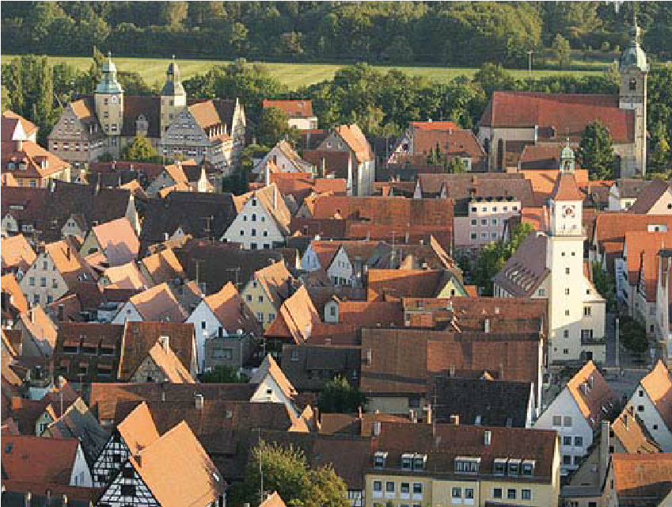
Slow Cities

Slide 4
What is the slow movement
Cittaslow was founded in Italy in October 1999, following a meeting organized by the mayor of Greve in Chianti, Tuscany.
A 54-point charter was developed, encouraging high quality local food and drink, general conviviality and the opposition to cultural standardization.
In 2001, 28 Italian towns were signed up to the pledge

Slide 5
The main aims of the movement are
making life better for everyone living in an urban environment so improving the quality of life in the cities
resisting the homogenization and globalization of towns around the globe (pop culture overtaking the historical culture of the place) so keep the local character (folk identity)
protecting the environment / avoid the problems of sprawl
Providing inspiration for a healthier lifestyle in part by returning to the pedestrian nature of cities

Slide 6
Slow pace / not fast pace

Slide 7
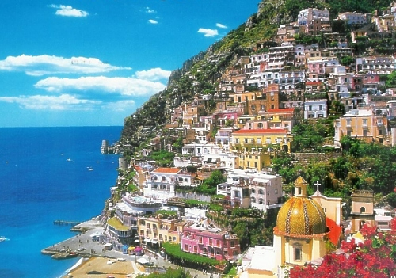
Emphasize local character and avoid negatives of globalization and pop culture
Food
Culture
Architecture
Public spaces and walkability
Applies better to smaller towns
Makes sense that it started in Europe

Slide 8
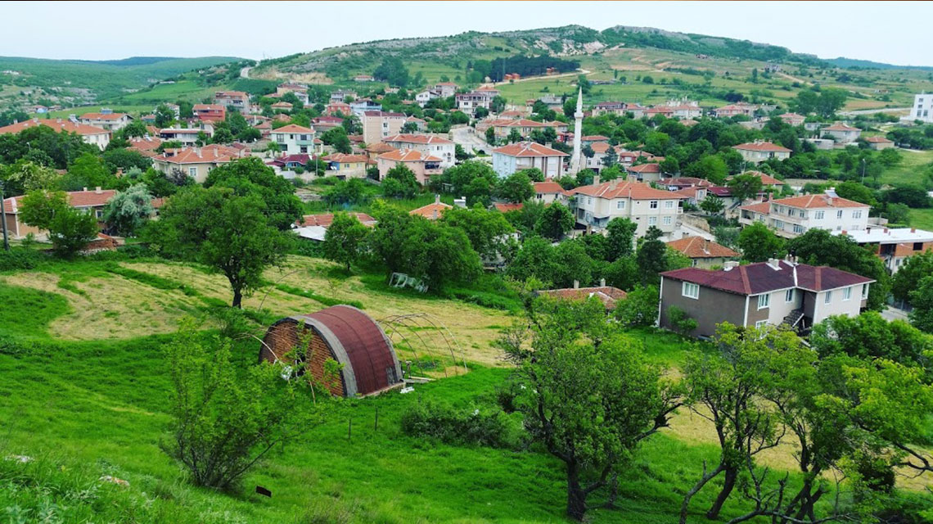
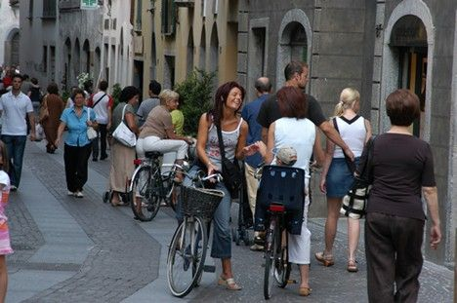
Slow pace – Environment and Health
Slow pace means keeping traditional walkways and public areas and not building over them with larger roads and highways (do not go to car-scale so quickly)
Keeping local foods and farms that sell to the local markets
This means avoiding the problems of sprawl and trying to control growth and keep local farms if possible (do not allow to spread quickly into green areas)

Slide 9
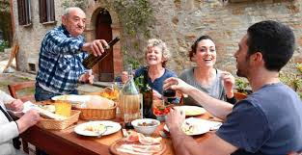
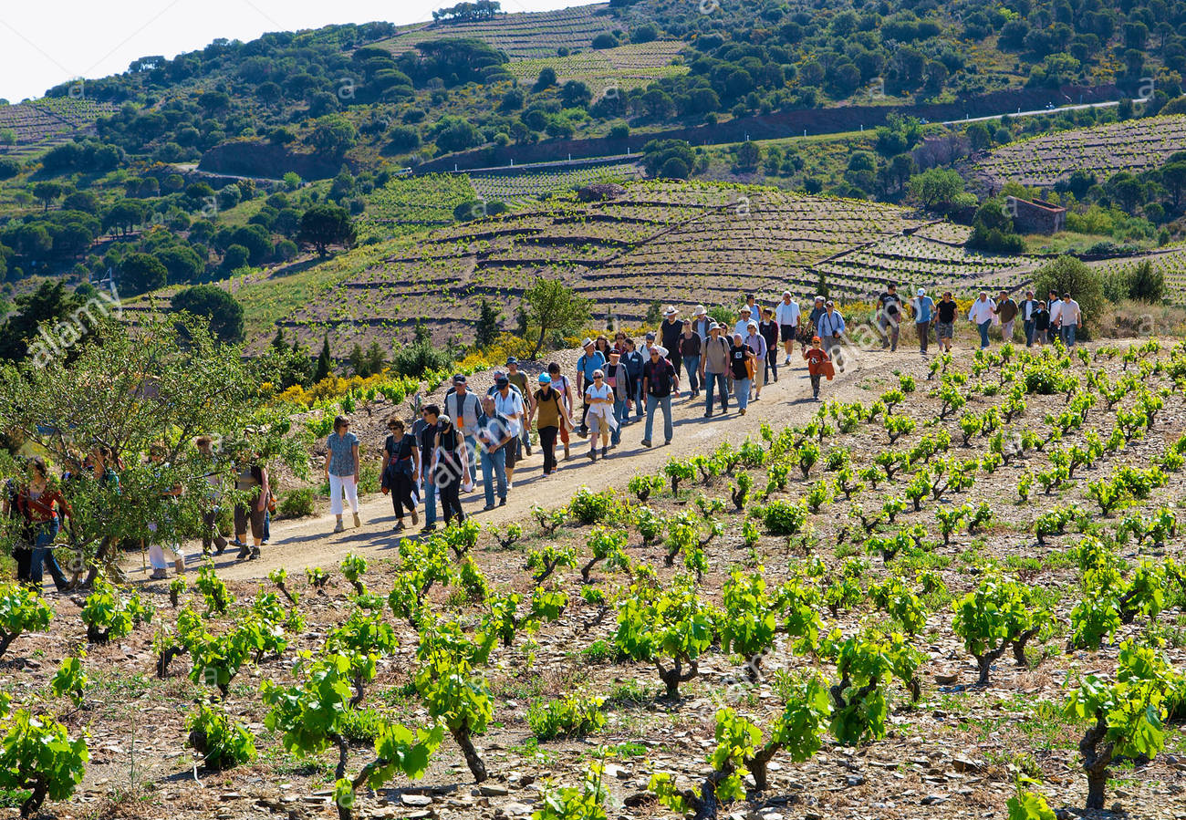
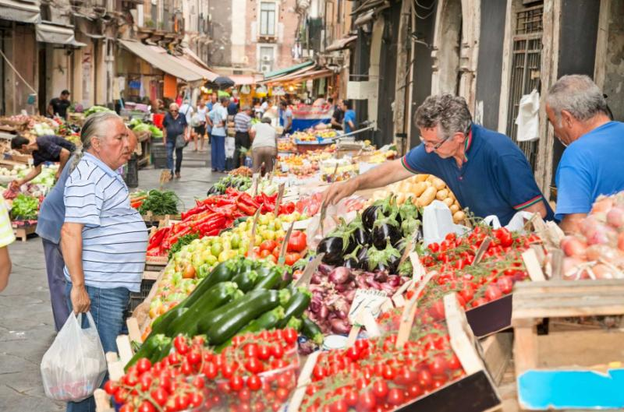
Slow food – maintaining the local character
food that is produced or prepared in accordance with local culinary traditions, typically using high-quality locally sourced ingredients. Reminds one of the local food movement

Slide 10
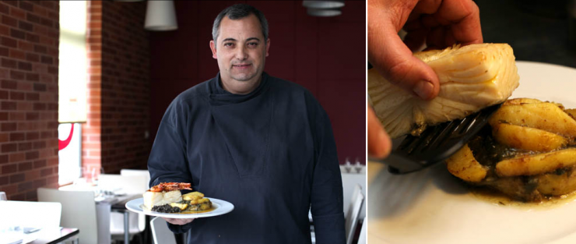
Local Character

Slide 11
European Cities – new topic
First, note that the slow city movement would definitely make sense for small, historical towns in Europe which is where it started
But could also apply to small town America w towns that have local main streets (worried about Wal Mart coming to town) or other areas of the world

