Slide 1
Unit 2a: Population

Slide 2
Critical Issues in Population Geography
more people alive today than any other time
world’s pop. incr. faster during the 2nd 1/2 of the 20th than ever before.
rate is slowing
peak NIR was in early 1960s ≈ 2.1%
now NIR ≈ 1.2%
More important: today virtually all pop. growth today occurs in LDCs
areas (low carrying capacity) least able to handle it
inhibits development (demographic trap)

Slide 3
World Population Growth
1st rise = Neolithic Rev.
“agricultural rev.”
“Guns, Germs and Steel”
reached 1b by early 1800s
European pop. Explodes 1st
Industrial Rev.
adv. in sanitation/medicine
fastest doubling time
1930 – 1975, Why?
Diffusion of med. adv. to LDCs
Mostly after WWII
7 billion + and counting
Growth is slowing
But still adding huge raw #s
Stage 3 but dem. momentum
Doubling time = 54 years
Doubling time = 45 years

Slide 4
Where Is the World’s Population Distributed?
Arithmetic density (total pop./total area)
“population density”
Physiological density (total pop./arable land)
High may mean resources are stretched
Must feed more people on less land
Difference between arithmetic and physiological?
Lots of land unsuitable for farming or unproductive

Slide 5
Where Is the World’s Population Distributed?
The ecumene
permanently settled area of world

Slide 6
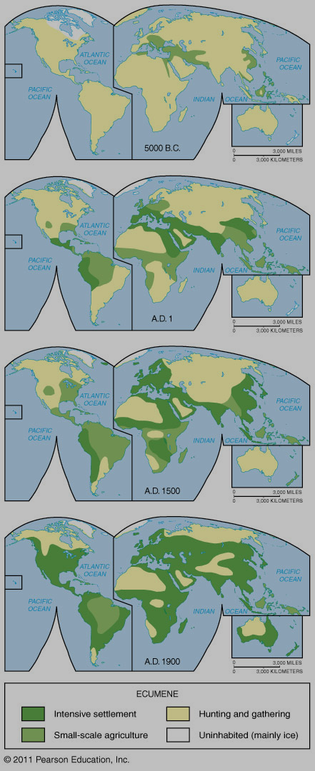
Growth of the ecumene over human history
could be viewed as “possibilism” as humans make previously hostile environments productive and attractive for human settlement.

Slide 8
Where Is the World’s Population Distributed?
Sparsely populated regions
People generally avoid:
Dry lands (example: Sahara desert)
Wet lands (Florida everglades, Amazon rainforest)
Cold lands (Antarctica, Greenland, etc.)
High lands (Himalayas)

Slide 10
Where Is the World’s Population Distributed?
Population concentrations
East Asia (Eastern China – Japan) = ¼ of world pop
Chinese Eastern Seaboard, along major rivers inland
South Asia (India – Pakistan – Bangladesh) = ¼
Ganges and Indus River Valleys, Coastal India
Europe (incl. European Russia)
highly urban
linked to industrial resources (coal, etc.)
Eastern North America (US and Canada)
Megalopolis (Boston to Washington DC)
Others
Sub-Saharan West Africa – Niger River, “The Sahel”
Sub-Saharan East Africa – “Great Rift Valley”
Southeast Asia (mainland and major islands)
the rim of South America

Slide 11
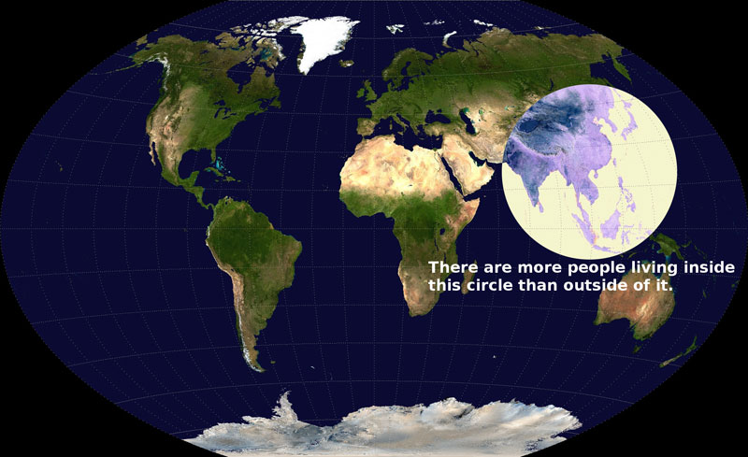

Slide 12
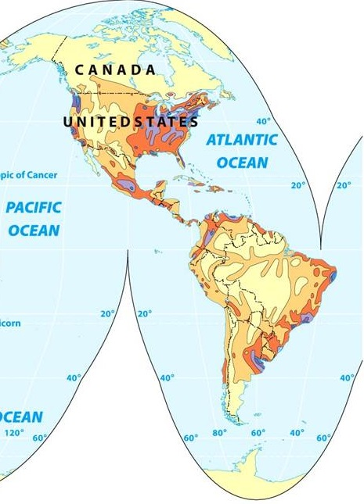
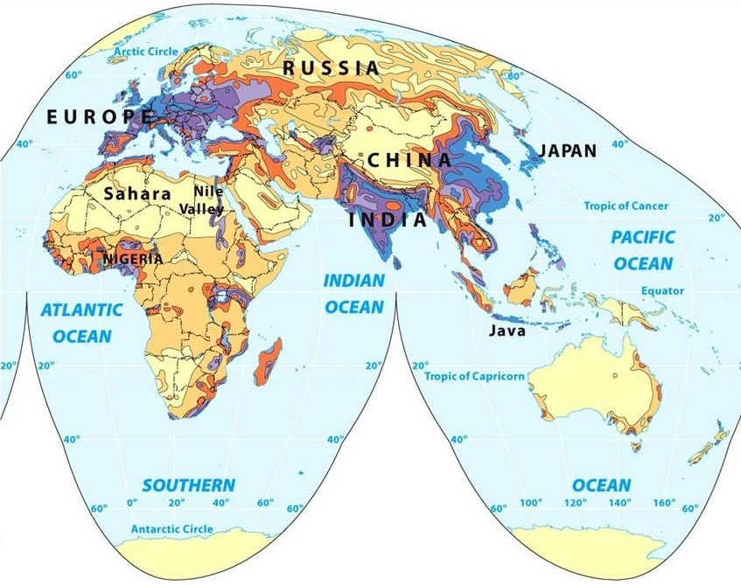
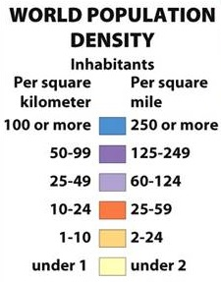
Population Distribution (compare to previous list)

Slide 13
Population Statistics
Crude birth rate (CBR)
# of births per 1,000 pop./yr
Crude death rate (CDR)
# of deaths per 1,000 pop./yr
Natural increase rate (NIR or RNI)
% by which a native population grows in a year
CBR – CDR (then convert to %, divide by ten, move decimal point to left one position)
Excludes migration
Doubling time
# of years needed to double a pop.
“rule of 70”
Takes into account that children born today will reproduce before population doubles = compounding like interest in a bank account

Slide 14
Population Statistics
Total fertility rate (TFR)
avg. # of children each women will have
predicts future (CBR assesses NOW)
2.1 = replacement rate
Infant mortality rate (IMR)
children who die under 1 yr old
per 1,000 live births
Life expectancy
Avg. # of yrs. a newborn will live

Slide 15
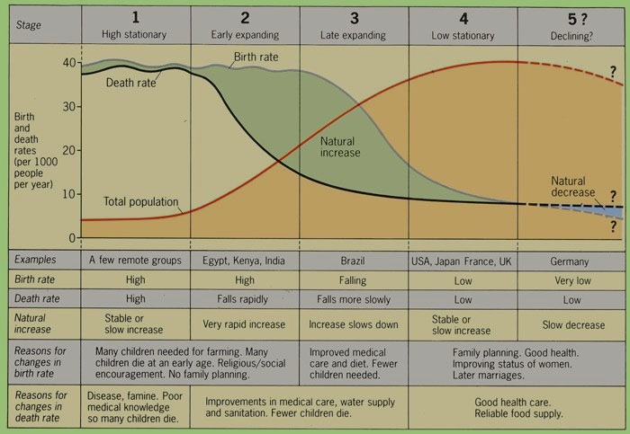
Demographic Transition

Slide 16
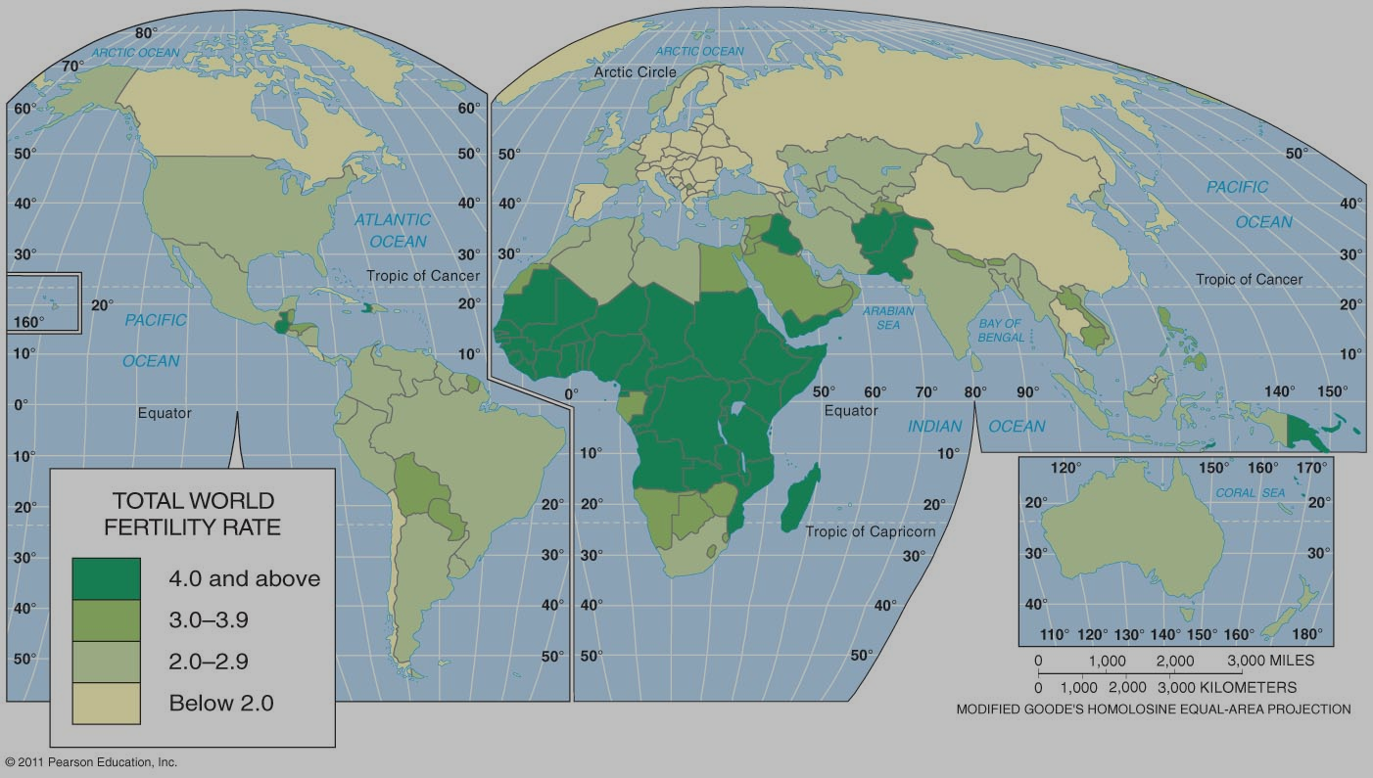
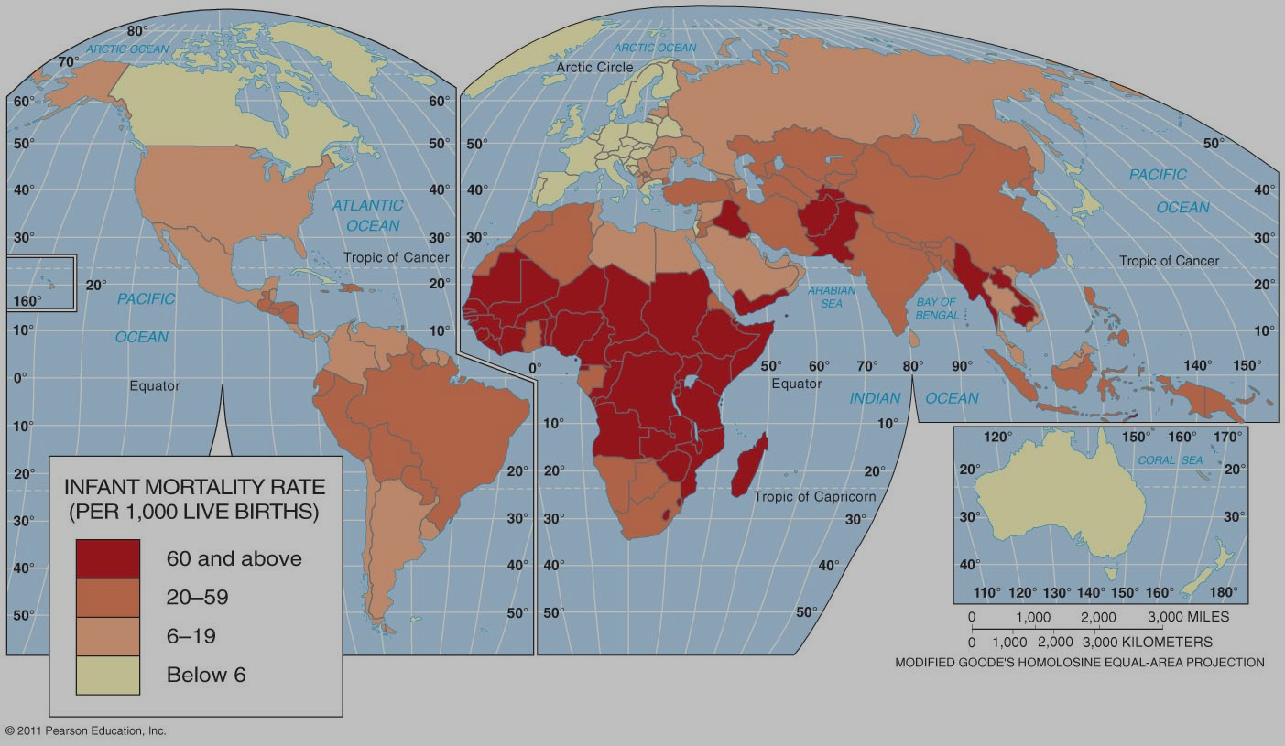
Notice that places with high TFRs tend to have high IMRs and that places with low TFRs have low IMRs.

Slide 17
Why Is Population Increasing at Different Rates? Demographic transition
Four (possibly 5) stages
Stage 1: High stationary
Agricultural (Neolithic) revolution (8000 BCE) to 1800
Hunting-gathering, early agricultural economy
traditional
High births/high deaths = low growth (NIR -0.1 – 1.9%)
Stage 2: Early Expansion
Industrial Revolution = MDCs 18th – 19th centuries
Diffusion of medical technology = LDCs (after WWII)
Late Agriculture, Industrializing, Developing economy
Declining CDR, high CBR = high growth
NIR (1.5 – 3.5%)

Slide 18
Why Is Population Increasing at Different Rates?
Stage 3: Late Expansion
CBR begins to decline
Growth continues but moderates
Demographic momentum (pop. still ↗ due to population bulge in young child-bearing age cohorts)
NIR (1.0 – 2.0%)
Industrial, maturing economy
Stage 4: Low stationary
CBR declines to approach/meet CDR (CBR = CDR)
Zero population growth (ZPG)
NIR (.0 – 1.0%)
Mature, tertiary economy
Stage 5: “Theoretical?” population decline
TFR < replacement rate of 2.1, NIR (< 0.0%, neg.)

Slide 19
Population Pyramids
A bar graph showing a place’s age and sex composition
Shape of the pyramid is determined mainly by the CBR
Age distribution
Dependency ratio
(# of people < 15 + # of people > 64)/ # of people 15 – 64
Sex distribution
Male and female side should be balanced
In elderly cohorts you can expect a somewhat larger number of females due to higher female life expectancy. Shouldn’t be too great however.
Sex ratio (comparing # of one gender to the other)
note anomalies (unbalanced by gender, missing populations)

Slide 20
Population Pyramids

Slide 21
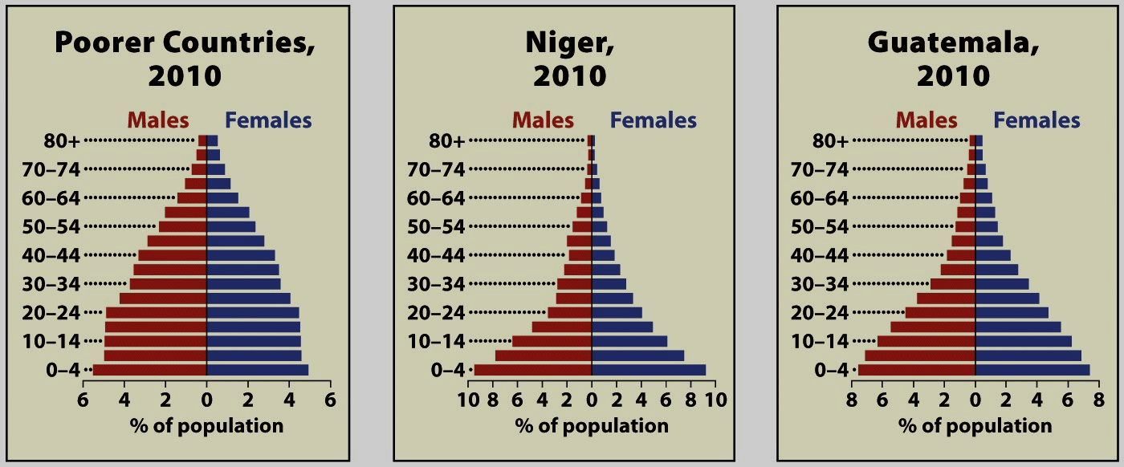
Population Pyramids for Poor Countries

Slide 22
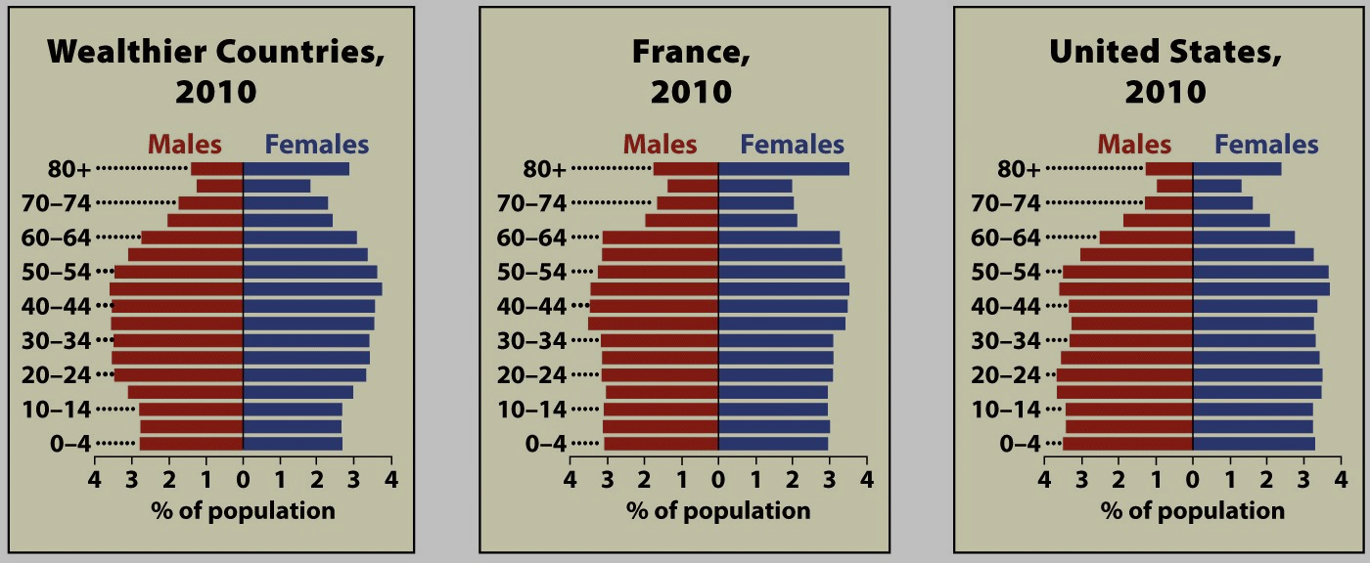
Population Pyramids for Wealthy Countries

Slide 23
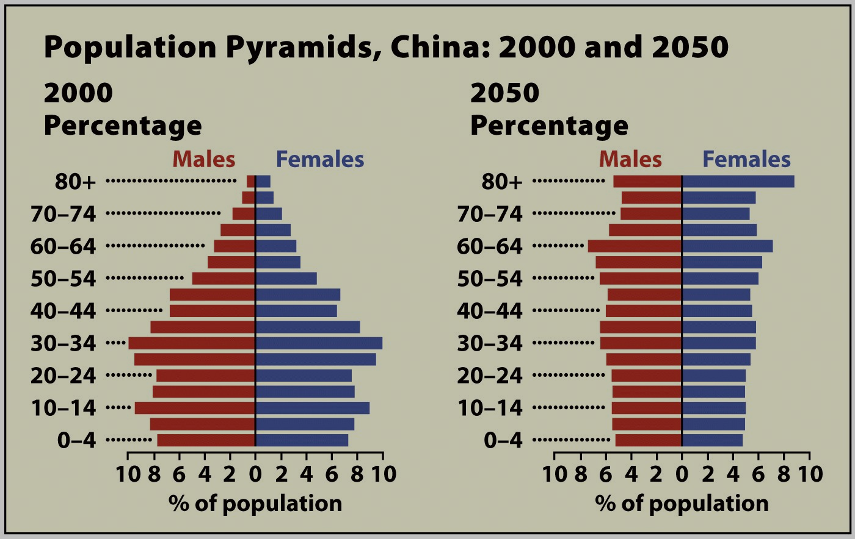

Slide 24
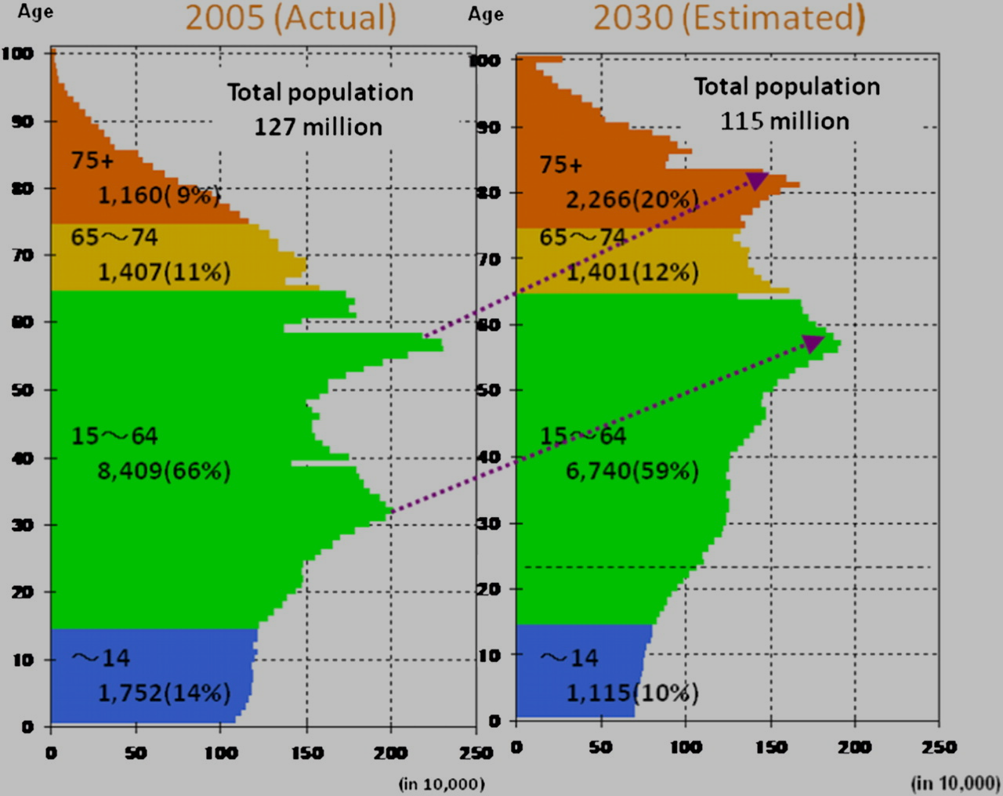

Slide 25
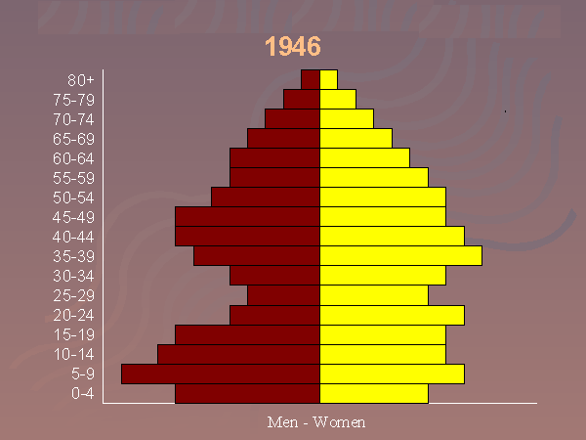

Slide 26
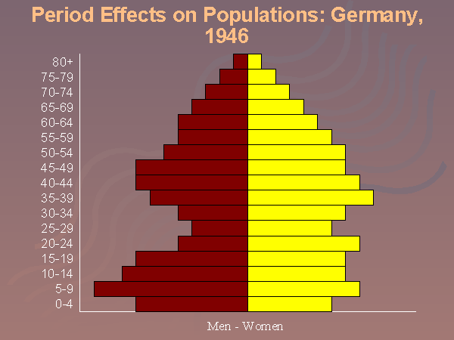

Slide 27
World health threats
The epidemiologic transition
Stage 1: Pestilence and famine
Pandemics
The Black Plague
Vectored diseases
Malaria
African sleeping sickness
West Nile Virus

Slide 28
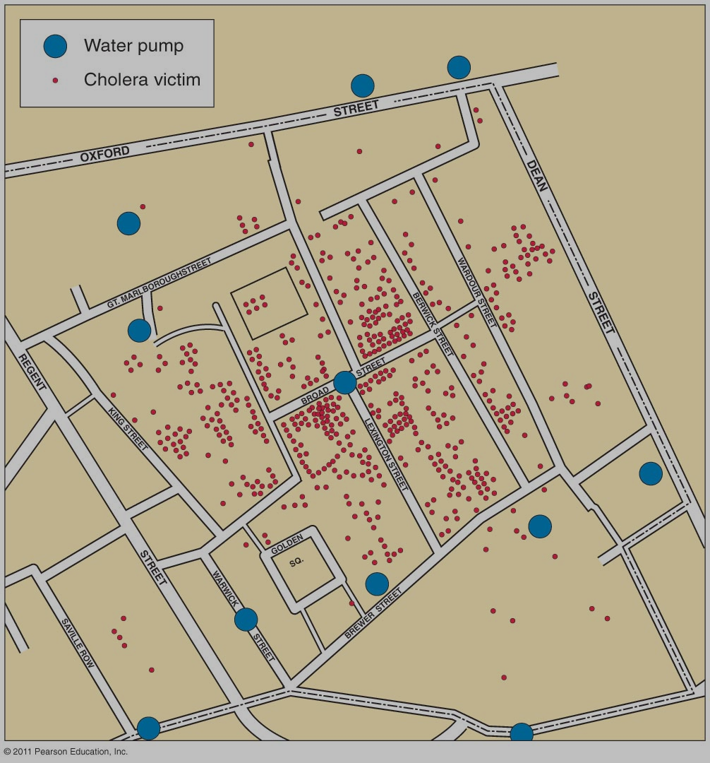
World health threats
The epidemiologic transition
Stage 2: Receding pandemics
Cholera and Dr. John Snow
Guinea Worm
But: declining CDR
Economic development in MDCs
Diff. of medical knowledge in LDCs
Figure 2-31

Slide 29
World health threats
The epidemiologic transition
Stage 3: Degenerative diseases
More people now middle-aged
Most significant: Heart disease and cancer
Stage 4: Delayed degenerative diseases
More people now elderly in population
Diseases related to lifestyle excess
Obesity, diabetes
Medical advances prolong life
Alzheimer’s

Slide 30
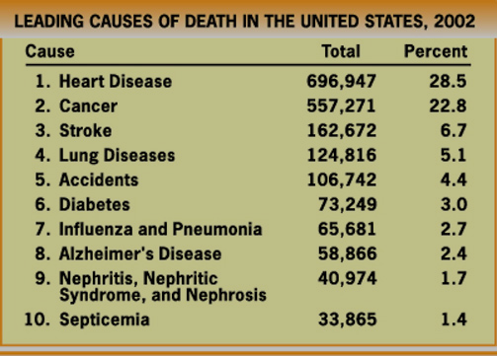
Longer Life Expectancies typically mean higher rates of chronic diseases.

Slide 31
World health threats
The epidemiologic transition
Not specifically linked to stage 5 demographics
Possible future health threat
Reemergence of infectious diseases?
Three reasons why it might be happening:
Evolution/mutation
Discuss HIV
Poverty (demographic trap in LDCs)
Globalization
Improved travel
Bird flu, swine flu, Contagion

Slide 32
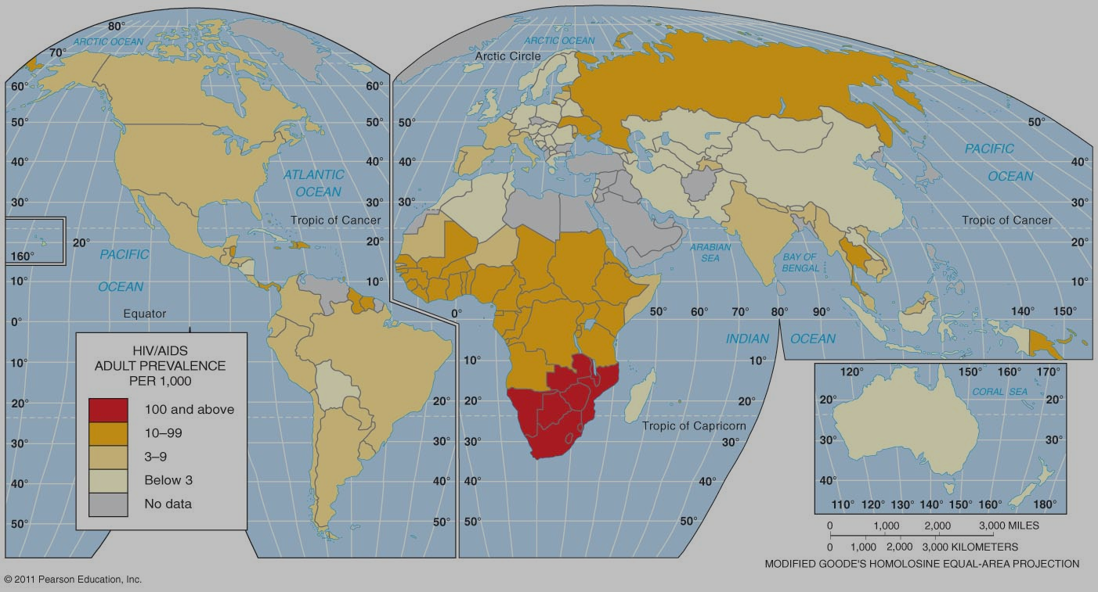
The Most Lethal Infectious Disease: AIDS
Figure 2-33

Slide 33
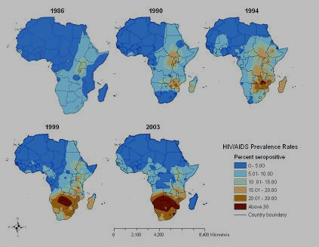

Slide 34
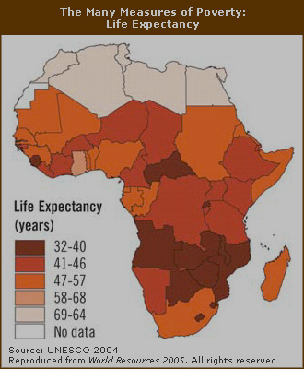
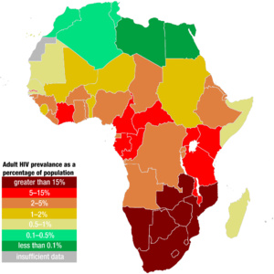

Slide 35
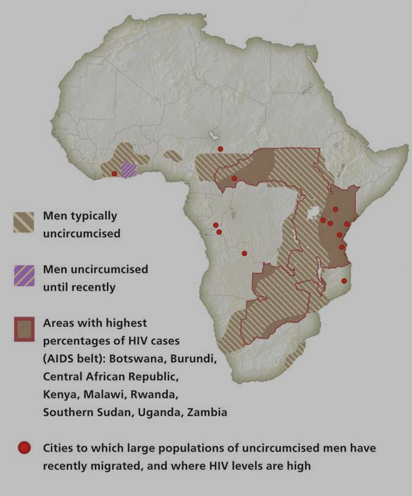
HIV/AIDS in Africa
Southern Africa, Why?
Cultural influences:
male infidelity
male sexual dominance
Polygamy
lack of circumcision
Economic
legacy of colonial and apartheid economies
prostitution
denialism
Mbeki

Slide 36
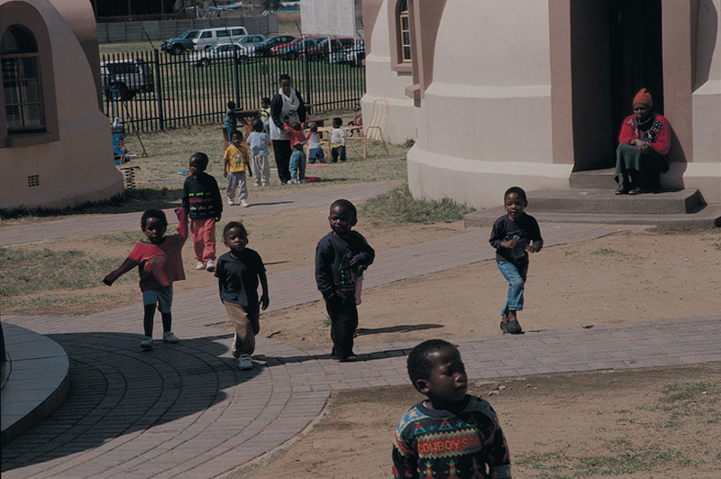
AIDS is leaving large numbers of AIDS orphans.

Slide 37
HIV/AIDS prevention
A = abstinence
B = be faithful
C = condoms
Drug treatment
Anti-retroviral drugs
George W. Bush
PEPFAR
$15 billion
Save 10 million lives?
Education
Uganda
1990s = 14%
2003 = 4.1%
Kenya
1997 = 13.6%
2002 = 9.4%

Slide 38
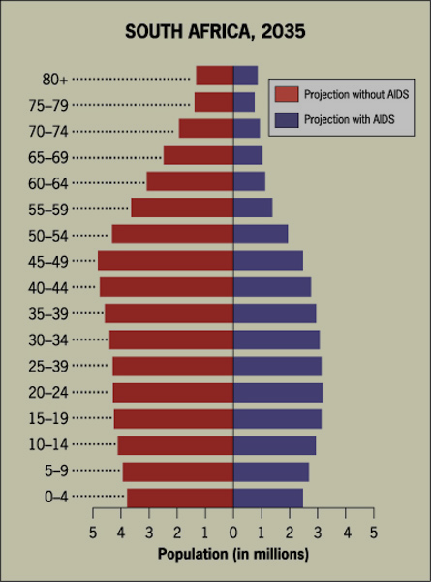
Affect of AIDS on population pyramid for South Africa.
Predicted population for 2035, without and with AIDS.

Slide 39
Dependency Ratios

Slide 40
Why Might Overpopulation be a Concern?
Malthus on overpopulation
Overpopulation = too many people for available resources
An Essay on the Principle of Population (1798):
Population grows geometrically
food supply grows arithmetically
Upper classes must lower CBRs thru moral restraint
or risk war, disease, famine
increase CDRs

Slide 41
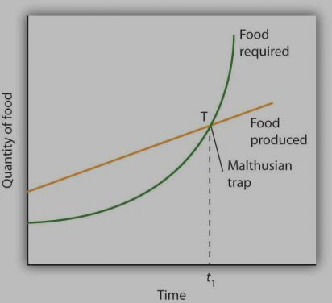

Slide 42
Criticism of Malthus
Resources
Too pessimistic on resource growth
Failure to consider technological innovation
Green Revolution greatly increased food production
Marxist critique
Not pop. growth but unequal dist. of resources
Malthus did blame overpopulation on the poor!!!
Population
Large population = economic growth
Esther Boserup, Simon Kuznets, Julian Simon
More babies – more workers, more innovation!
Population growth has moderated (stage three)

Slide 43
Neo-Malthusians
Frightened by NIR during second ½ of 20th century
Growth in LDCs (stuck in demographic trap)
Also….competition will be for other resources not just food
Search for clean air, fuel, water could lead to violence

Slide 44
Demographic trap
Population growth ⇒ lack of investment, overspending on social services ⇒ low living standards ⇒ no economic development/primary jobs ⇒ reinforces high fertility ⇒ population growth!
∴ country is unable to advance to stage 3 of declining birth rates.

Slide 45
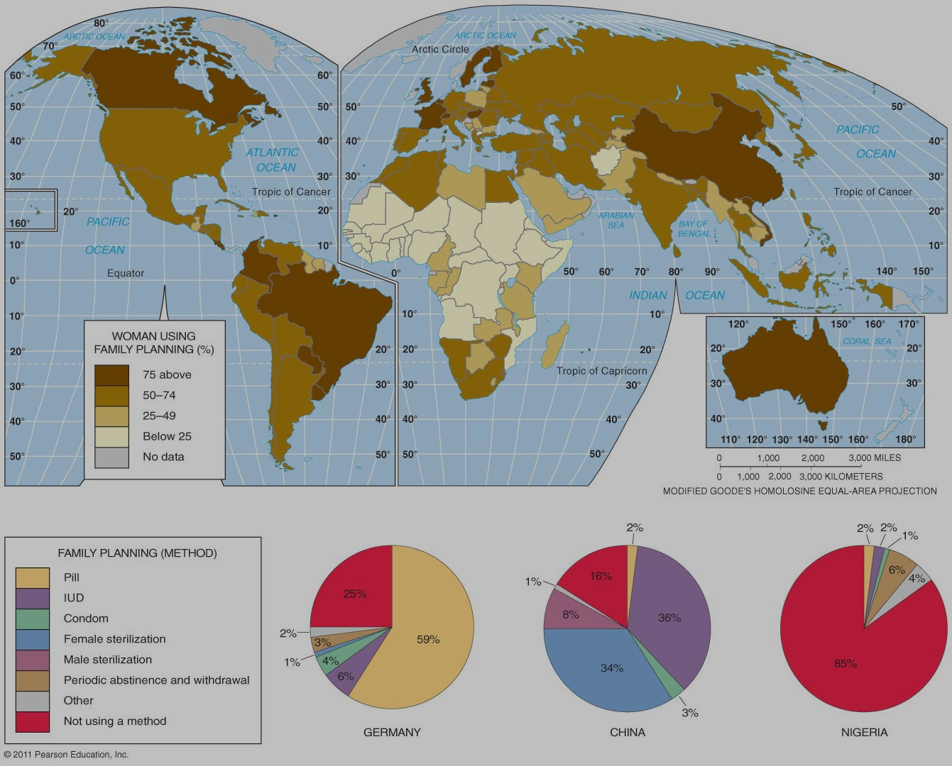
Family Planning

Slide 46
India (example of govt pop. policy)
1960s: population planning program
1970s: country began forced sterilization program for men with 3 or more children.
22.5 million men were sterilized.
2004: state of Uttar Pradesh began guns for sterilization program (attempt to incentivize policy).
Today, most states use advertising and persuasion to lower birth rates.
Must know example:
China’s One-child policy (1978 – 2015)
“Expansionary” or “pro-natalist”

Slide 47
“Restrictive” or “anti-natalist” policy
China’s One Child Policy (1978 – 2015)
“must know” example
Why has China loosened policy to allow 2 children per family?
Aging population, needs young workers to continue economic growth
Doesn’t want to slip into stage 5.
Cultural reasons = sex ratio, not enough female babies for males
Anti-natalist policies are not the same as:
Eugenics = targeted population control
Like selective breeding it is intended to “improve” population by weeding out “undesirables”
targets are usually minorities or the disabled
US, Nazi Germany, India

Slide 48
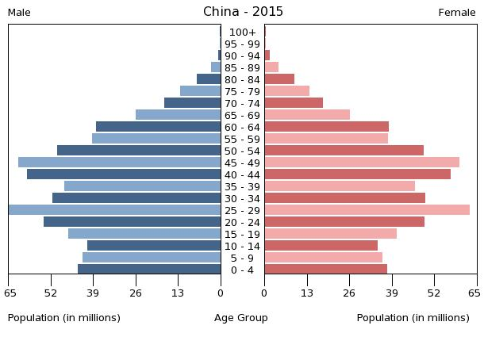
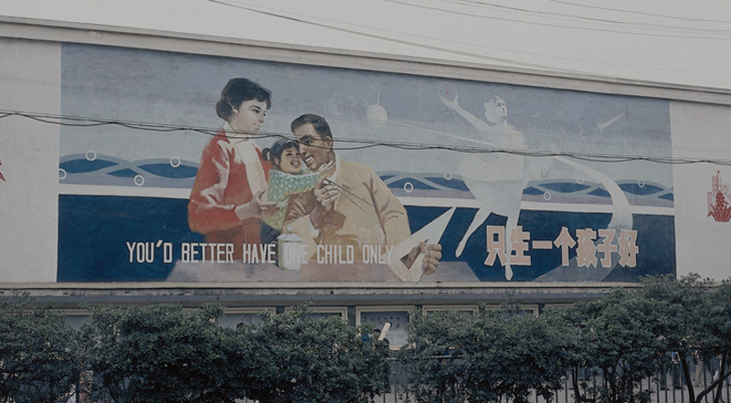

Slide 49
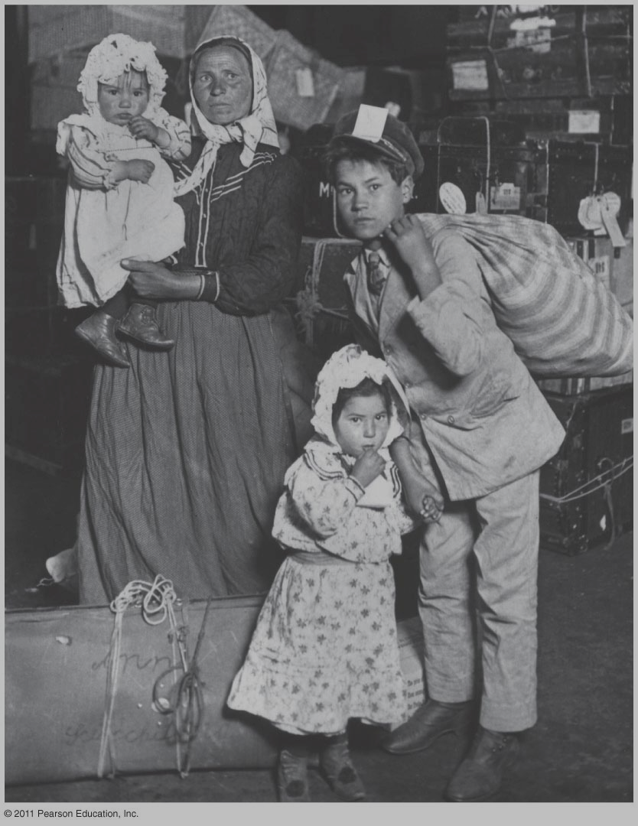
The End.
Figure 3-1
Up next: Migration

