Slide 1
Political Geography

Slide 2
Geopolitical Theory

Slide 3
Do Geopolitics Help Us Understand the World?
Geopolitics: The interplay among geography, power, politics, and international relations
Economic focus
Immanuel Wallerstein’s World-Systems Theory

Slide 4
How does Geopolitics Help Us Understand the World?
Geopolitics: The interplay among geography, power, politics, and international relations
Economic focus
Immanuel Wallerstein’s World-Systems Theory
Classical geopolitics
German School
Ratzel’s organic state theory
British /American School
Mahan’s Sea Power theory
Mackinder’s heartland theory
Spykman’s Rimland Theory

Slide 5
Ratzel’s Organic State Theory (1897)
Based on Darwin’s theory of evolution
state as a “living organism”
engaged in a “survival of the fittest”
What does this organism need to survive?
state must control territory to survive!
Described expansion of empires and large states in the 19th century
Ratzel was observing the US as a prime example
Territory gives states an advantage
Eventually contributed to Nazi expansionist goals
“Lebensraum” = “living space” for the German people carved from Slavic lands to the East.

Slide 6
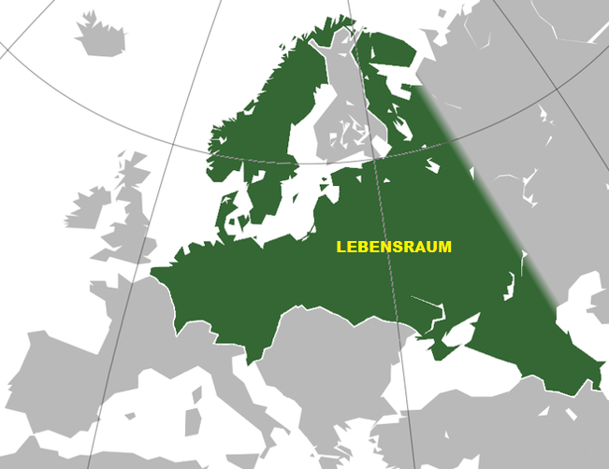

Slide 7
Mahan’s Sea Power Theory (1890)
Mahan was American
but studied British dominance during the 17th thru 18th centuries
Conclusion was that sea power was needed to connect home country to colonies and/or global trade/resources
Strong navy as important as the control of land for success of state
Therefore, it is important to control chokepoints
Strategic narrow passages that restrict access OR allow a small force to offset a numerical disadvantage
Canals, straits, valleys, mountain passes, etc.
Suez Canal, Gibraltar, Strait of Malacca/Singapore (UK)
Panama Canal (US)

Slide 8
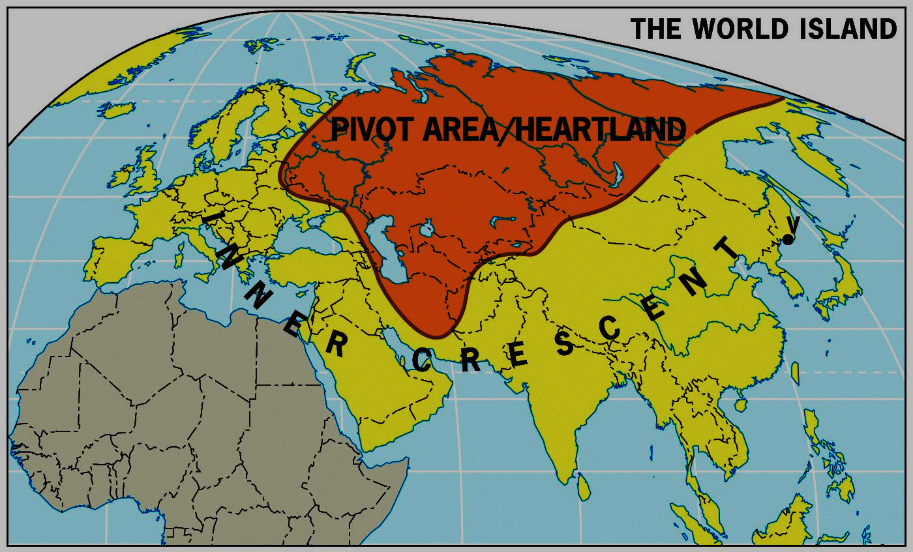
Mackinder’s Heartland Theory (1904)
Who rules East Europe commands the Heartland
Who rules the Heartland commands the World Island
Who rules the World Island (Eurasia) commands the World
Obsolete? Evidence?
Some would argue the failure of the USSR to achieve global dominance disproves MacKinder’s theory.
Putin would counter “It ain’t over until the Ukrainian woman sings”

Slide 9
Spykman’s Rimland Theory (1944)
derivative of Mahan’s sea power theory
opposes Mackinder to make coastal Eurasia dominant
What global strategy does this theory support
CONTAINMENT
Results in a “shatterbelt” encircling the communist world

Slide 10
Shatterbelt
a REGION of instability due to larger opposing political/cultural values.
The Rimland was a shatterbelt during Cold War
communism vs. capitalism (ideological struggle that spanned state borders), created multiple areas of conflict
Eastern Europe (Berlin, Iron Curtain)
Greece and Turkey (Truman Doctrine)
Chinese Civil War (China/Taiwan)
Korean War
Vietnam War
the Middle East (US-backed Israel vs. Soviet-backed Arabs)
Where are there shatterbelts today?
West Africa/Sahel (Islam vs. Christian/Animist)
The Middle East (Sunni vs. Shiite)

Slide 11
Non-state Geopolitics
Terrorism
Systematic use of violence to intimidate a population or to coerce a government
Use of bombing, kidnapping, hijacking, and murder to instill fear and anxiety in a population
better fits definition when civilians are the targets.

Slide 12
Terrorism
Arab-Israeli conflict (many terrorist events groups are connected to this conflict)
PLO (Palestinian Liberation Organization) disavows terrorism in early 1990s
American (domestic) terrorists
Timothy McVeigh (April 19, 1995 in Oklahoma City)
“federal government is tyrannical”
FBI attacks at Ruby Ridge, Waco Branch Dravidian cult
September 11, 2001, attacks
Al-Qaeda
Osama bin Laden (Saudi harbored in Afghanistan)
Anti-Westernization, influence in Islamic world
fundamentalist and extremist
believed they are engaged in jihad = holy war

Slide 13
State support for terrorism
Three increasing levels of involvement
Providing sanctuary
Afghanistan (under Taliban) gave home base for Osama bin Laden
failed states can’t police activity within their borders
Pakistan
anti-India terrorists
harboring Osama bin Laden, Taliban insurgents
Supplying weapons, $, and intelligence to terrorists
Iran
Hezbollah (Lebanon), Hamas (Gaza) = anti-Israel
North Korea
Could supply nuclear know-how
Others listed (Syria, Cuba)
But wait……what about
Saudi Arabia = huge source of funding for Sunni groups
Use terrorists as proxies to carry out attacks
avoids retribution/revenge
terrorists have no geography or “state” to take revenge on, plausible deniability

