Slide 1
Political Geography

Slide 2
State Interaction

Slide 3
State Interaction
Political, military and econ. cooperation
The United Nations (est. 1945)
Promote int’l cooperation (peacekeeping, humanitarian efforts, economic development, environmental protection and human rights)
UNESCO, WHO (World Health Organization), UNCLOS (Law of the Seas)
Security Council members get vetoes (US, UK, Russia, China, France)

Slide 4
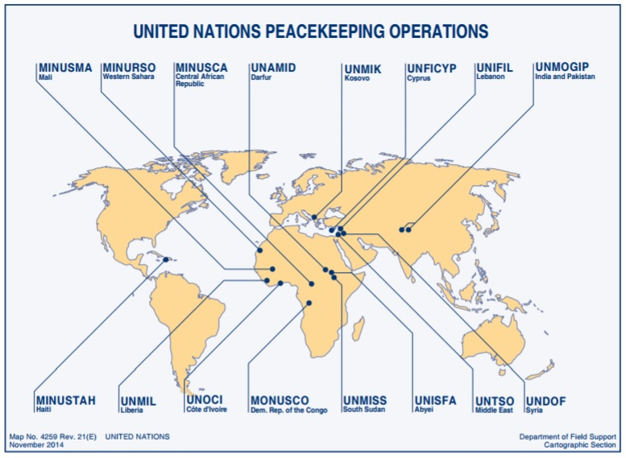

Slide 5
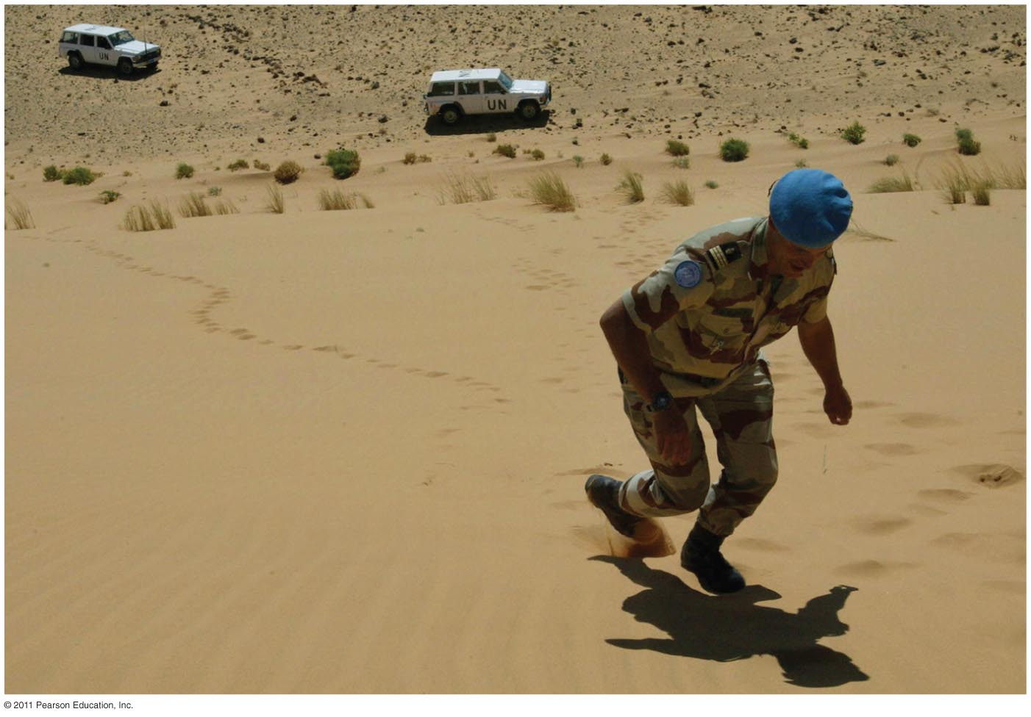
United Nations Peacekeepers

Slide 6
State Interaction
Political, military and econ. cooperation
The United Nations (est. 1945)
Promote int’l cooperation (peacekeeping, humanitarian efforts, economic development, environmental protection and human rights)
Regional military alliances maintain balance of power
Post–World War II: NATO (US) or the Warsaw Pact (USSR)

Slide 7
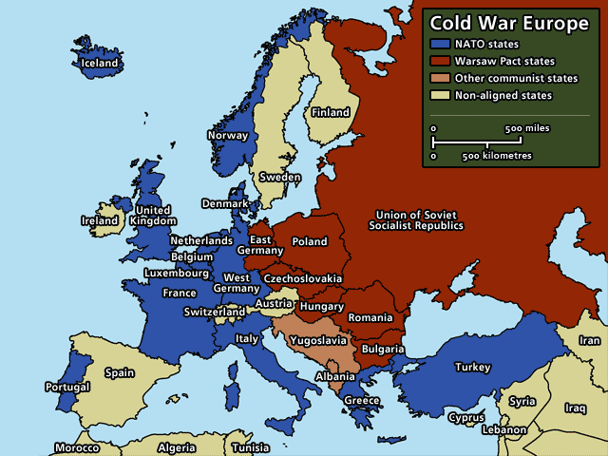

Slide 8
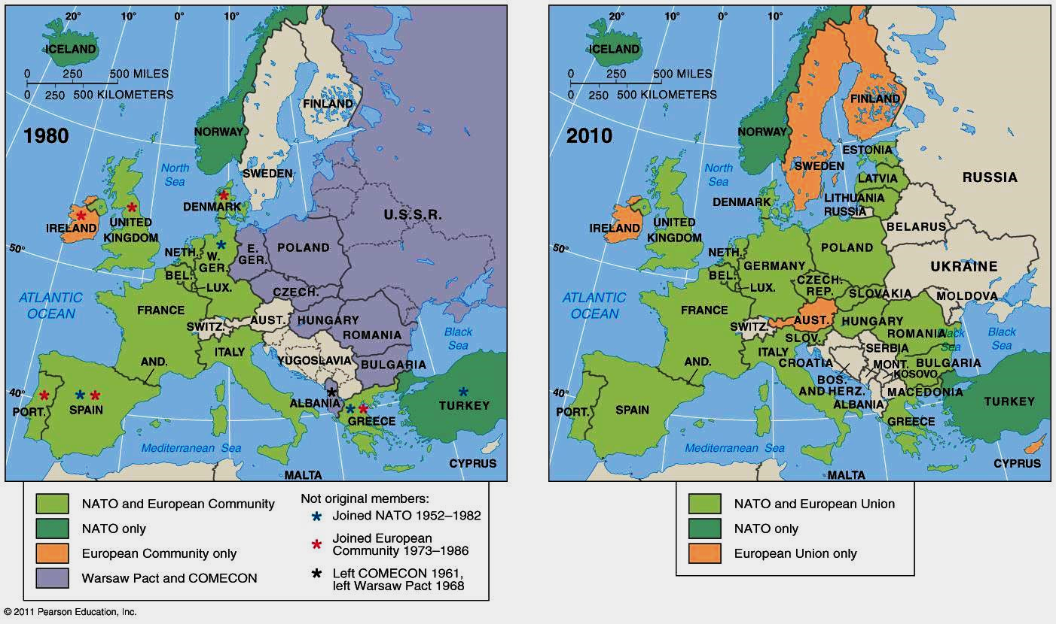
Expansion of NATO

Slide 9
State Interaction
Political, military and econ. cooperation
The United Nations (est. 1945)
Promote int’l cooperation (peacekeeping, humanitarian efforts, economic development, environmental protection and human rights)
Regional military alliances maintain balance of power
Post–World War II: NATO (US) or the Warsaw Pact (USSR)

Slide 10
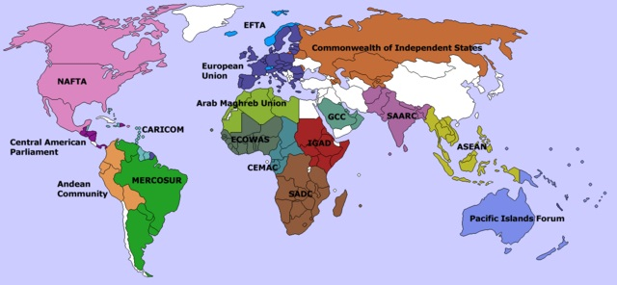
Other examples of state interaction

Slide 11
State Interaction
Political, military and econ. cooperation
The United Nations (est. 1945)
Promote int’l cooperation (peacekeeping, humanitarian efforts, economic development, environmental protection and human rights)
Regional military alliances maintain balance of power
Post–World War II: NATO (US) or the Warsaw Pact (USSR)
Supranational organizations (listed in CED)
A venture involving 3 or more nation-states involving formal political, economic, and/or cultural cooperation to promote shared objectives.
NATO, Warsaw Pact, UN, EU,
African Union (promote African unity),
ASEAN (Assoc. of SE Asian Nations promotes intergovt cooperation and facilitates econ., political, security, military, educ. and sociocultural integration between its members and other countries in Asia.),
Arctic Council (promoting co-op and coordination among the Arctic states (US, Canada, Russia, Norway, Denmark, Finland, Iceland, Sweden and involvement of indigenous communities)
Strictest definition requires the sacrifice of some sovereignty
Who is a better example of a supranational org. the UN or EU?
EU!!!! Because they sacrifice sovereignty.

Slide 12
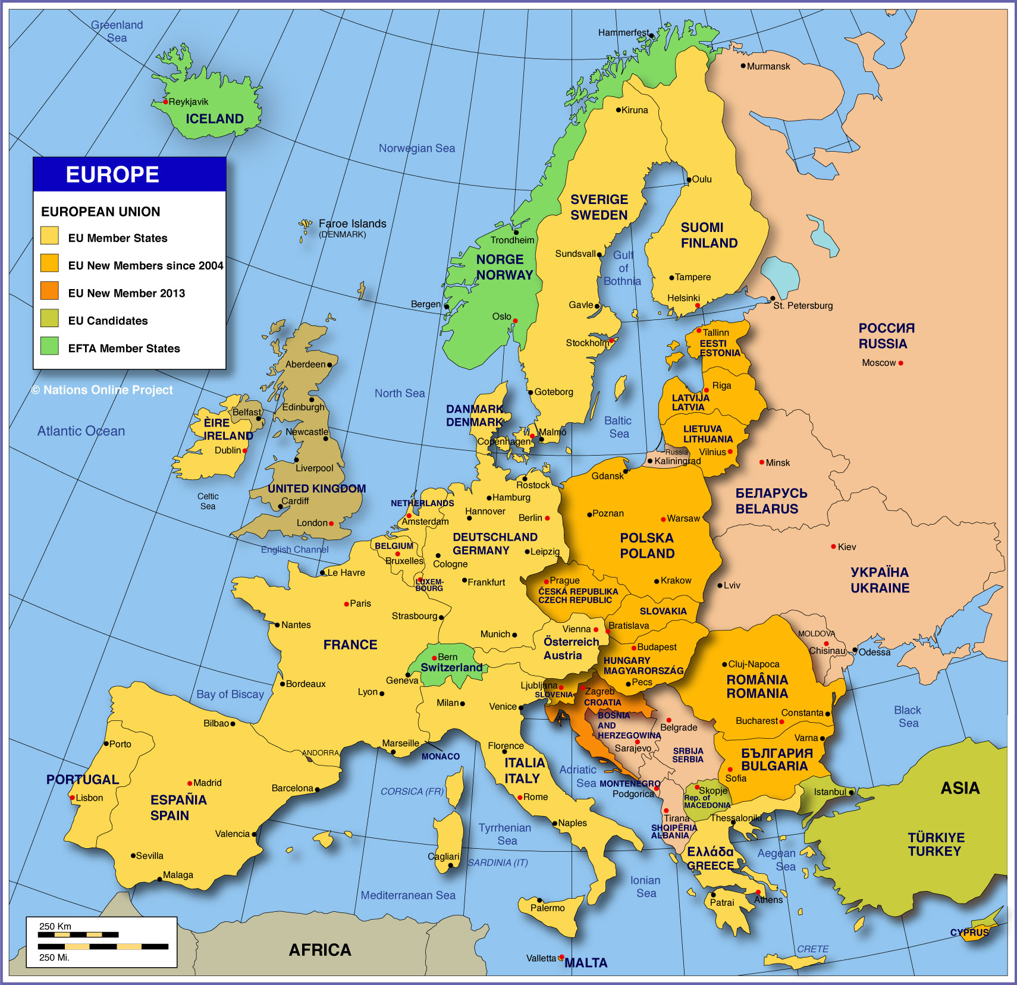

Slide 13
Policies & Problems
Single Market
Free trade = no tariffs (open borders)
Common currency (Euro)
Pro: Huge market = 450 mil. people = $15 t (3rd behind US & China)
Single market/currency leads to greater economic growth
Con: Interdependence without direct control over country policy
Sovereign debt crisis = high state debt
PIIGS (Portugal, Ireland, Italy, Greece, Spain)
Individual state economic decisions (pensions, etc.) threaten the economic health of all
Freedom of movement (open borders)
Freedom to live or work anywhere in EU.
migration from poor East/South → rich West/North
Non-European migrants have access to entire continent
creates nativism in some host countries
Common agricultural, environmental, humanitarian policies
Often applies new regulations/policies that are resented in individual countries
See as a loss of sovereignty, self-determination, favoritism for other countries
“Brussels” (capital of EU) becomes the boogeyman
Must meet requirements (stability, democracy, rule of law, etc.)
No unified foreign policy
no combined military (but most are NATO members)
© Corbis

Slide 14
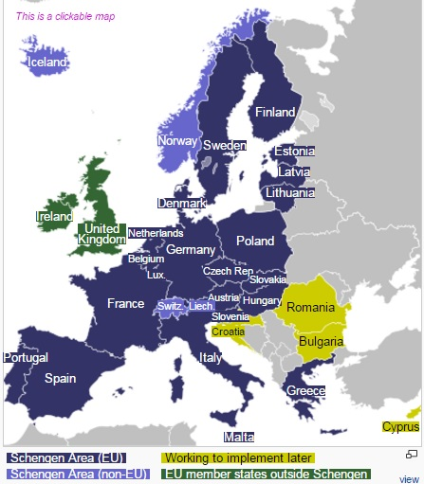

Slide 15
Is the EU a centrifugal or centripetal force for member states?

Slide 16
EU effect on STATE cohesion
Centripetal
Centrifugal
Rise in nationalist sentiment (anti-EU) may strengthen loyalty to individual states
Policy disagreements at supranational level leads to calls for return of sovereignty
France for the French!
Marine Le Pen
Nativism
Hungary (Orban/populism)
Brexit
EU umbrella allows for regional autonomy which weakens individual states
Wealthy local regions no longer rely on individual state
Why are we loyal to this state if we have to pay all these taxes?
Catalonia (Spain)
Padania (Italy)
Multinational states threatened by regional nationalism
Attitude is “We can be independent AND still part of EU”
UK
Scotland threatens to secede in reaction to Brexit
Belgium (Flemish/Walloons)

Slide 17
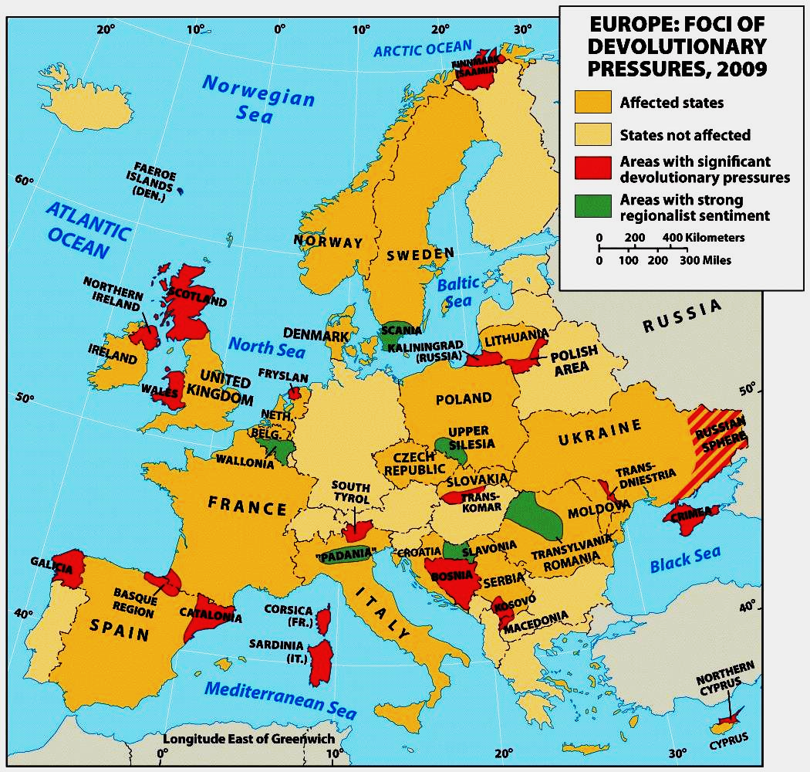
Devolution in Europe

