Slide 1
Political Geography

Slide 2
Internal Politics

Slide 3
Internal Structure of States
Unitary
central govt. dictates all policy from capital
All decision making is made by central govt.
Local, regional, sub-state govts only carry out decisions made by central govt.
example: France
has “departments” but they only implement decisions made in Paris
Recently France has devolved some power to regions (trend)
dictatorships, communist governments are examples but unitary systems, unitary governments can be democratic too!
positives
less bureaucracy, lower cost of govt, lower chance of corruption (?)
standardized, equal treatment across country
promotes patriotism, unified national identity (centripetal)
negatives
local needs/services not provided, slow response time
centrifugal
disconnected from minority or regional groups
decision-making dominated by national elite or dominant group
causes resentment and desire for local autonomy in regions who feel neglected

Slide 4
Unitary System

Slide 5
Internal Structure of States
Federal
Power shared by central and regional govts.
Example: U.S.
Centripetal
large countries can more effectively provide services by sharing power with local/regional governments
People feel better served by local government
diverse or large countries can satisfy desire for ethnic or regional autonomy through federalism
Centrifugal
can lead to separatist movements, regionalism
Since regions make their own decisions, they may think they can make ALL of their own decisions.
constant source of political conflict within the U.S.
Slavery, Civil War, “States Rights”, Jim Crow Laws all result from our federal system.
Globally, there is a trend toward federations

Slide 6
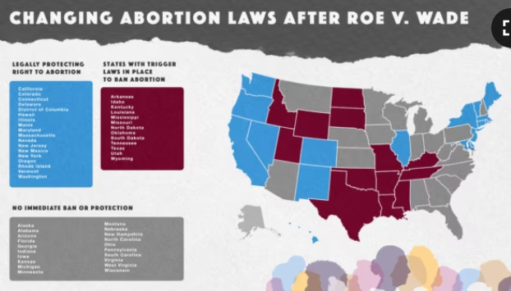
Differences in state abortion laws: reflects federalism in action

Slide 7
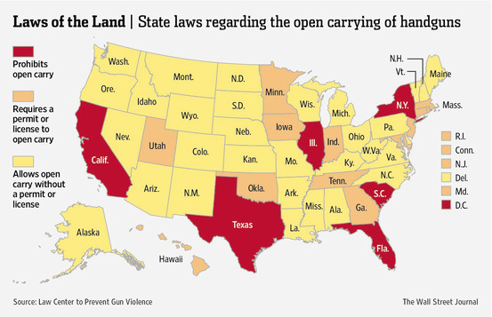
Open-carry Laws

Slide 8
Federal System
Power is shared between the central and regional governments

Slide 9
“Devolution”
weakening of central power, shift in power away from the central government to regional governments
UK allows Wales, Scotland and N. Ireland parliaments so that they have more autonomy → goal = hopefully less outright separatism
Canada → Nunavut (Inuit/First People) given autonomy to appease separatism and retain access to resources
Yugoslavia, USSR devolved power to regions/ethnicities this snowballed into break up of their states and the creation of new states
result = balkanization
devolution ≠ federalism
devolution = movement of power
Unitary → federalism = devolution
Federalism by itself is a power-sharing structure and doesn’t reflect devolution unless there is movement
For example:
Welfare block grants (Fed. govt allows states to make rules for who receives welfare in the 1980s) = devolution
gay marriage = Supreme Court decision was anti-devolutionary
Central government taking power away from regional governments

Slide 10
Devolution ≠ Federal System
With devolution decision- making power is actually shifted form the central to regional governments

Slide 11
Gerrymandering
KNOW STEPS IN ORDER
every 10 years = census
seats in Congress are
“reapportioned” , therefore…
new maps need to be drawn =
Redistricting
“gerrymandering” is the manipulation of redistricting
Two main types
1) Wasted or “cracking”
Spreading opponents strength across several districts in order to weaken
2) Excess or “packing”
Concentrating opponents strength in one district to lessen effect on others
3) “Stacking” (form of packing)
Create majority-minority district

Slide 12
Gerrymandering: wasted vote or “cracking”
An example of the "cracking“ form of gerrymandering.
The urban (and mostly liberal) Columbus, OH, located in Franklin County, is split into thirds, each segment then attached to — and outnumbered by — largely conservative suburbs and rural areas

Slide 13
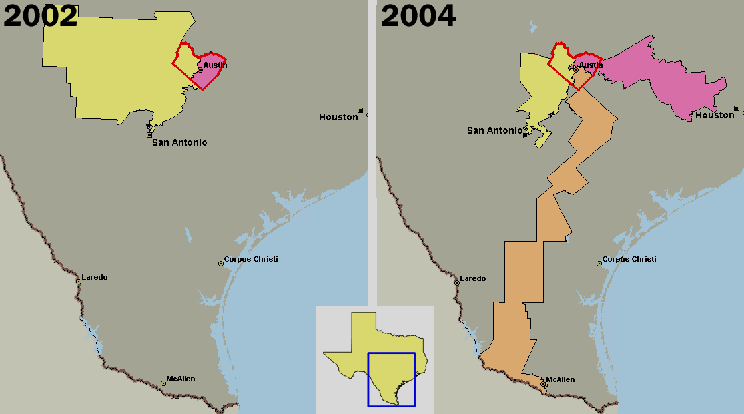
“Cracking” Austin
By dividing the liberal (pink in 2002) district in Austin in two and attaching each half to conservative rural areas, by 2004, the conservative Texas legislature was able to eliminate an opposition (liberal) representative.

Slide 14
Excess vote or “packing”
By “packing” one district with your opponent, you can guarantee wins in the other three
Scenarios above all have the same (evenly split) populations, but through gerrymandering (packing) one side can guarantee a 3 to 1 majority.
Note that by controlling redistricting and employing gerrymandering, either the pink or the green can accomplish this

Slide 15
Gerrymandering: “stacked” vote (form of “packing”, goal is to guarantee minority representation

Slide 16
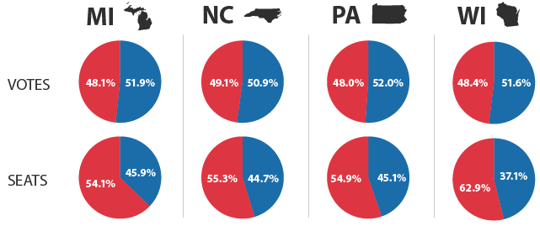
Gerrymandering Effects
What effect has gerrymandering had?
Elections results don’t represent will of people.
The party that wins the most votes doesn’t get the most seats!

Slide 17
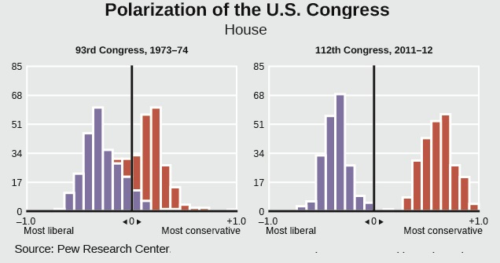
Gerrymandering Effects
What effect has gerrymandering had?
Polarization of Congress
Candidates only speak to their ideological “base” to win elections.
Ignore concerns of the opposition and moderates

