Slide 1
Political Geography

Slide 2
Boundaries (Types)
Types:
Physical
Natural geography like rivers, lakes, oceans, mountains or deserts
Cultural
Human features (language, religions, other)
“isogloss”
Geometric
Survey lines usually along lines of latitude and longitude
Borders extend in a plane above and below the Earth

Slide 3
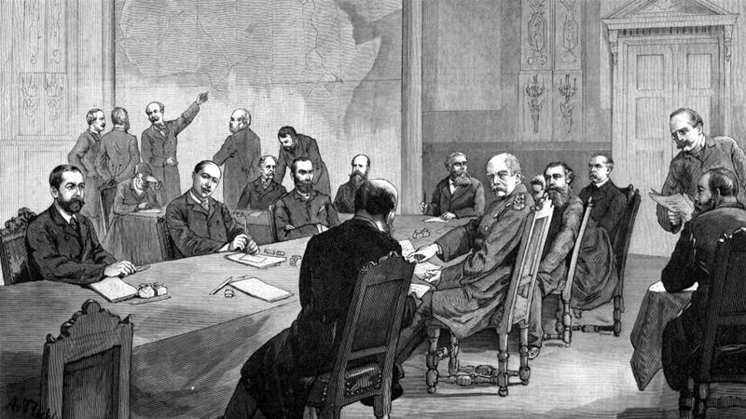
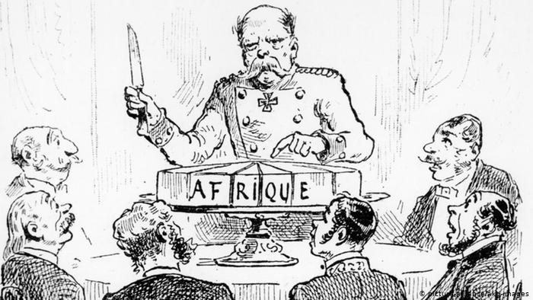
Boundary Formation Processes
define:
negotiate a treaty to establish a border
delimit:
cartographers (mapmakers) then draw the boundary on a map

Slide 4
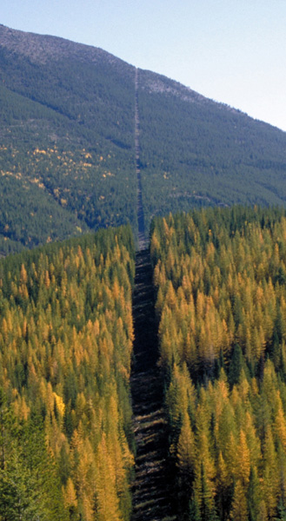
Boundary Formation Processes
demarcate:
physically representing the border on the Earth’s surface
Demarcation of the border dividing U.S. and Canada

Slide 5
US Border Wall
Advocated by American nativists to control immigration
Limit undocumented entry
Reestablish sovereignty through controlling territorial integrity

Slide 6
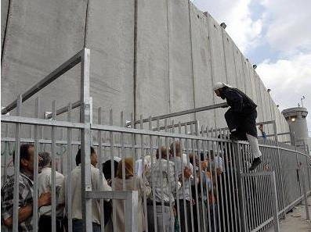
Israeli West Bank Security Barrier
The West Bank Security wall has increased Israeli security tremendously. Terrorist incidents (suicide bombings etc.) have decreased making Israeli citizens feel more secure going about their everyday lives.
However, the wall has been built to encircle Jewish settlements on the West Bank. Many see this as a land grab (a Palestinian state on the West Bank is
envisioned in most peace plans) by the Israelis
It has also made everyday life for some Palestinians very difficult as they must pass through checkpoints to reach fields/villages on the other side of the wall.
Often time they must wait in security checkpoint lines for hours to accomplish simple daily tasks.

Slide 7
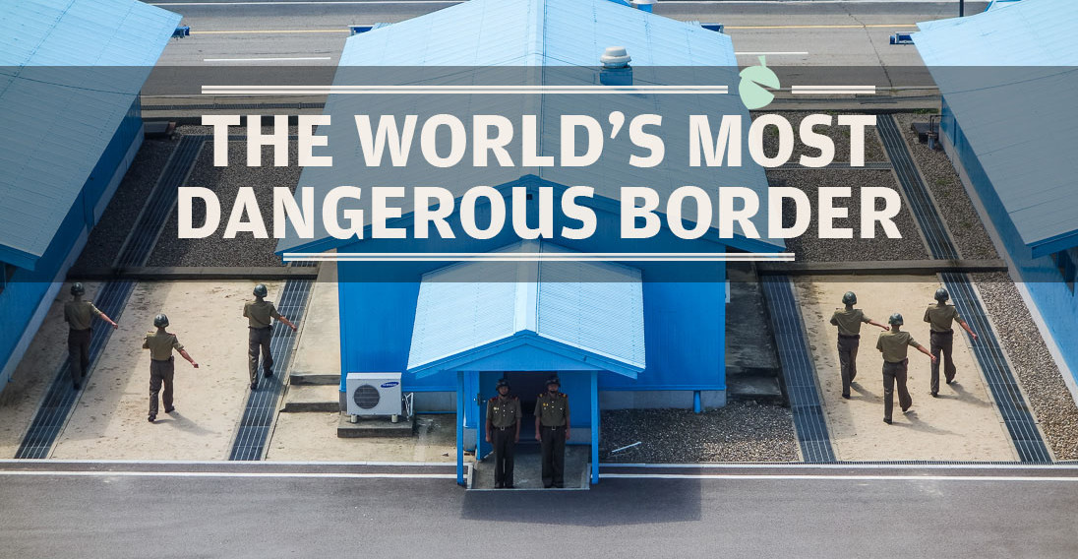
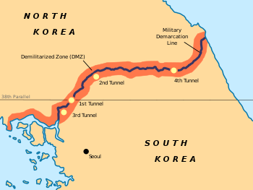
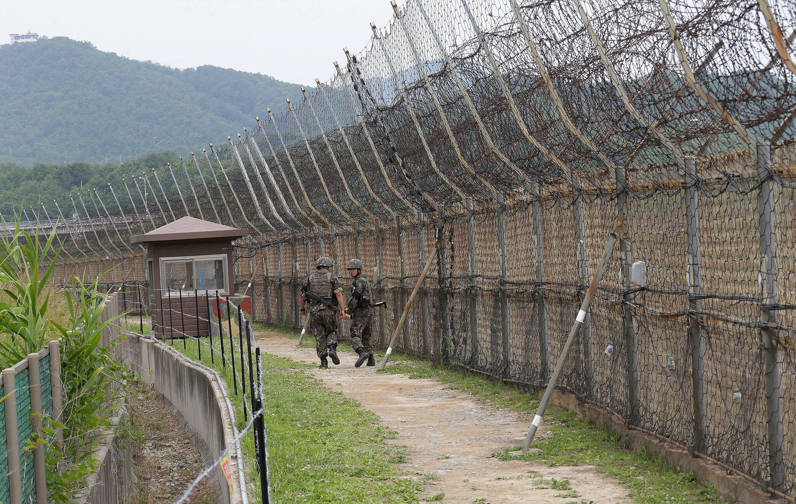
Korean DMZ (demilitarized zone)

Slide 8
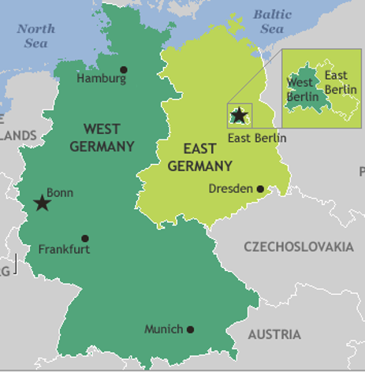
Berlin Wall

Slide 9
Berlin Wall

Slide 10
Berlin wall

Slide 11
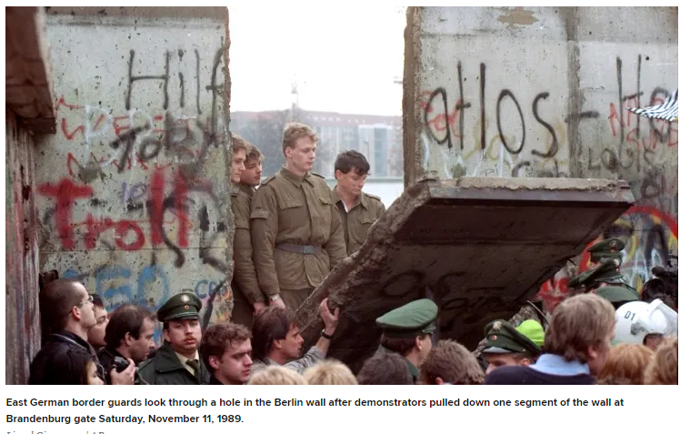
Berlin wall falls 1989 (symbolic end of the Cold War)

Slide 12
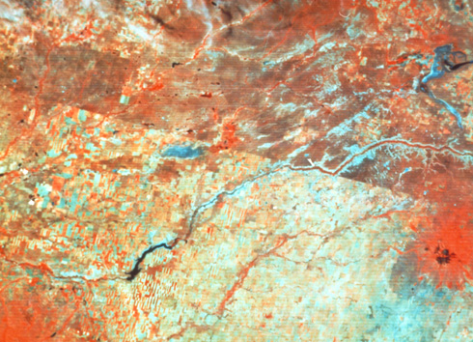
Boundary “Origins”
Origins:
Antecedent
Est. before settlement
Usually aligns with physical boundaries
Cultural groups spread toward border but don’t cross
49th parallel est. by US and UK (Canada) in 1818.
Drawn before area was permanently settled by treaty signers (not of course by Native Americans) US or Canada.
Ignoring of Native American inhabitants of the area could imply “superimposed”
Satellite image shows differences between American and Canadian land use policies.
Grain farming vs. open range

Slide 13
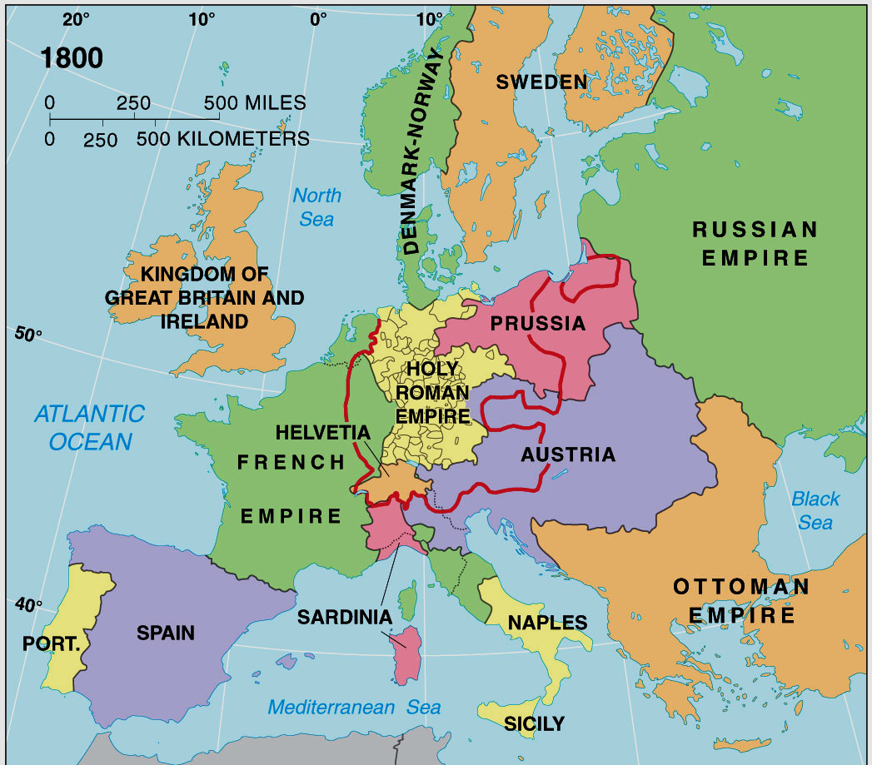
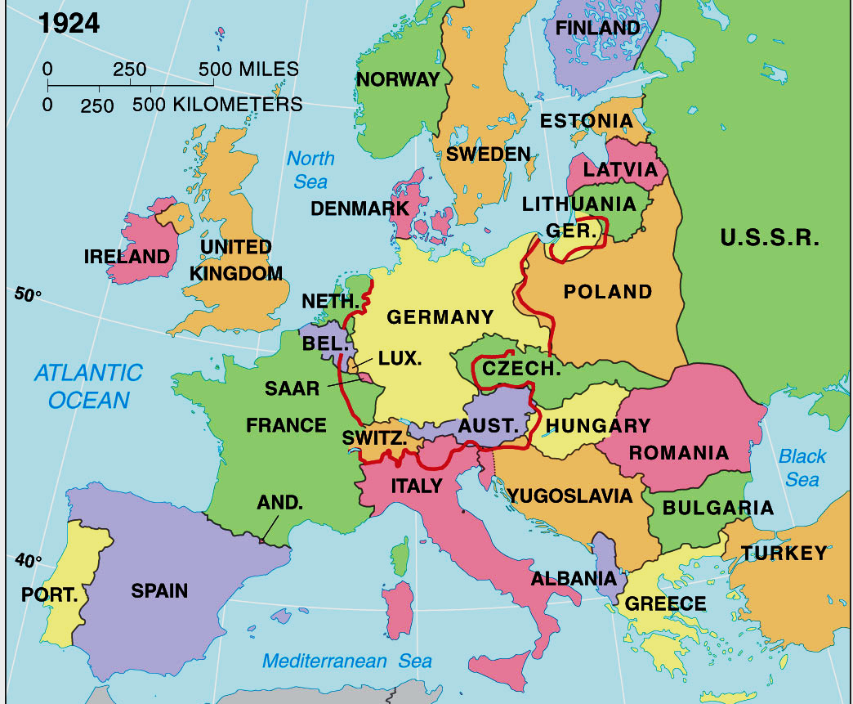
Boundary “Origins”
Origins:
Antecedent
Subsequent or Consequent
Both after settlement
Consequent is a subcategory meaning it is a subsequent border drawn due to changes brought on by conflict or culture
Post WWI and Post-WWII Europe
Borders drawn to match settlement patterns already existing

Slide 14
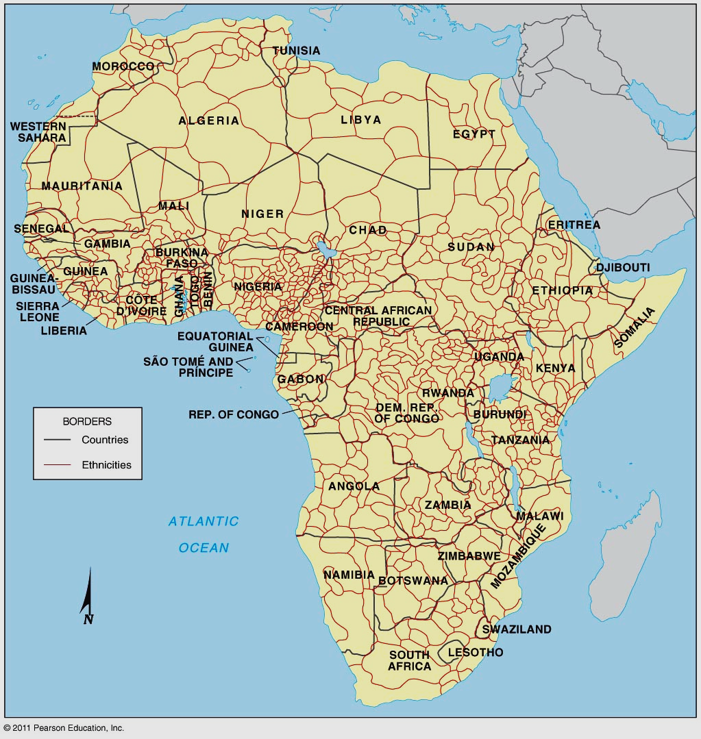
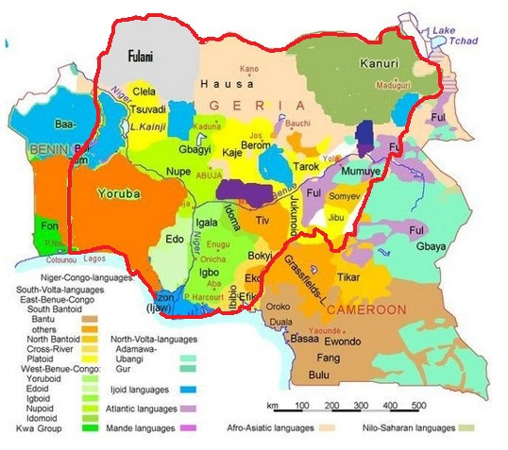
Boundary “Origins”
Origins:
Antecedent
Subsequent or Consequent
Superimposed
Lines laid down for political reasons disregarding cultural boundaries
Scramble for Africa
Borders drawn based on what Europeans wanted (resources, military control, etc.)
Source of centrifugal pressure as decolonized African states struggle to form a national identity

Slide 15
Is Radcliffe’s Line, subsequent or superimposed?

Slide 16
Radcliffe’s Line
the migration and violence associated with the Partition would imply the line is a “superimposed” border.
This is what the College Board
says!
But,
It appears that Radcliffe did take into account the settlement pattern already existing (compare maps)
“subsequent”
Maybe it was just a bad job?
Or an impossible task given the intermixing between Hindus and Muslims in South Asia?
“consequent”
Or the result of the British withdrawal from South Asia

Slide 17
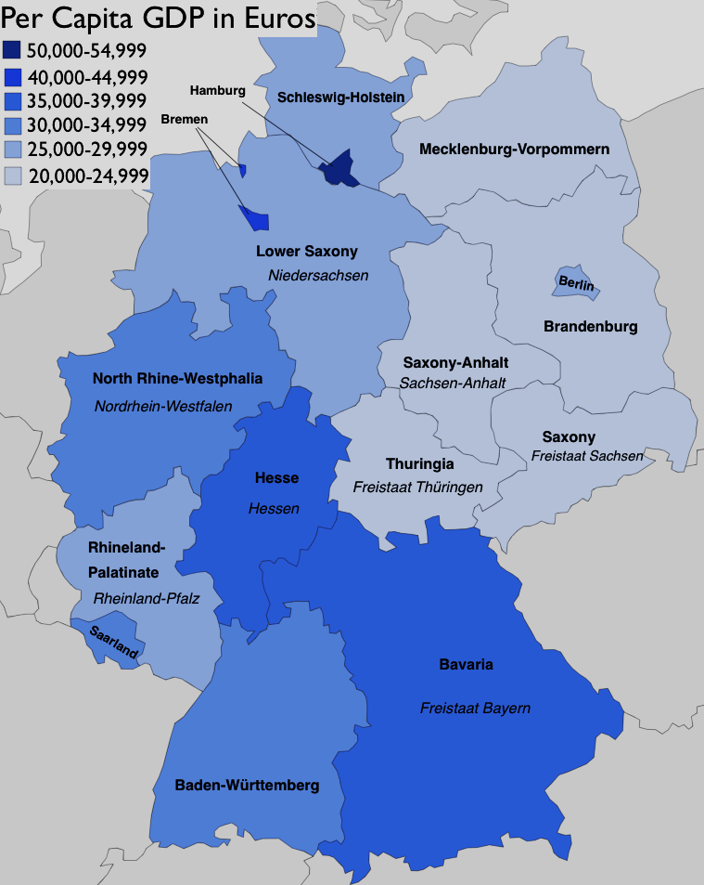
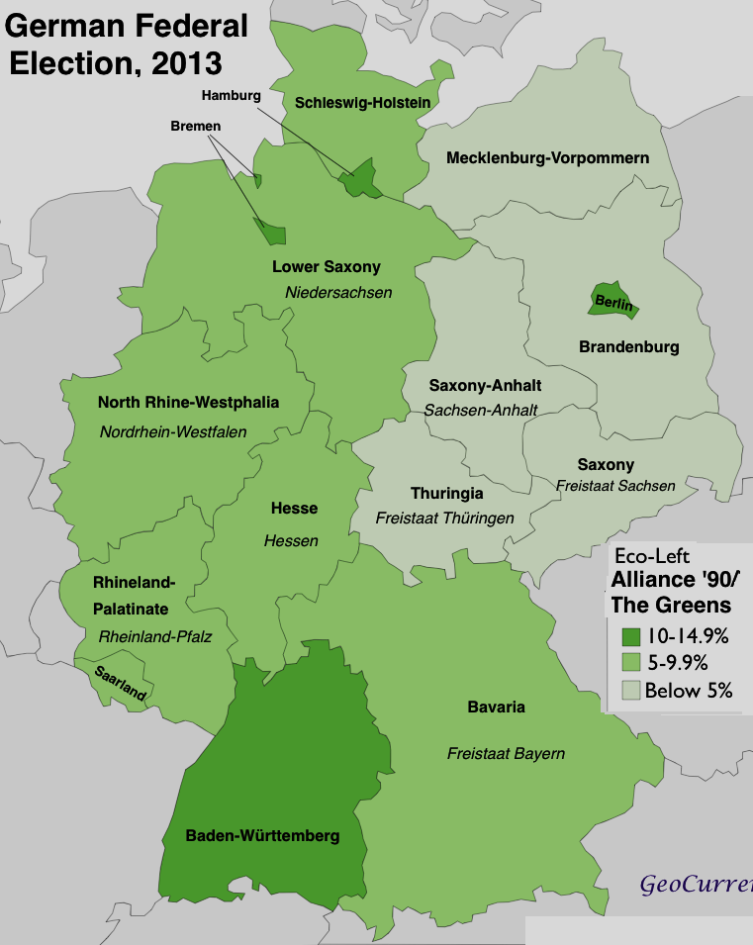
Boundary “Origins”
Origins:
Antecedent
Subsequent
Superimposed
Relic(t)
Former boundary that still has meaning
East and West Germany
divided into 2 states during Cold War
border now obsolete = one Germany
but still has meaning economically and politically. (You can still see East Germany in these maps)

Slide 18
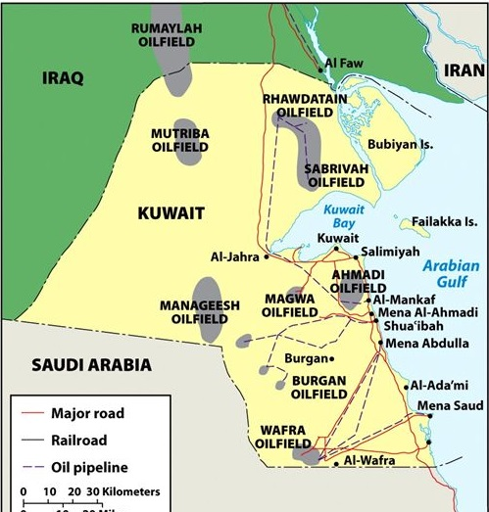
Boundary Disputes
Definitional/Locational
Disagreement on the precise legal definitions of the borders?
“If we are drawing a border at the midpoint of a river, are we doing that at high tide or low tide”
What happens when the border moves (ie: a river changes course)
Operational
how to pass through a border becomes a problem.
Immigration laws/trade policies/paperwork, etc.
Allocational
When a resource lies on two sides of a border who gets what?
Iraq would negotiate to be able to pump more oil than the Saudis from this well (maybe 80/20 split)

Slide 19
Water Boundaries at Sea
Est. by the UN Conference on the Law of the Seas (ratified 1994) UNCLOS
Territorial
Sovereignty extends 12 nautical miles from shore
All national laws apply
Beyond 12 mi. = high seas, admiralty law applies
Exclusive Economic Zone (EEZ)
Exclusive economic rights extend 200 nautical miles from shore
Natural resources, fishing, etc.
If overlap with another state, generally split halfway, but many areas are under dispute

Slide 20
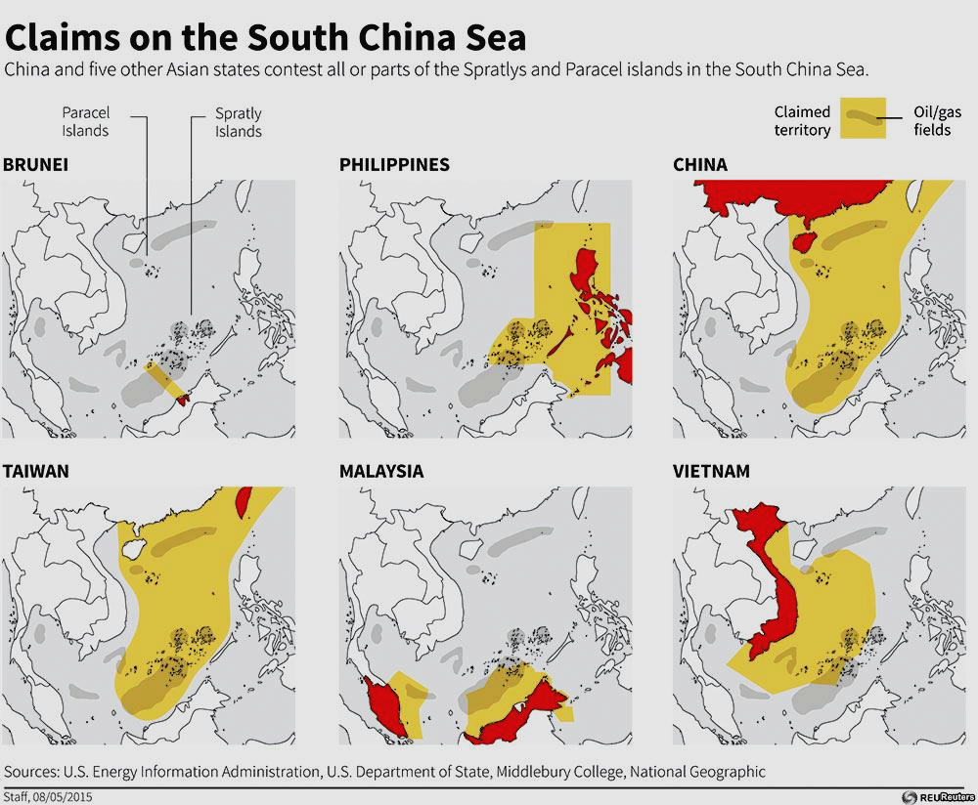
China is building man-made islands in the South China Sea in order to claim valuable oil/gas reserves through the UN Law of the Seas (200 mile EEZ).
How does the US assert non-recognition of Chinese claims in the Spratlys
placing the American fleet within 12 miles of the manmade items

Slide 21
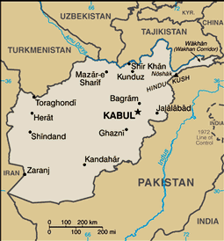
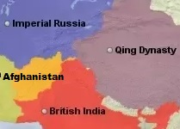
Transition Zones (sort of boundaries)
Until recently many boundaries were not sharp, clearly defined lines, but were zones called marchlands
Frontiers - area between two states or between inhabited and uninhabited areas
Now rare since most modern govts. have technology and want to exploit all territory to the fullest
Buffer state — independent but weak country lying between two powerful countries
Mongolia—lies between Russia and China
Afghanistan- between Russian Empire and British India

