Slide 1
Globalization and the New International Division of Labor

Slide 2
Review: What is globalization?
Simply put, it is….
The process by which the world is becoming more interconnected (and largely ignoring state borders) through improvements in transportation and communication.
Globalization has affected many areas we have already studied
migration, culture, politics, agriculture, etc.
Our focus in this power point is
ECONOMIC GLOBALIZATION

Slide 3
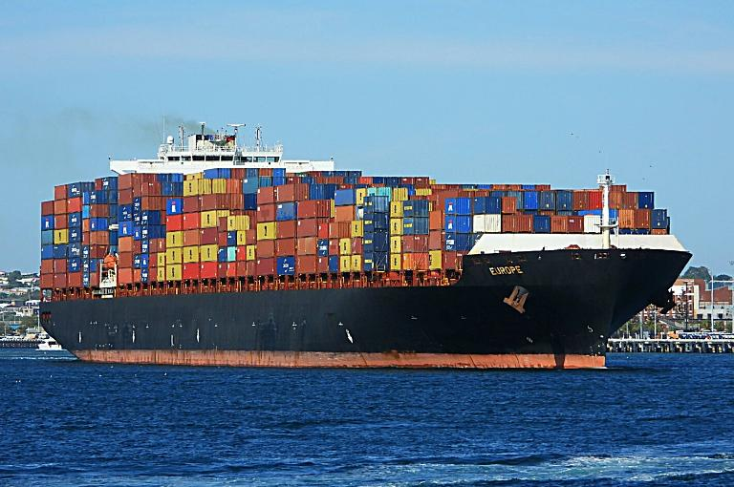
Diffusion of Industry
Globalization has led to the relocation diffusion of industry from from a few wealthy MDCs to many LDCs
This has been made easier (facilitated) by
Cheap, relatively fast shipping (think huge cargo ships stacked with railroad car containers) = very low cost/unit
Communication advancements
Factories can now be managed via the internet, cell phones
Money for investment (capital) can be moved over wires
Remember, globalization has been made easier by advancements in transportation and communication

Slide 4
Diffusion of Industry
Globalization has led to the relocation diffusion of industry from from a few wealthy MDCs to many LDCs
This is made easier by
Cheap, relatively fast shipping (think huge cargo ships stacked with railroad car containers)
Communication advancements
Factories can now be managed via the internet, cell phones
Money for investment (capital) can be moved over wires
Free trade = elimination of trade barriers
Trade barriers can come in many forms
Quotas on goods allowed to be imported
Strict regulations on goods allowed to be imported (like EU restrictions on GMOs)
Government subsidies which allow a domestic producer to sell and export at under cost (we do this with corn, just ask Mexican corn farmers)
Most common example of trade barriers are TARIFFS!

Slide 5
Deindustrialization in MDCs
How has this impacted American manufacturing?
“deindustrialization”
Company’s looking to increase profits have moved manufacturing jobs to lower wage areas.
Since 2000, US has lost 5 million manufacturing jobs
similar situation in EU and Japan (MDCs)
This has also been driven by automation (replacing human jobs with machines/robots)
linked video may overestimate this effect
When trade was normalized with China manufacturing jobs dropped dramatically, that is not all automation
correlation ≠ causation, but still….

Slide 6
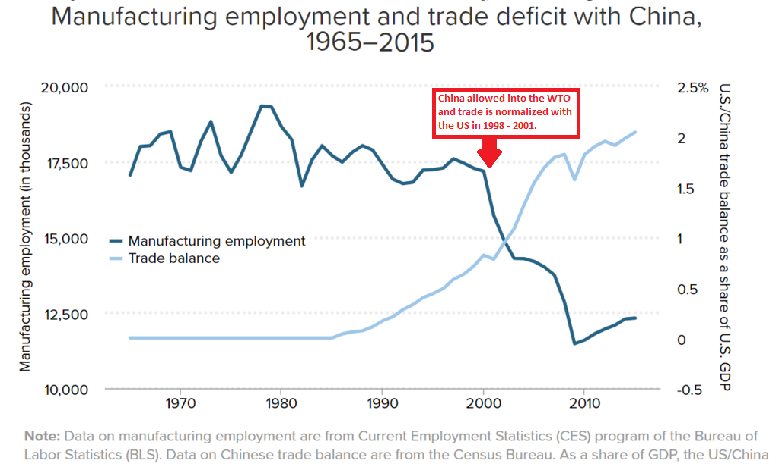
For more on how China “cheats” on trade (see article on website)
And where did China learn to do this? (see article on website)

Slide 7
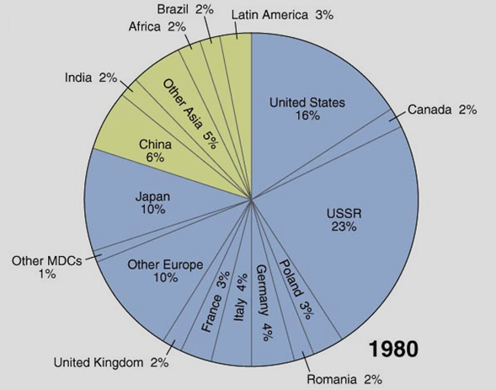
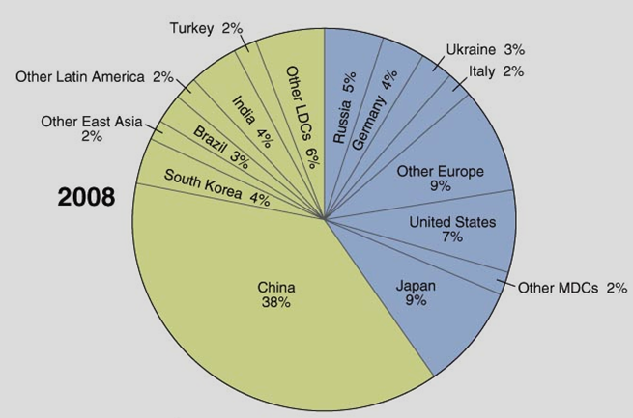
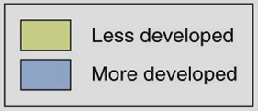
Global Production (Steel)

Slide 8
Effects of Economic Globalization
New International Division of Labor
process by which companies move low skill industrial jobs to other regions with cheap labor while retaining high-skilled jobs. (there are two sides to the division)
MDCs = keep and create new jobs that require high skills but add higher wealth.
High-skill manufacturing, engineering, design, advertising and marketing, technology, data, decision-making.
Do these sound familiar?
Mostly quaternary and quinary jobs
LDCs = new secondary jobs are unskilled, labor-intensive
This is so Wallerstein!

Slide 9
Effects of Economic Globalization
My favorite lectures is when I draw the following graph on the board to show the varying effects of globalization on different segments of the global pop. I am going to try to replicate that here.
You may want to draw this yourself as a way to learn it. I will be going step-by-step. This is best done by viewing this power point through the slide show function.
These numbers are rough estimates, it is supposed to reflect general trends, it is not intended to be exact.
The four groups discussed will be:
Highly skilled people in MDCs
Unskilled workers in MDCs (often middle class, working class and poor)
LDC residents connected to international trade
LDC residents not connected or isolated from int’l trade.

Slide 10
Globalization/Int’l Trade Model/Neo-liberalism/New Int’l Division of Labor
Global economic growth has exploded with globalization
It was $20 trillion in 1970
now over $80 tr
This is often cited as to why economists think free trade and globalization has been successful

Slide 11
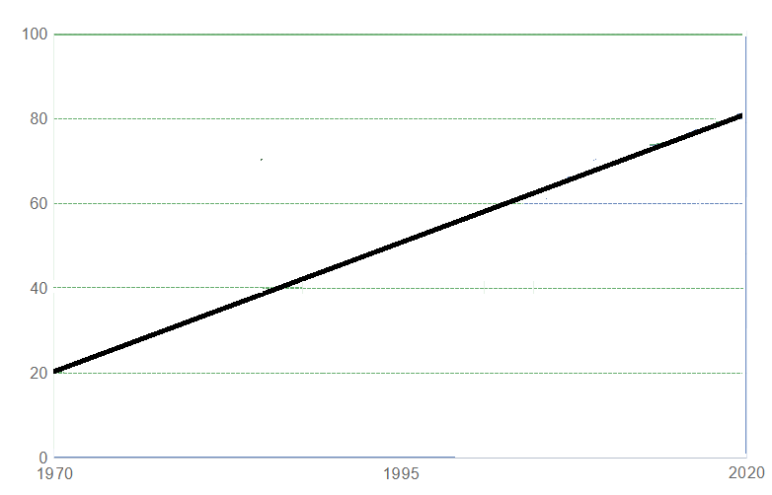

Slide 12
Globalization/Int’l Trade Model/Neo-liberalism/New Int’l Division of Labor
In 1970, MDCs controlled 70% of global wealth
US, Europe, Japan, Australia
Basically, north of Brandt’s Line
LDCs controlled about 30%
Remember this includes China, India, all of Latin America, Africa
Global “South”

Slide 13
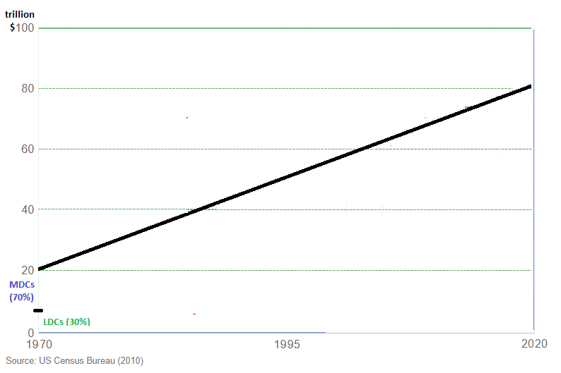

Slide 14
Globalization/Int’l Trade Model/Neo-liberalism/New Int’l Division of Labor
mid-20th c., US (ex. of MDC) had a more equal dist. of wealth.
stronger unions
manufacturing jobs
high taxes on upper income earners
aka “The Great Compression”
Top 10% had 60% of wealth
Bottom 90% = 40%
Sounds unfair but it gets worse
Europe = social welfare programs

Slide 15
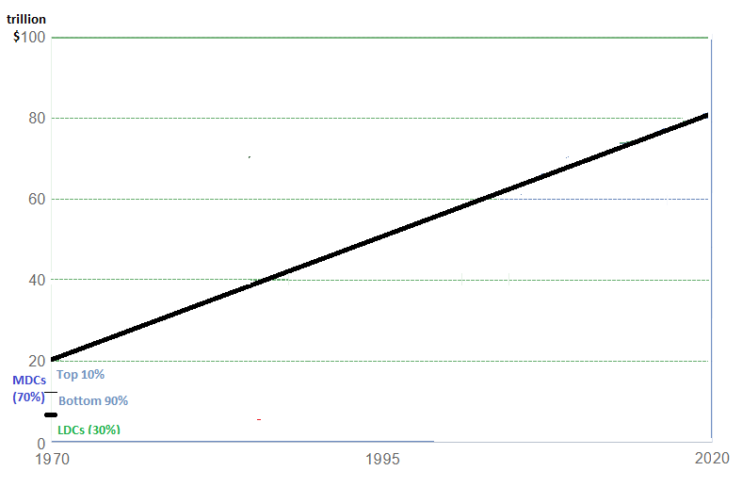

Slide 16
Globalization/Int’l Trade Model/Neo-liberalism/New Int’l Division of Labor
With the NIDL, income has definitely grown in LDCs.
manufacturing jobs
urbanization
Lifts over 1 billion people in LDCs out of poverty.
However, as you can note from the graph the lion’s share of global income is still concentrated in MDCs
This correlates with Wallerstein’s theory as the core benefits by exploiting the semi-periphery and periphery
Don’t draw the red and green lines, I’m just drawing your attention

Slide 17
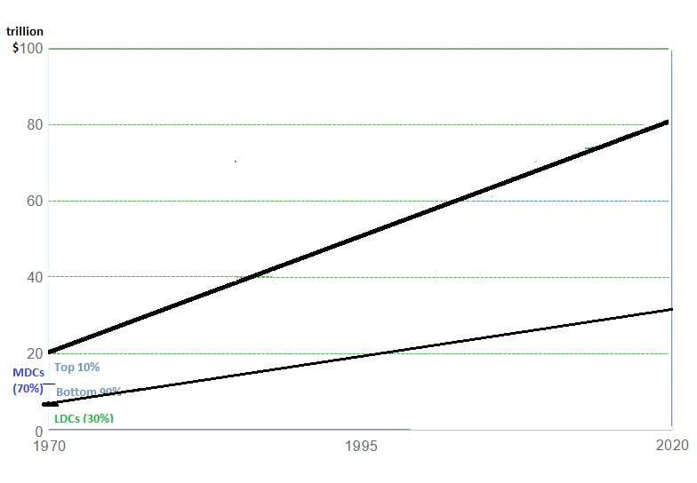

Slide 18
Globalization/Int’l Trade Model/Neo-liberalism/New Int’l Division of Labor
Within LDCs, globalization has mostly benefitted new secondary workers & those in semi-peripheral societies connected to global trade.
Even though wages are low, living std is still higher than those of subsistence farmers.
Some countries would now be considered MDCs
South Korea, Taiwan, Singapore
Others =emerging economies
Brazil, India, China
Coastal China (ex. Shanghai) by its enormous recent growth is a huge part of this wedge
“Islands of Development”
“Islands of Development” are areas (usually coastal cities and/or capitals) in peripheral countries where foreign investment and development are concentrated

Slide 19
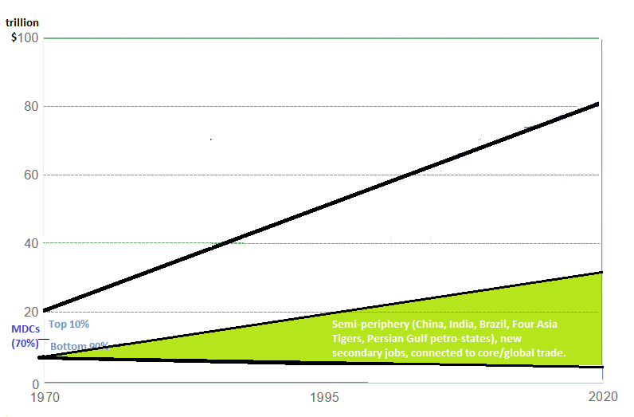

Slide 20
Globalization/Int’l Trade Model/Neo-liberalism/New Int’l Division of Labor
LDC areas not connected to international trade have not shared in this new prosperity.
This includes entire areas in the global periphery like sub-Saharan Africa
Except for islands of dev.
Or, interior/isolated areas in the semi-periphery
Interior of China

Slide 21
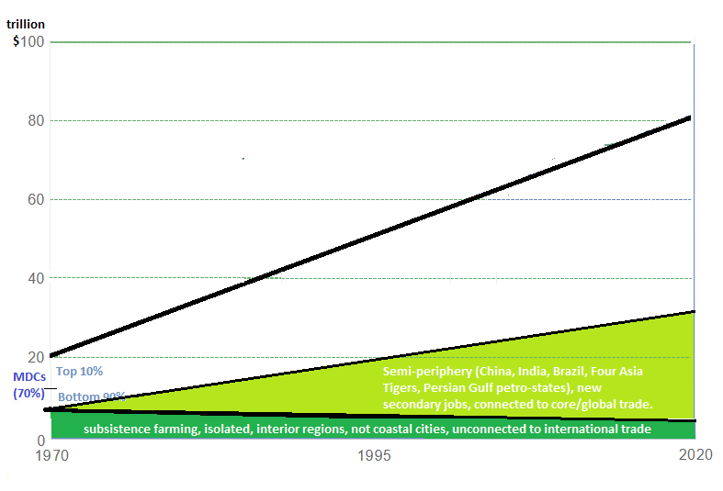

Slide 22
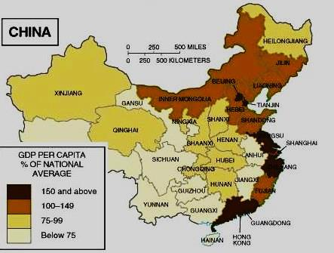

Slide 23
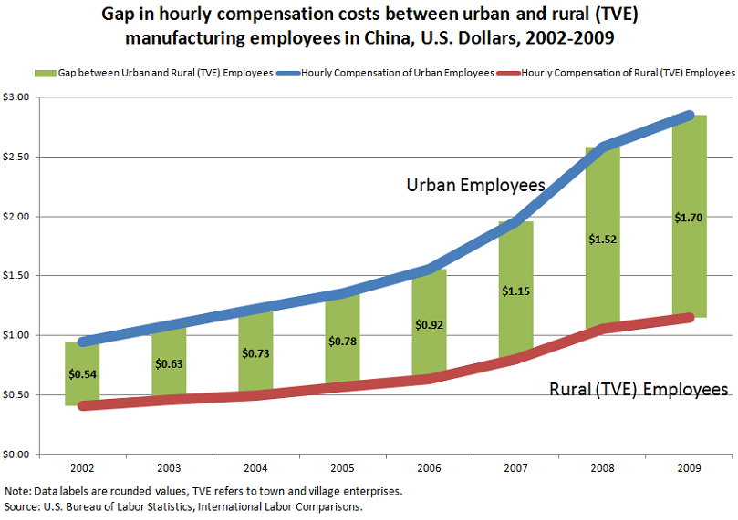
China Wage Gap

Slide 24
Globalization/Int’l Trade Model/Neo-liberalism/New Int’l Division of Labor
LDC areas not connected to international trade have not shared in this new prosperity.
This include entire areas in the global periphery like sub-Saharan Africa
Except for islands of dev.
Or, interior/isolated areas in the semi-periphery
Interior of China
Northeast Brazil

Slide 25
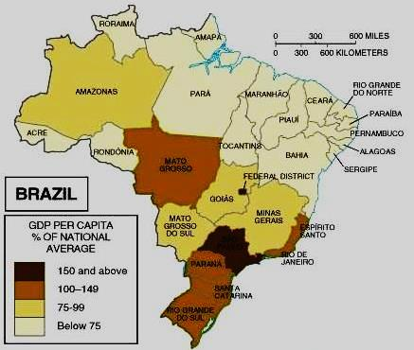

Slide 26
Globalization/Int’l Trade Model/Neo-liberalism/New Int’l Division of Labor
LDC areas not connected to international trade have not shared in this new prosperity.
This include entire areas in the global periphery like sub-Saharan Africa
Except for islands of dev.
Or, interior/isolated areas in the semi-periphery
Interior of China
Northeast Brazil
Southern Mexico

Slide 27
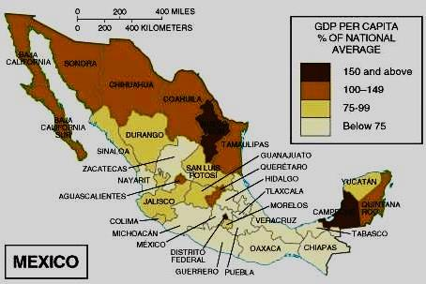

Slide 28
Globalization/Int’l Trade Model/Neo-liberalism/New Int’l Division of Labor
Globalization has also had a varied effect in MDCs
This variance has been felt across social class and education levels rather than physical geography
The main beneficiaries of the NIDL has been highly-skilled, college educated people.

Slide 29
Globalization/Int’l Trade Model/Neo-liberalism/New Int’l Division of Labor
Why have the highly-skilled/educated benefitted the most from NIDL?
Higher wages due to skills
They share in the profits of multinational corporations through investments.
Cheaper goods due to NIDL/free trade
This is not just the “1%”
But their benefits have been on steroids!
This is where we (teachers/parents) hope you position yourself (dark blue wedge) as MDC residents in a globalized economy.

Slide 30
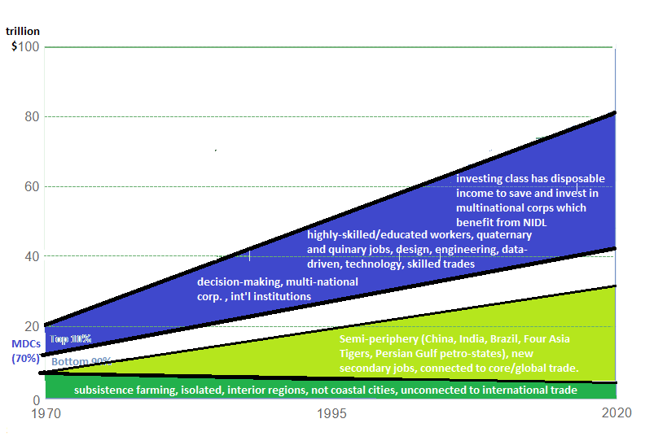

Slide 31
Globalization/Int’l Trade Model/Neo-liberalism/New Int’l Division of Labor
The group in MDCs most hurt by globalization has been unskilled workers.
Formerly good paying secondary jobs have disappeared.
These have been replaced with low-paying tertiary jobs for unskilled workers
Fast food
Hospitality
Reduction of union power and influence
Neo-liberal reductions in wages and benefits (see CPS Aramark example)
Note how the light blue wedge’s share of global income/wealth has not increased in width especially in comparison to the dark blue and light green wedges. This “middle class squeeze” has caused a great deal of resentment within this segment and has manifested itself politically.

Slide 32
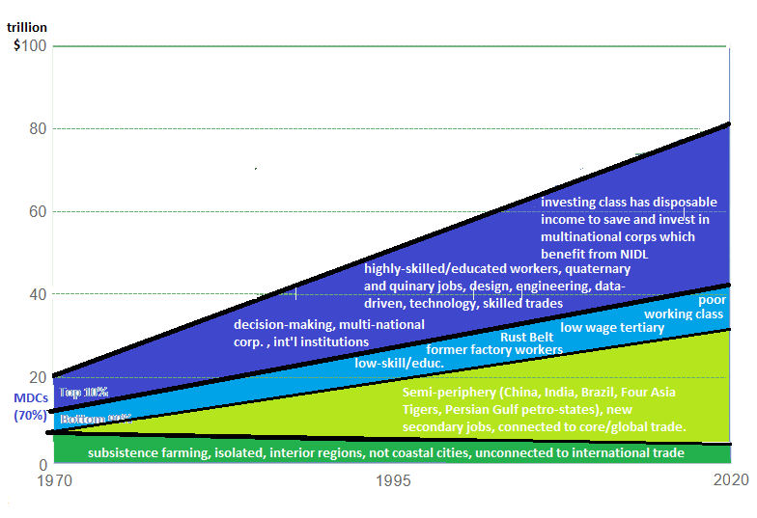

Slide 33
Who should these unskilled workers blame for the “Middle Class Squeeze”? Opinions vary!
Right
Left
Moderates
“Establishment”
Sanders/Warren
Blame corp. power (dark blue wedge)
big banks, Wall Street, pharma Monsanto, WTO, IMF, Walmart
Appeal to class identity
“tax the rich” 1%
Get big money out of politics
Multinat’l corps have too much influence
Economic socialism
Trump
Blame outsiders (Light green wedge)
China
Immigrants for wage stagnation
Politicians have taken advantage of you!
“drain the swamp”
appeal to cultural identity
Racism, nativism
xenophobia
Economic nationalism
“Make America Great Again”
Status quo is good
Look at overall growth!
Globalization is good.
Poor people are being lifted up globally
“workers need to adapt to a changing world”
Get skills, go to college
But college is $$$$$
“internationalist” POV
Who are they?
Mainstream Republicans
Bushes
Neo-liberal Democrats
“New Democrats”
Clintons

Slide 34
Other Effects of Economic Globalization (NIDL) on LDCs
Leads to Interregional Migration
urbanization in LDCs is largest migration flow globally
Migration to EPZs
improves personal economic positions
but weakens family and traditional culture
Squatter settlements (not so much in China, but India, Brazil, Mexico)
Regional differences
establishment of Export Processing Zones (EPZs)
Favorable tax, regulations, etc. for foreign firms
maquiladoras in Mexico
Special Economic Zones (China)
Islands of Development (sub-Saharan Africa) are cities, capitals, ports with concentrated econ. development, foreign inv. $
Can lead to unequal development within states (centrifugal)

Slide 35
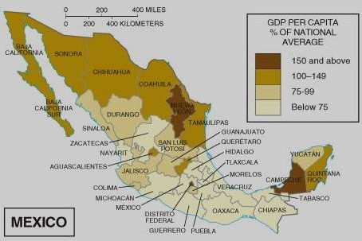

Slide 36
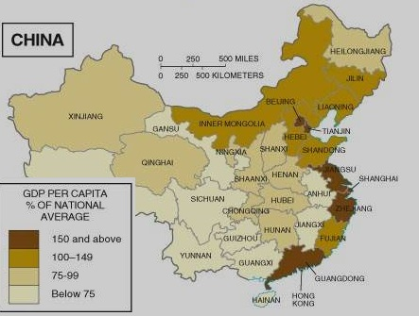

Slide 37
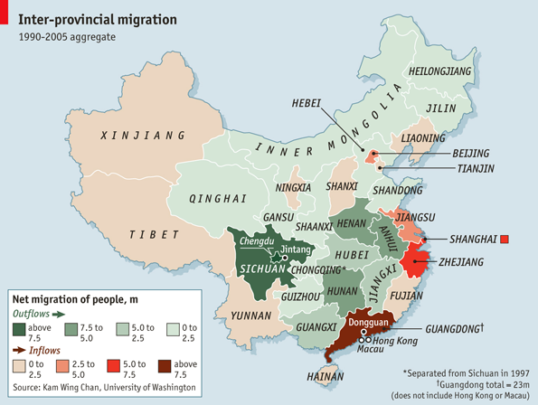
Interregional Migration

Slide 38
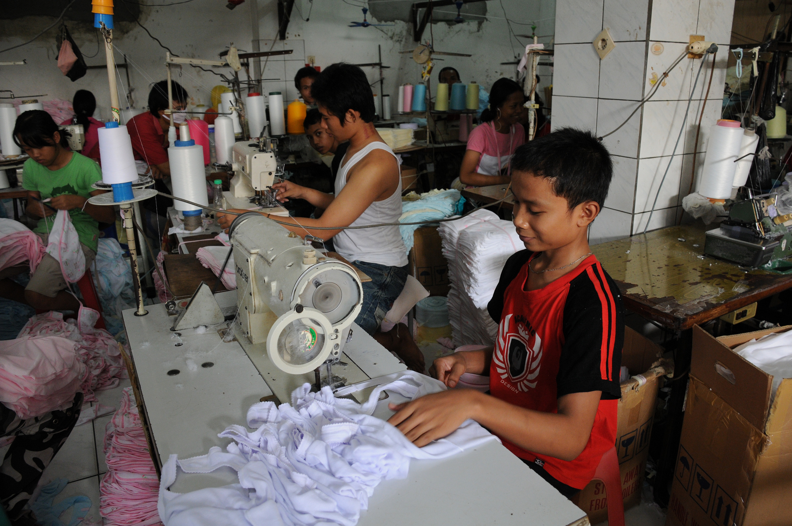
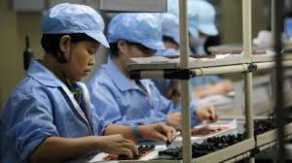
Other Effects of Economic Globalization (NIDL) on LDCs
Gender opportunity
Entry of women into work force means added inc. household support, which improves the standard of living and lowers population growth rate.
Child labor
abuse and exploitation
use of child labor discourages further education which might hinder development in the long-run.

Slide 39
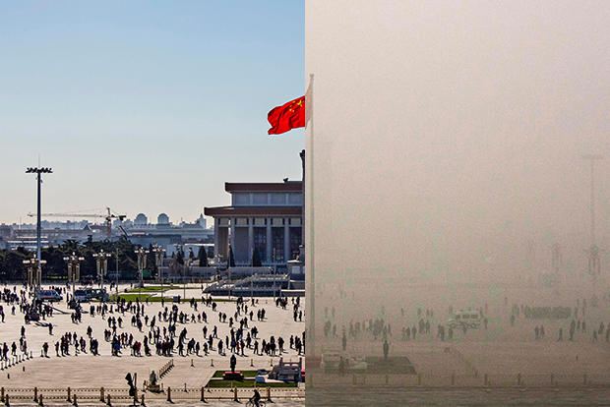
Other Effects of Economic Globalization (NIDL) on LDCs
Environmental damage/pollution
One of the reasons multinational corps are locating in LDCs is to cut regulatory costs related to environmental laws (land site costs) and therefore make a bigger profit
invites new health ailments/pollution problems.
Beijing, China

Slide 40
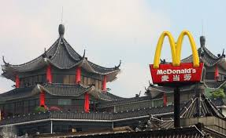
Other Effects of Economic Globalization (NIDL) on LDCs
Cultural change
Westernization of production, management, etc., changes the social and cultural relationships (e.g., women in the workplace, language, cultural disruption, lifestyle, etc.)
Relates to the diffusion of pop culture

