Slide 1
Day Four Gendered Space and Power Relationships

Slide 2
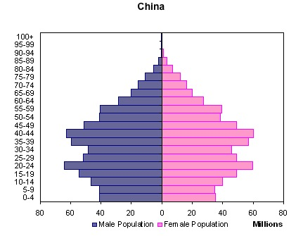
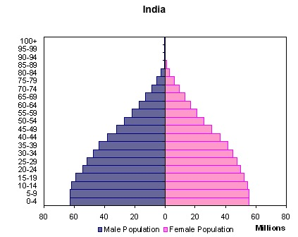
“Missing Girl” Problem
Evidence = sex ratio (# of males/100 females)
Many fewer girls being born than boys!
1.03 – 1.06 males for every female = natural rate
China = 1.17 (has dropped from a peak of 1.21 (2004))
India = 1.24 (1.39 if previous girl has been born, 5.62 if two previous)

Slide 3
“Missing Girl” Problem
Cultural preference for male children in some societies
esp. in patriarchal societies dep. on subsistence farming
Boys
more useful in labor, earn higher income for family
provide support for elderly parents
only men can perform certain religious rituals
Girls
leave and become assets to another family
cost of dowry
Results of the preference for male children
NIR
↑ = parents have more children until they get a boy
Young adult men without mates
more prone to violence, civil unrest, will look outside ethnicity for mates, migrate
Maladaptive behavior (esp. in reaction to anti-natalist policies)
= sex-selective abortion, infanticide, female malnutrition and lack of medical care.

Slide 4
“Missing Girl” Problem

Slide 5
Gendered space
Mandatory segregation (usually privacy/safety concerns)
bathrooms, locker rooms, dorms, prisons, military service, etc.
Some cultures = strict division of space by gender
Hinduism/Islam – purdah
Islam/Orthodox Judaism – separate areas of worship

Slide 6
Gendered space

Slide 7
Gendered space
Mandatory segregation (usually privacy/safety concerns)
bathrooms, locker rooms, dorms, prisons, military service, etc.
Some cultures = strict division of space by gender
Hinduism/Islam – purdah
Islam/Conservative Judaism – separate areas of worship
Voluntary segregation
to reduce sexual harassment – women only train cars

Slide 8
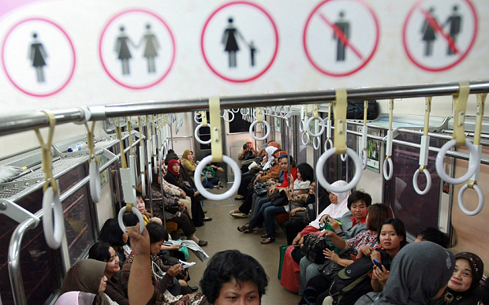
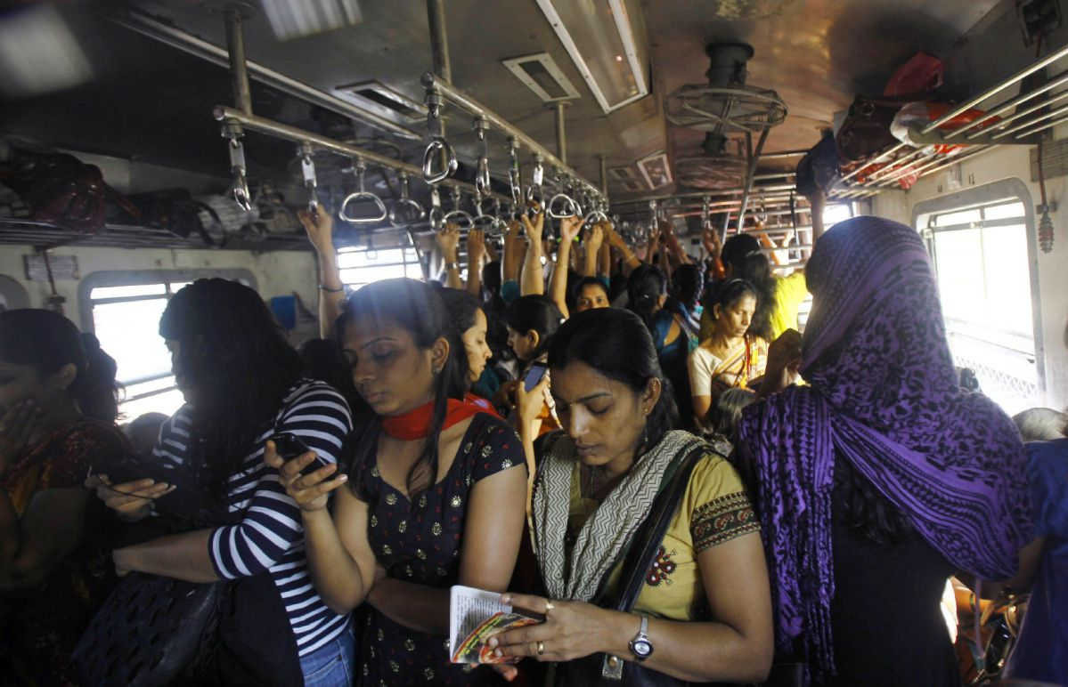

Slide 9
Gendered space
Mandatory segregation (usually privacy/safety concerns)
bathrooms, locker rooms, dorms, prisons, military service, etc.
Some cultures = strict division of space by gender
Hinduism/Islam – purdah
Islam/Conservative Judaism – separate areas of worship
Voluntary segregation
to reduce sexual harassment – women only train cars
to incr. educational outcomes – single-sex schools
Woman’s Workout World, Curves – same sex gyms

Slide 10
Other issues dealing with gender and geography
LDCs farmland/work is often divided up between genders
men grow cash crops ← $ for household
men have greater control of family's finances
women grow basic staples, reinforcing women's domestic roles
often provide labor for cash crops but don’t get income
Women grow most of the food that is consumed by the family
to combat this, development agencies target female production
Example = microloans in Bangladesh (Grameen Bank)
hope to reduce gender inequality.
Studies have found the most effective way to combat starvation/child malnourishment is to empower women
“Feminized” rural areas in Africa
Globally short-distance migration (urbanization) is dominated by young single women who send money home to their villages
EXCEPT..short-distance migration (urbanization) in Africa = men
Factory work/mines outside of cities
Rural areas are then left with mostly women, children, elderly

Slide 11
Sexuality and Space
Gendered Space in our society
Masculine
public spaces, active
hardware stores
taverns
wilderness
camping, hunting, etc.
Feminine
largely ltd to private realm
domestic duties/children
elementary schools
grocery stores
Most spaces are heteronormative (denoting or relating to a world view that promotes heterosexuality as the normal or preferred sexual orientation.) Therefore, Lesbian Bisexual Gay Trans Questioning (LGBTQ) people have carved out geographic spaces (“gay villages”, “gayborhoods” etc. like Northalsted (“Boystown”) in Chicago, the Castro in SF, West Hollywood in LA, the West Village later Chelsea in NYC etc.) where gay people feel free to express their sexuality w/out fear of violence or discrimination.
What is the future for these spaces?
With incr. acceptance of the LGBTQ community, gay villages (much like German or Irish neighborhoods of the past) are becoming less distinct as the gay population “assimilates” or gains acceptance.

