Slide 1
Population (Unit 2)
Objective: Analyze population composition. Identify population pyramid structure @ each stage of the DTM.

Slide 2
Population Structure
Population structure refers to the composition of a population in terms of age + sex.
Best illustrated by population pyramids (aka age-sex pyramids)
Bar graphs that graphically display a population’s age + gender composition (#s of males + females in each age cohort).
Shape of pyramid determined mainly by CBR.
DTM lines are reflected in the shape of the pyramid.
Notes:
What are population pyramids?
What can the shape of a population pyramid tell us about a country?

Slide 3
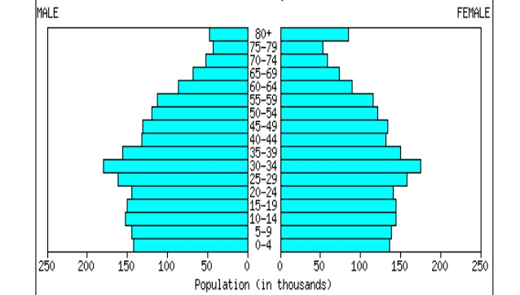
For space, it caps everyone
@ 80+
Wider cohort of elderly @ top
Ages (0-80)


Males (always left)
Females (always right)
← 0
% of pop
0 → (Raw #s)
% of pop
Notes:
Wider cohort @ top (naturally weighted to what side? – women)
In elderly cohorts, you can expect a larger # of females. Why is that?
- *female life expectancy is longer
***Slight biological pref. for males, but sides should be even.
If they are non-symmetrical, there’s a problem. What could it indicate?
If there are more females than males, what might have caused that?
What are men more likely to engage in than females? (war/ the military)

Slide 4
Sex distribution:
Sex ratio (comparing # of 1 sex to the other)
Male + female sides should be balanced.
Slight biological preference for baby boys, but sides should be even. (If non-symmetrical, there’s a problem)
Military/War (males)
In elderly cohorts, you can expect a somewhat larger # of females. Why?
Higher female life expectancy
*Note anomalies
unbalanced by gender, missing populations.
Notes:
What could cause it to be non-symmetrical?
What might cause there to be more females than males?
- war / the military
What do males tend to engage in more than females? (military/war)
Ex.) Germany’s pop pyramid after WW2 – inward missing area for men

Slide 5
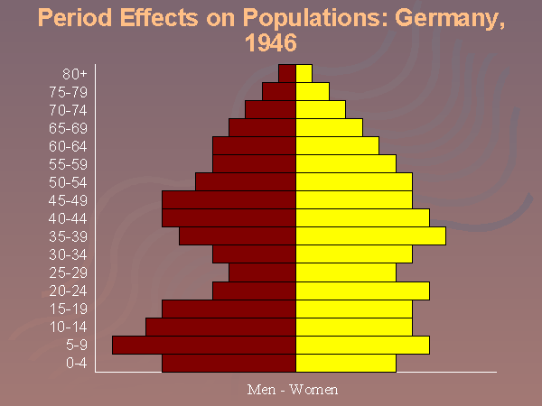

Slide 6
What info can a pop. pyramid tell us?
Besides age + sex distribution, also:
Used to project population growth or decline.
Shape of pyramids → development of a nation + stage in the DTM.
Shape determined mainly by CBR.
5 main types of pyramid shapes, each with corresponding levels of development.
How many dependents there are (unproductive, not part of labor force)
Also used to predict markets for goods + services + the need for social services.

Slide 7
Age Distribution
Dependent population:
those aged 0-14 years (youthful dependents) and 65+ years (elderly dependents).
Considered economically unproductive.
These people depend on the working age (15-64) for economic support.
Dependency ratios (ratio of workers to dependents):
the # of people who are too young or too old to work, compared to the # of people in their productive years.
Reflected as a ratio of dependents per every 100 workers
Dependency ratio = (# of people < 15 + # of people > 64) / # of people 15–64
#Dependents / #Working Age = Dependency Ratio
*The higher the % of dependents, the greater the financial burden on those who are working to support the others.

Slide 8
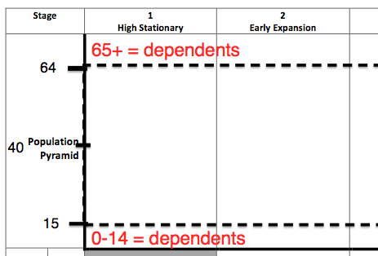
Economically unproductive
15-64 =
Working Age
Economically unproductive

Slide 9
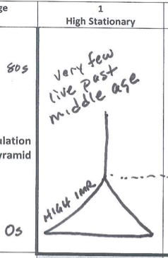
Stage 1: High Stationary
CBR?
CBR = very high (> 25)
High CBR = wide base
What happens to wide base as we go up? Will people live until 65?
Concave (high IMR, low life expectancy); cohorts become small quickly
“Lives short, brutal, hungry”
Where is average age?
less than or = to 15
Avg. Age 15

◆
Notes:
Most of human history – dominated by young people

Slide 10
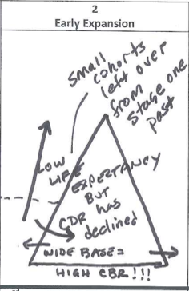
Stage 2: Early Expansion
CBR?
Still very high (25-40).
High CBR = wide base
What else gets wider + why?
CDR drops (ppl live longer + IMR drops).
Top widens. Not as concave or dramatic. Upper cohorts larger.
Shape?
More of a triangle/tree.
Avg age: late teens/early 20s
Dependency ratio
High youth dependency
See following slide
demographic trap, dev. funding limited. No jobs for maturing youth → unrest
◆

Slide 11
High Youth Dependency
Current funding problems:
education
pediatric medical care/immunizations
daycare/childcare
Future problems (as these children reach adulthood)
Country reaches carrying capacity of economic opportunity
too few jobs compared to population leads to widespread poverty
could result in criminal activity, gangs, political unrest, substance abuse
could result in emigration
Who moves? Your society’s best, brightest, most ambitious who want to exploit their talents where they can benefit
“brain drain” for overpopulated source country
“brain gain” for destination country

Slide 12
Stage 2 Demographic Trap (circular)
High CBR
(Low CDR)
Children =
economic assets
STRAIN ON ECONOMIC RESOURCES
$ on schools, daycare, hospitals
No $$$ for infrastructure
Primary Jobs (Periphery)
High agricultural density
No female empowerment
No economic development
Notes:
STRAIN ON ECONOMIC RESOURCES
$ on schools, daycare, hospitals
No $$$ for infrastructure (roads, transportation, communication, other services necessary for economy)

Slide 13
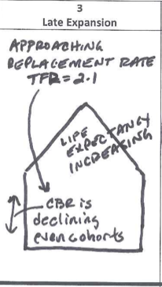
Stage 3: Late Expansion
Big change in shape in S3!
*CBR drops (2nd break -- less children)
Life expectancy increasing
TFR approaching replacement rate (TFR 2.1)
# of parents cohorts = CBR cohorts; but pop continues to grow – even sides (demographic momentum)
New Pyramid shape?
House shape (CBR is declining – even cohorts);
Average Age: late 20s – mid 30s
Dependency ratio?
Healthier ratio of workers to dependents. Decreasing focus on youth dependency.
Avg. Age late 20s -mid 30s
◆
# parents = CBR
Notes:
Replacement rate = rate @ which pop. can replace deaths with births
To reach replacement rate levels, you need a TFR of 2.1

Slide 14
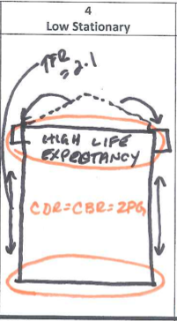
Stage 4: Low Stationary
CDR = CBR = ZPG
Zero pop. growth (low rates, stationary NIR);
TFR = 2.1 (@ replacement rate)
*Higher life expectancy
Female empowerment
New Pyramid shape?
Rectangle / chimney
Grandparents + kids equaling out.
Deaths equaling births
Average Age = late 30s, early 40s
Dependency ratio
Healthiest ratio of dependents to workers (stage 3 is also fairly strong)
Growing focus on aged dependency.
Late 30s,
Early 40s
◆
#Grandparents = #kids
Notes:
What’s happening at the top of Stage 4?
How is the top of Stage 4 duff than eariler??
What has extended?

Slide 15
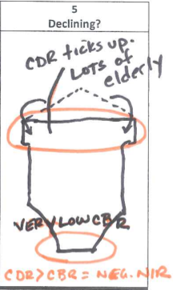
Stage 5: Declining?
CDR > CBR = NEGATIVE NIR
Aka a declining population
CDR ticks up (lots of elderly)
Very low CBR (female empowerment, pessimism, etc.)
Under replacement rate (< 2.1 TFR) ex. Japanese not having children not replacing themselves
new pyramid shape? (connected to sports)
Home plate
Average age = mid 40s +
30% of Japanese > 65
Dependency ratio:
High elderly dependency ratio, concern for health care
See following slide
Shrinking non-independent productive sector
Avg. Age 45 +
◆

Slide 16
High “Aged” or “Elderly” Dependency
Current funding problems:
Nursing homes/long-tern care for elderly who can no longer care for themselves
Retirement income for elderly who are no loner working (social security/pensions)
Health care costs (old people need more medical care, prescription drugs, medicare (health insurance for old people who are no longer working).
Future problems (from continued low CBR)
Lack of workers to fulfill essential functions in society
Less workers to pay taxes to fund elderly support programs like social security and medicare
Less workers could mean less consumers resulting in a shrinking economy

