Slide 1
Political Geography

Slide 2
The Shape and Size of States

Slide 3
Size of States
state sizes vary considerably
Largest = Russia (11% of the world’s land area)
Megastates = very large states
> 2 million square miles
Canada, China, US, Brazil, Australia
Smallest = Monaco? (Rubenstein)
Vatican City = smallest independent country
but not in UN!!!! Monaco is! Stupid distinction, Rubenstein!
Microstates = states with very small land areas
About two dozen microstates
mostly in Europe or
islands (Caribbean/Pacific)
Usually can only maintain sovereignty through tourist economies, otherwise too small to function as an independent state. Many island have opted to remain colonies for the economic links to Europe/US.

Slide 4
Map of microstates

Slide 5
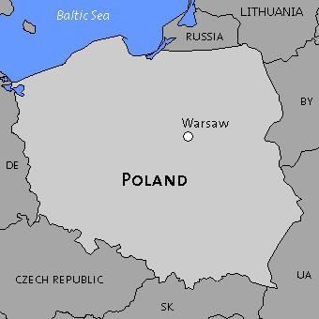
Compact State
most efficient, centripetal force
Best if equidistant from capital
Theoretically, most desirable shape is round or hexagonal
short borders easy to defend.
short communication lines
As a rule, the more compact the territory the better
Some countries come close to ideal —France, Poland
Other shapes (following) = problematic, have centrifugal elements
Most common = separatist sentiments from isolated areas

Slide 6
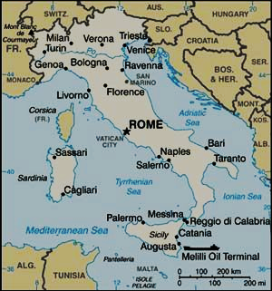
Elongated State
long and narrow
poor communication
Borders are hard to control/defend, state easily dissected, porous.
potential to isolate regions from the capital.
shape is centrifugal force
Northern Italy and Southern Italy often have conflicting interests and have had separatist sentiments

Slide 7
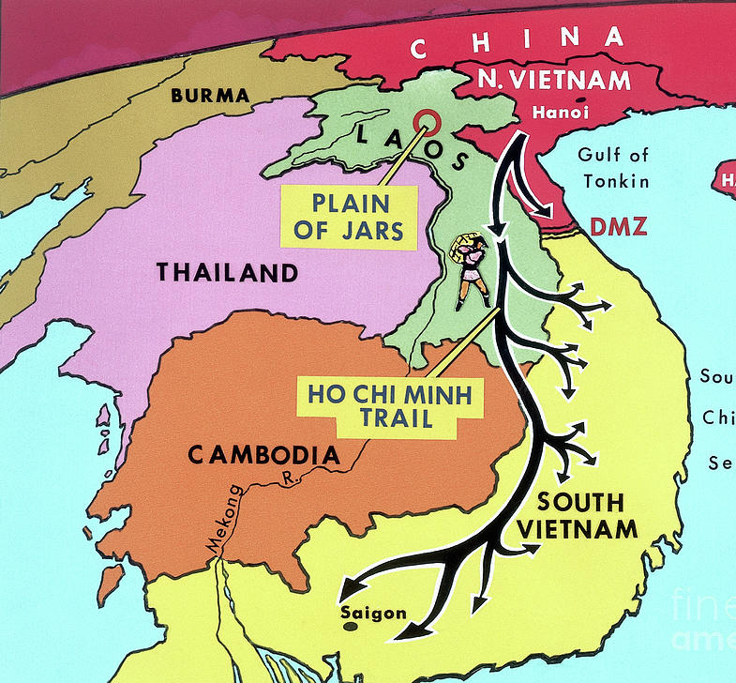
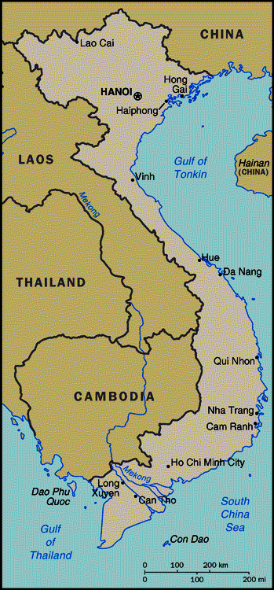
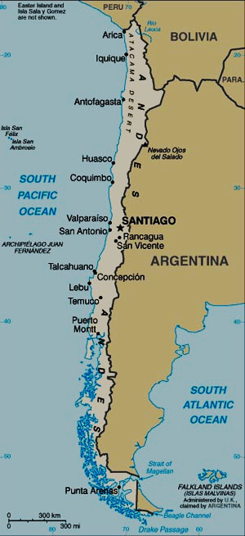
Chile
The inability of the South Vietnamese and Americans to control Vietnam’s border against incursions from the North and Viet Cong (Ho Chi Minh Trail) is one reason we lost the war.
Vietnam

Slide 8
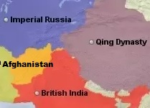
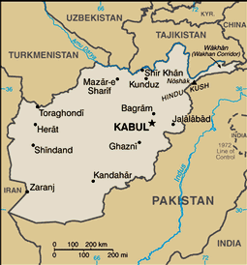
Prorupted State
otherwise it is a compact state but with a large projecting arm
gives access to a natural resource
Belgian Congo gets port to export rubber
or separates two rival states that would otherwise share a border.
British India and Imperial Russia kept apart
proruption could be isolated and develop separatist sentiments
hard to defend

Slide 9
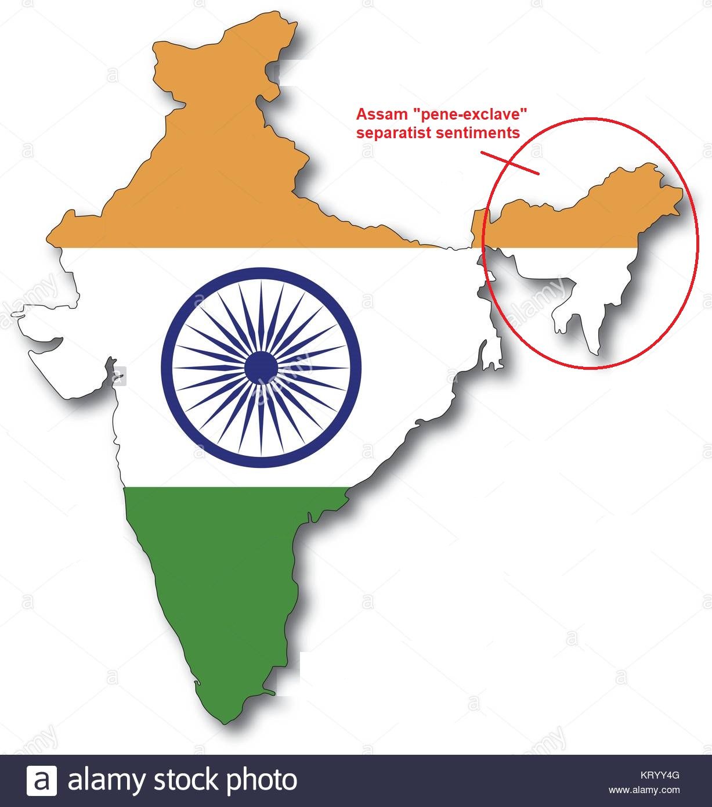
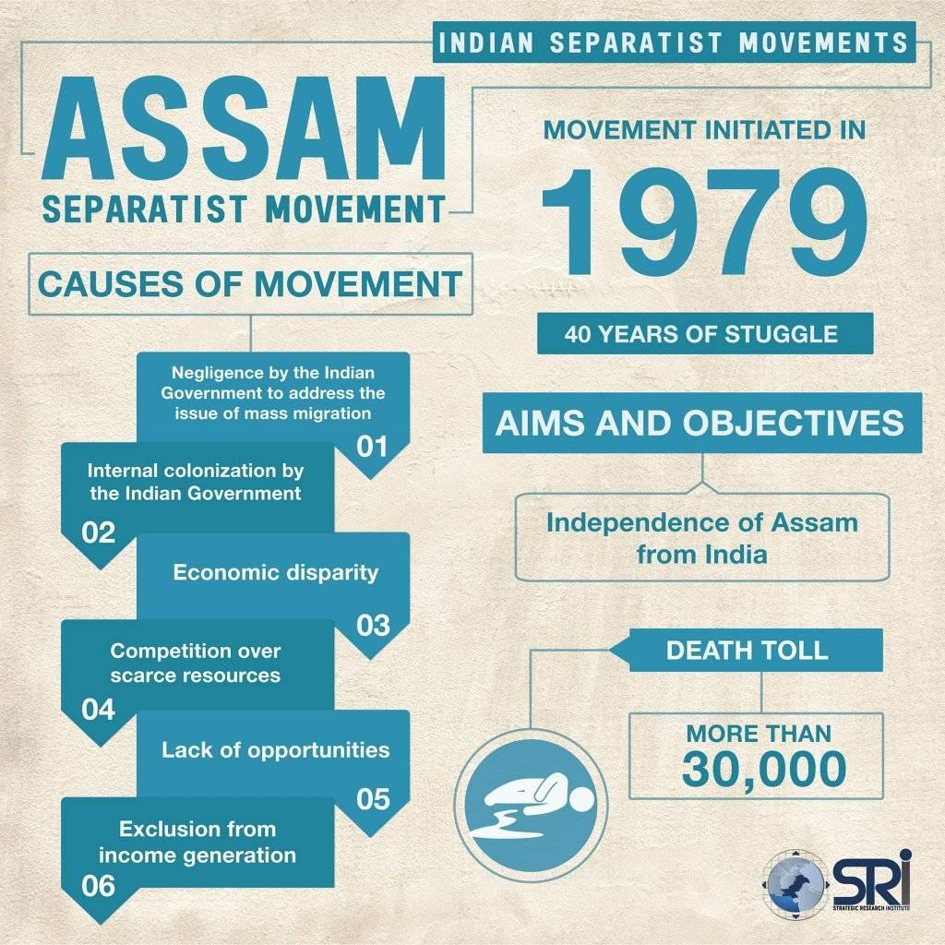
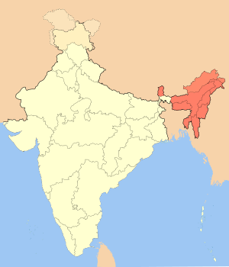
The isolation of the “Assam” proruption from the main body politic of India has led to separatist sentiments

Slide 10
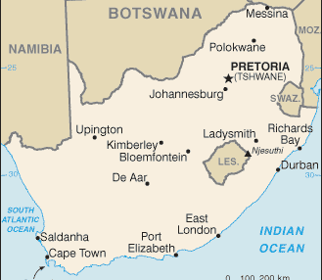
Perforated State
state that completely surrounds another.
Enclave — political area (sometimes just ethnic) surrounded by a country but not ruled by it
ethnic enclave is just a different ethnicity, so the state is not “perforated”
Italy = perforated
San Marino, Vatican = political enclaves
South Africa = perforated
Lesotho = political enclave
Centrifugal for So. Africa because Lesotho served as a place of safety/asylum/base of operations for apartheid dissenters
See West Berlin example
Centrifugal for Lesotho because they had to rely on South Africa for a lot of economic activities and infrastructure, had to deal with South African meddling in internal affairs

Slide 11
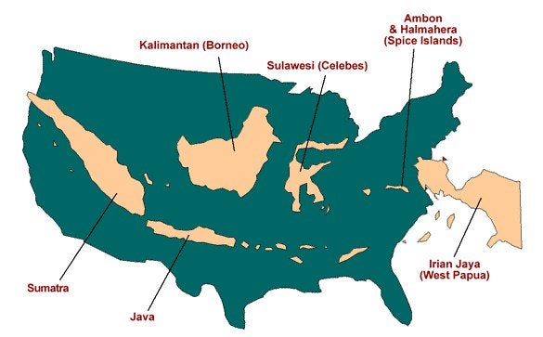
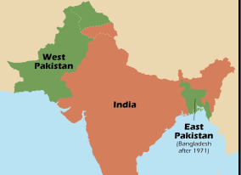
Fragmented State
Has several discontinuous territories
separated by water or an intervening state.
Hard to defend
Exclaves — Pieces of nat’l territory separated from the main body of a country by the territory of another
Effect is centrifugal
Isolated population may develop separatist feelings
Pakistan/Bangladesh
After partition (1947), Pakistan was a fragmented state.
The East feels isolated, neglected
East Pakistan → Bangladesh
Indonesia (very fragmented due to 17,000 islands) suffers from centrifugal forces
East Timor decl. independence in 2002

Slide 12
Landlocked States
all landlocked states outside of Europe = LDCs
Often the poorest countries in their region, Why?
limited access to international trade routes
dependent on neighbors (sometimes unstable)
increases cost of imports/exports

