Slide 1
Day Three Urban and Rural Ethnic Clusters

Slide 2
Ethnic Clustering
How ethnicity manifests itself spatially
Urban
Ethnic neighborhoods
Rural
Ethnic Homelands
Ethnic Islands
Ethnic Substrates
formal/uniform ethnic cultural regions occur in cities throughout the world
Why formal? Uniform characteristics. Everybody is the same ethnicity.

Slide 3
Urban ethnic neighborhoods and ghettos
ethnic neighborhood
a voluntary community (local culture) where people of like origin reside by choice to maintain cohesiveness, distinctiveness, authenticity.
benefits:
common use of language/nearby kin
stores and services tailored to tastes
institutions/services important to the group
churches, synagogues, mosques, temples
social services
educational facilities
ghettos = involuntary!

Slide 4
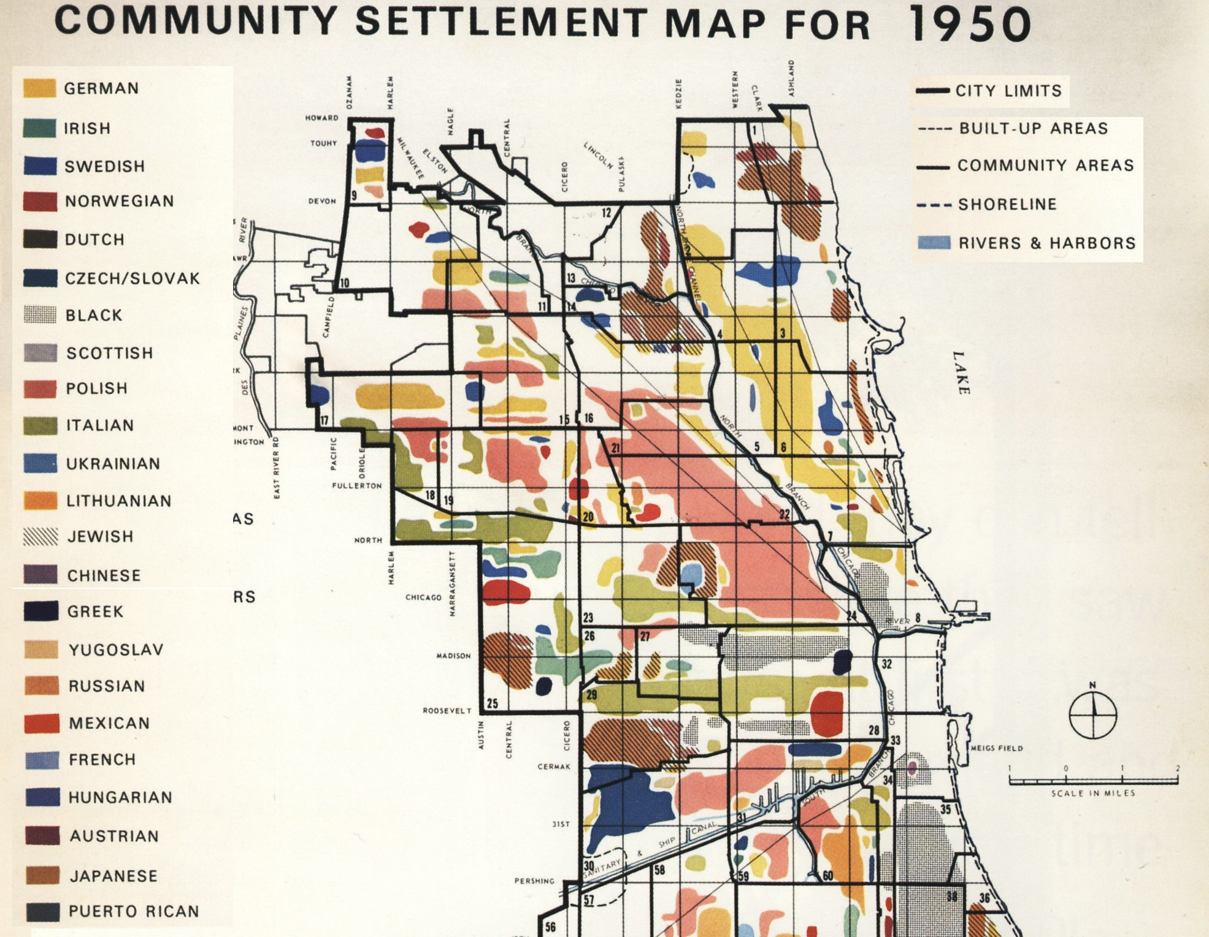

Slide 5
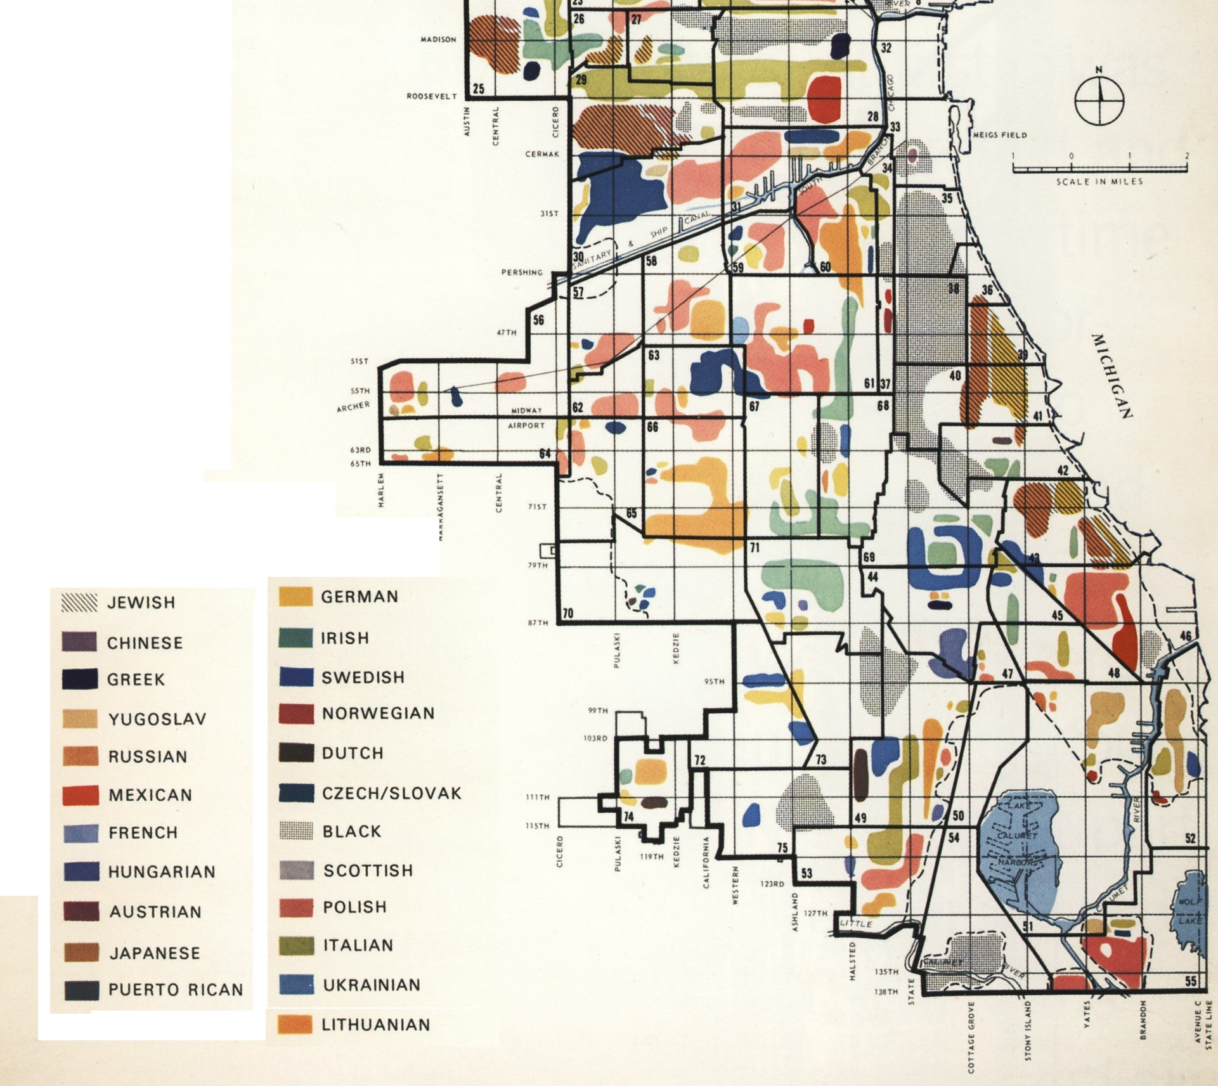

Slide 6
North American cities
By mid- 1800s became more ethnically diverse than other world urban centers (especially in the Rust Belt)
ethnic neighborhoods become more typical after 1840
Catholic Irish, Germans -1840s
Later 1880s - Italians, Poles, and East European Jews
non-European groups came later (mid-20th c) to cities —
southern blacks (Great Migration)
Puerto Ricans, Appalachian whites (Scots-Irish)
as immigration laws changed (post-1965), non-European ethnic diversity grew
Mexicans, Chinese, Koreans, Filipinos and Vietnamese comprise the new immigrant groups and neighborhoods
Little India (Devon Avenue)
Many W. Coast cities have big Asian pops. (Vancouver = 11% 1981)

Slide 7
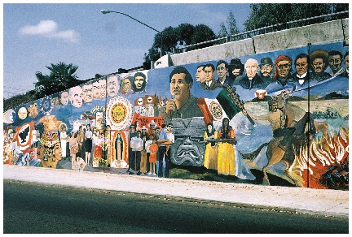
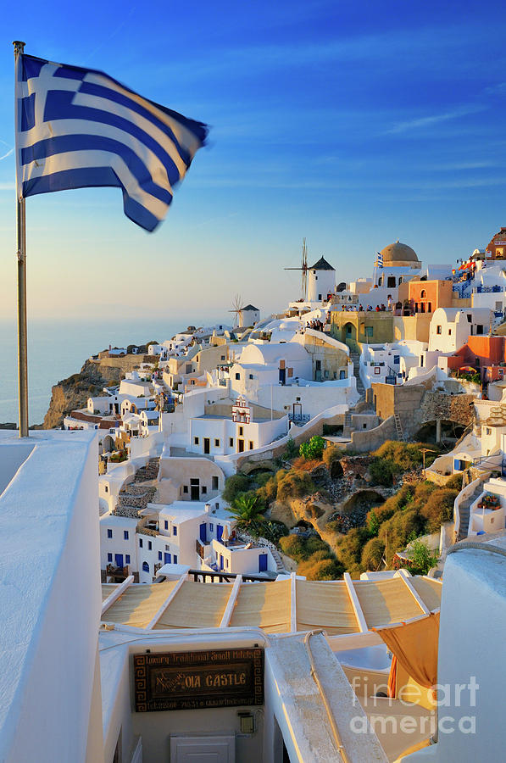
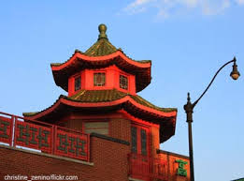
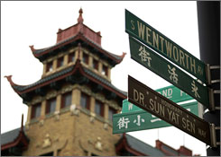
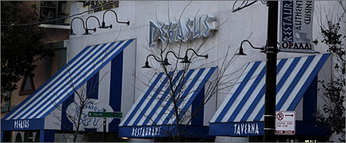
Ethnic Neighborhoods
Ethnic cultures affect built/cultural landscape
cultural practices (evidence of language/religion/other)
use of native language in signage, business names, etc.
wall murals found in Mexican-American neighborhoods
Chinese pagodas architecture
color preferences revealed in the landscape
Red is a venerated and auspicious color to the Chinese
Light blue is a Greek ethnic color, derived from their flag
Greeks avoid red, perceived as the color of their ancient enemy, the Turks
Green, an Irish Catholic color, but also finds favor in Muslim neighborhoods

Slide 8
Life Cycle of Urban Neighborhoods
Urban ethnic neighborhoods usually transitory (“changing”)
(Invasion and) Succession
Newly arrived immigrants settle closer to industry & ports and transportation located near Central Business District (CBD)
“point of entry neighborhoods”
Often one group is replaced by a later-arriving one
sometimes this transition results in conflict
Example:
Boston’s West End
Irish (19th century) → Jews replaced the Irish (early 20th century) → Poles and Italians replaced Jews (late 1930s)
As older groups acculturate, then assimilate, they move outward from CBD into less dense neighborhoods
perceived as “upward mobility” , the American dream.
clustering sometimes survives relocation to suburbs
“ethnoburbs”

Slide 9
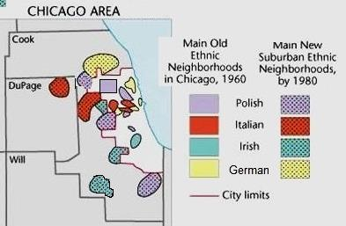

Slide 10
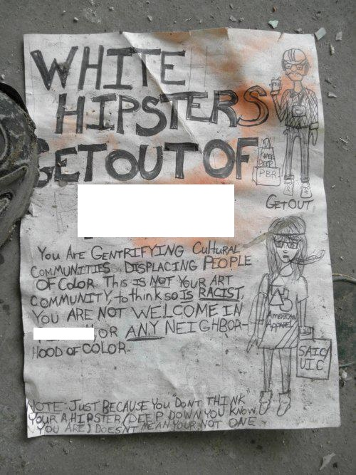
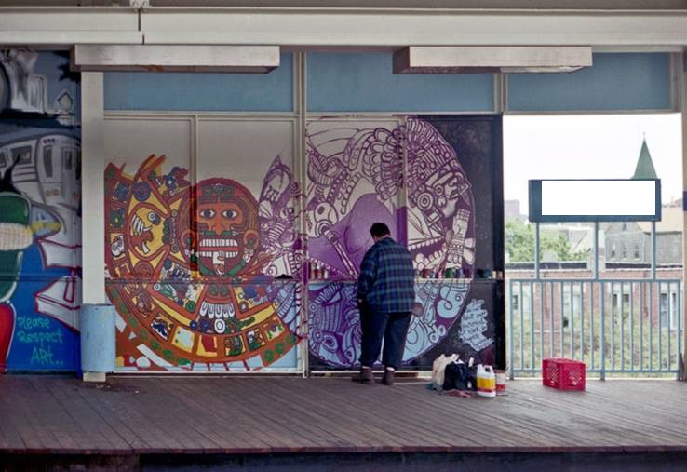
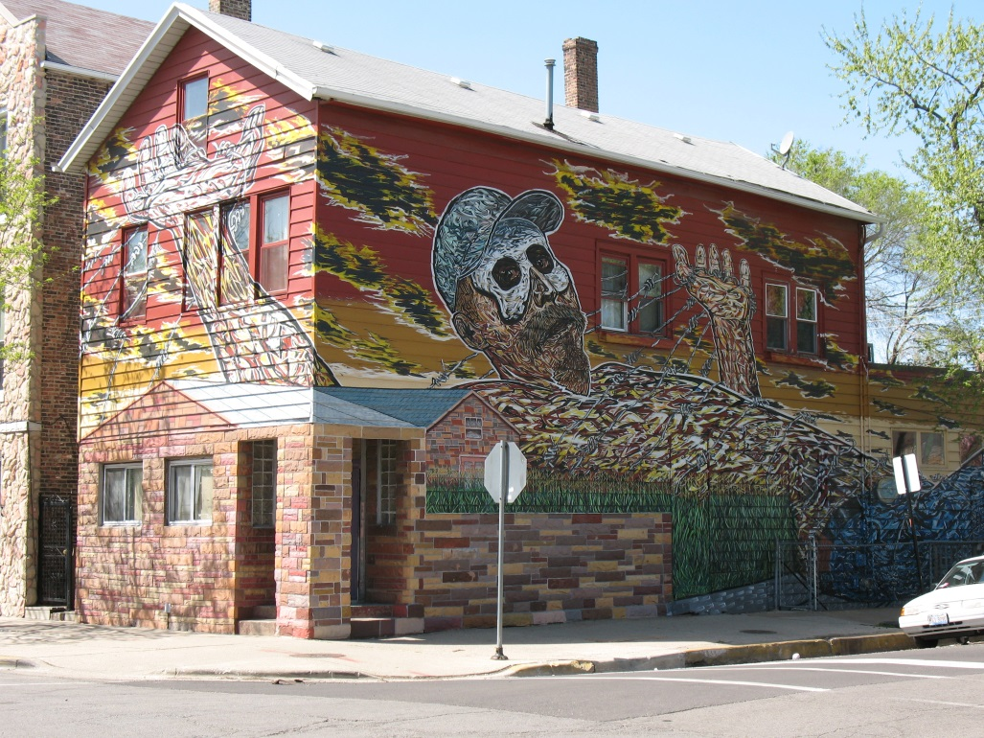
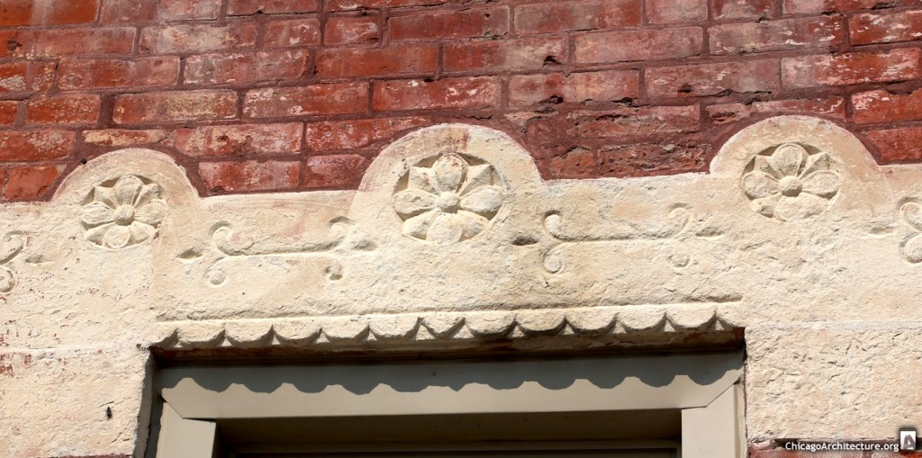
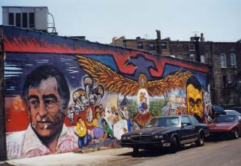
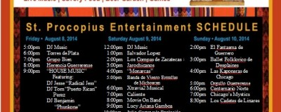
sequent occupance
visual evidence on the cultural landscape of the prior cultural groups having occupied a place.
shows succession
Each group leaves their mark
Example: Can you name this neighborhood?
point of entry neighborhood
Irish, Germans ⇒ Czech ⇒ Mexicans ⇒ hipsters
PILSEN

Slide 11
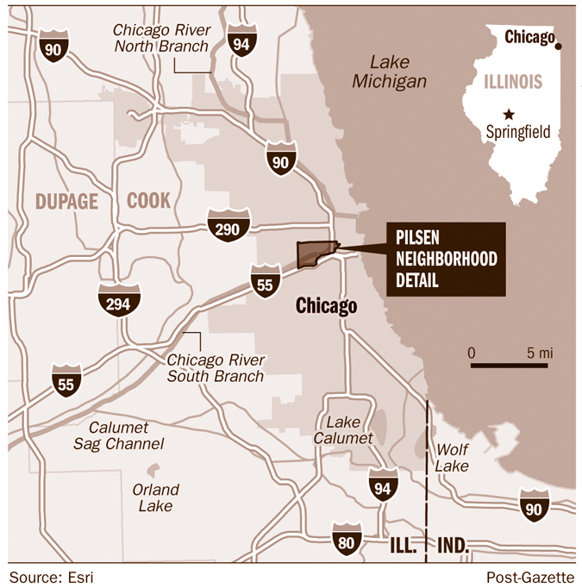

Slide 12
Ethnic geography (rural)
Please keep in mind that “rural” ethnic regions are not tested nearly as much as urban ethnic neighborhoods on the AP Exam
2 distinct types of rural ethnic regions exist
1) Ethnic homeland
ancient home territory
Becomes “ethnic” when their land was absorbed into a larger state
Examples:
Quebecois into British Canada
Basques into Spain
Native American reservations
Place and region provide a basic element of their ethnic identity

Slide 13
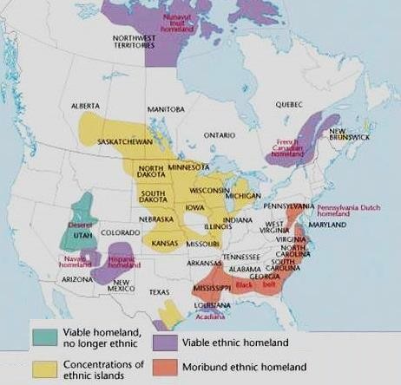
Ethnic homelands & islands

Slide 14
Ethnic geography (rural)
2 distinct types of rural ethnic regions exist
2) Ethnic islands
Rural clustering within a multi-ethnic society
Usually smaller than a county
home to only several hundred or several thousand
Goal: maximize interaction between group members
minimize exposure to the outside world
ideal shape = circular or hexagonal

Slide 16
Ethnic geography (rural)
2 distinct types of rural ethnic regions exist
2) Ethnic islands
Rural clustering within a multi-ethnic society
Usually smaller than a county
home to only several hundred or several thousand
Goal: maximize interaction between group members
minimize exposure to the outside world
ideal shape = circular or hexagonal
Could be the result of cultural preadaptation
The tendency of an ethnic group to seek out an environment like their homeland with which they are familar with the climate and consequently the farming practices

Slide 17
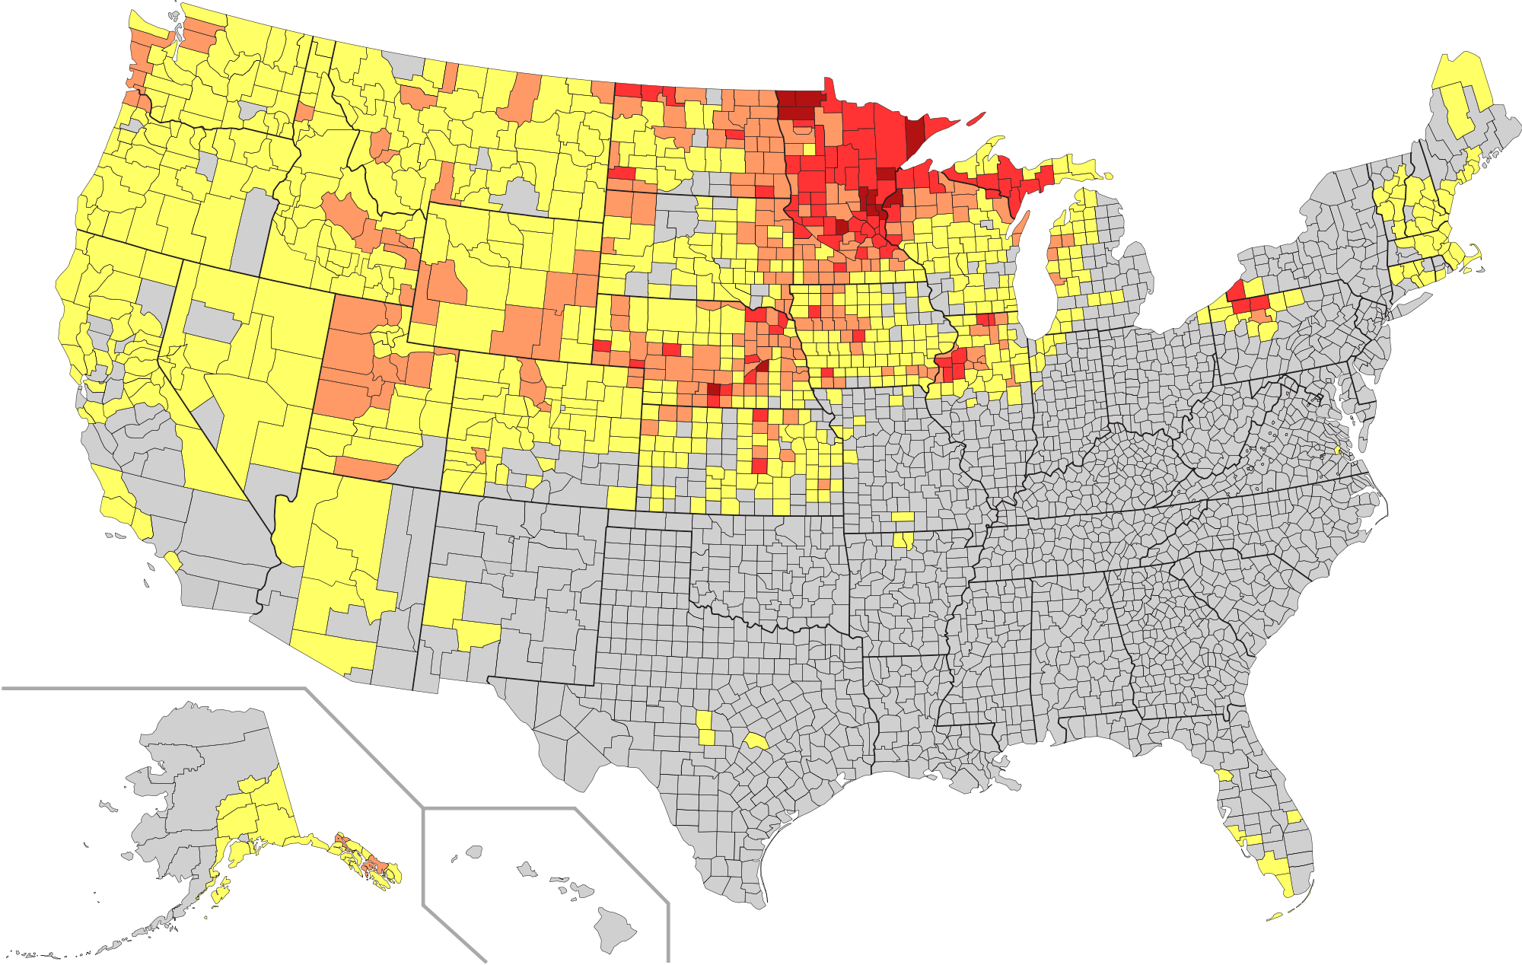
Scandinavians in the U.S.

Slide 18
Ethnic geography (rural)
2 distinct types of rural ethnic regions exist
2) Ethnic islands
How do ethnic islands survive generationally?
most land is inherited, sales confined to group
social stigma against sale to outsiders
However, smaller populations make ethnic islands more vulnerable to assimilation, Why?
Brain drain of young population/urbanization
Lack of mates, business contacts, people to sell land to.

Slide 19
Ethnic cultural regions
Ethnic substrate
ethnicity assimilated but cultural residue remains
provides an “unseen” cultural foundation
Native American influence on place names, foods, symbols, even government
German presence in American Heartland
helped shape cultural character of the Midwest heartland
and some would argue the nation
hot dogs, hamburgers, pretzels, beer
Santa Claus, Christmas trees, “Yule”,
Easter Bunny
kindergarten, vocational and physical education
Sunday recreation = picnic grounds, bandstands, sports clubs, concert halls, bowling alleys, and playgrounds

