Slide 1
Development Models

Slide 2
Paths to Development
self-sufficiency model
Over riding idea:
Barriers are established to protect local businesses
most common barriers = (1) tariffs (tax on imported goods), (2) quotas, and (3) restricting # of importers 4) government support for money-losing domestic businesses so they can maintain low prices.
“protectionism”

Slide 3
Paths to Development
International Trade Model/Rostow’s model of development
Relies on “free trade” & neo-liberal concepts
Five stages (know beginning and end and how they get there, differentiating between stages in the middle is not important, just understand the main ideas and process.)
Why is it seen as optimistic?
Japan, Four Asian Tigers, etc.
LDCs have tons of resources to exploit
Examples of international trade approach
The “Four Asian Dragons” or “Four Asian Tigers”
Taiwan, Singapore, South Korea, Hong Kong
“Baby Tigers” , “Tiger Cubs” “Asian cubs” following pattern
Malaysia, Thailand, Vietnam, Indonesia, Philippines
Petroleum-rich Arabian Peninsula states
Current example?
See “Ghana” article on website for how the International Trade Model works in real life.

Slide 4
Opposing models for the paths to Development for LDCs
Self-sufficiency model
Characteristics:
Use trade barriers to protect domestic industry
“we will make it ourselves”
develop national industries
Distribution/pace of dev. = even but slow
Investment spread across all sectors & regions in the economy
Goal is to reduce poverty over consumerism
Rostow’s Int’l Trade Model
Identify an “asset” the global market wants
Cheap labor, minerals, export crop etc.
Encourage foreign investment (FDI) or national elite with access to capital to exploit asset thru int’l trade
higher wages, modern technology, infrastructure, etc. diffuses from the one industry to benefit rest of the economy
End goal is a consumer economy w/ domestic demand, transition to services

Slide 5
International Trade Model of Dev. (Rostow) = relies on “free trade”

Slide 6
Limitations of the Opposing models
Self-sufficiency model
Two major problems:
Inefficient biz are protected
Large bureaucracy is needed to regulate and monitor barriers
costly
susceptible to corruption
growth of black market to avoid barriers
Rostow’s Int’l Trade Model
Often single commodity (not diversified) carries risk
depends on world price
could lead to loan default if price collapses
therefore, commodities are often leased and controlled by outsiders who keep lion’s share of profits
Wallerstein World Systems Theory
Ex. of “Dependency theory”
Neocolonialism or economic imperialism
income inequality w/in country
Elite grows rich but benefits never trickle down.
Corruption (Panama Papers)

Slide 7
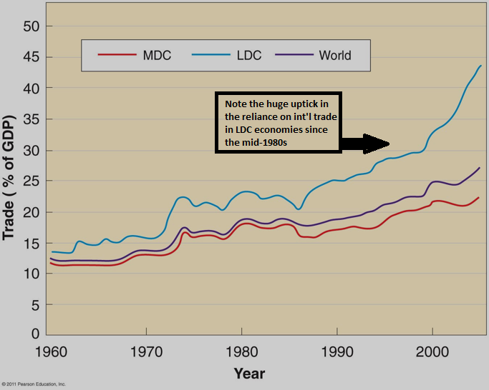
Self-sufficiency vs. Int’l trade approach Who wins?
International trade approach triumphs
Countries adopt because evidence shows that international trade is the more effective path toward overall development
Becomes favored circa 1980

Slide 8
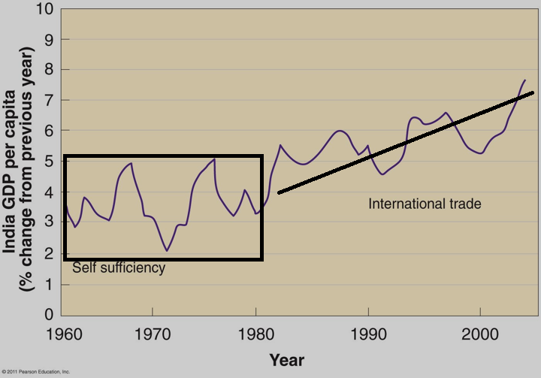
Triumph of International Trade Approach
Example: India
Economic growth has been consistently higher since switch to Int’l Trade Model.
Underlying economic ideas are:
Comparative advantage
Countries should concentrate on what they are best at producing (lowest cost/”comparative advantage”) and trade with others for what others are not best at producing. If everybody concentrates on producing what they have a comparative advantage in producing then overall trade and economic activity will grow.
Complementarity
When two regions/countries, through trade, can specifically satisfy each others demands. For example, the US makes many high-tech components that then are shipped to Mexico for low-skill, low-cost assembly. Many US products are sold in Mexico (its reciprocal)

Slide 9
“Neo-liberalism”
Dominant economic/political theory by end of 20th c.
Reduce govt intervention in markets
eliminate trade barriers (free trade)
privatize government functions
Example: CPS’ custodial staff no longer works for CPS they work for Aramark who won a contract for “cleaning services”
Result = custodian salaries/benefits cut, Aramark makes $, CPS saves $, filthy buildings as jobs are cut.
Favored (opposed) by:
Global institutions = WTO (World Trade Org.), IMF (Int’l Monetary Fund), World Bank all seek to protect global trade.
Multinat’l corps., Big Biz, Wall St. = Old School (pre-Trump) Republicans
Opposed by Trump, MAGA Republicans = economic nationalism, anti-China rhetoric
Bill Clinton, Pres. Obama, Rahm Emanuel = moderate “New “ Democrats since the 1990s (NAFTA, TPP = new free trade deal that wasn’t passed)
Opposed by Sanders/Warren = socialism, protect American workers from corporate power, reduce income inequality

Slide 10
International Organizations and Globalization

Slide 11
International Organizations
WTO (World Trade Org.) = referee on global trade
Enforces trade agreements
Helps reduce trade barriers = “free trade”
Allows for non-penalized retaliation or fines.
Eliminate restrictions on the movement of capital
Criticisms:
Left = anti-democratic, favors wealthy corps., ignores the poor
Right = national decision-making is sacrificed to outside authority

Slide 12
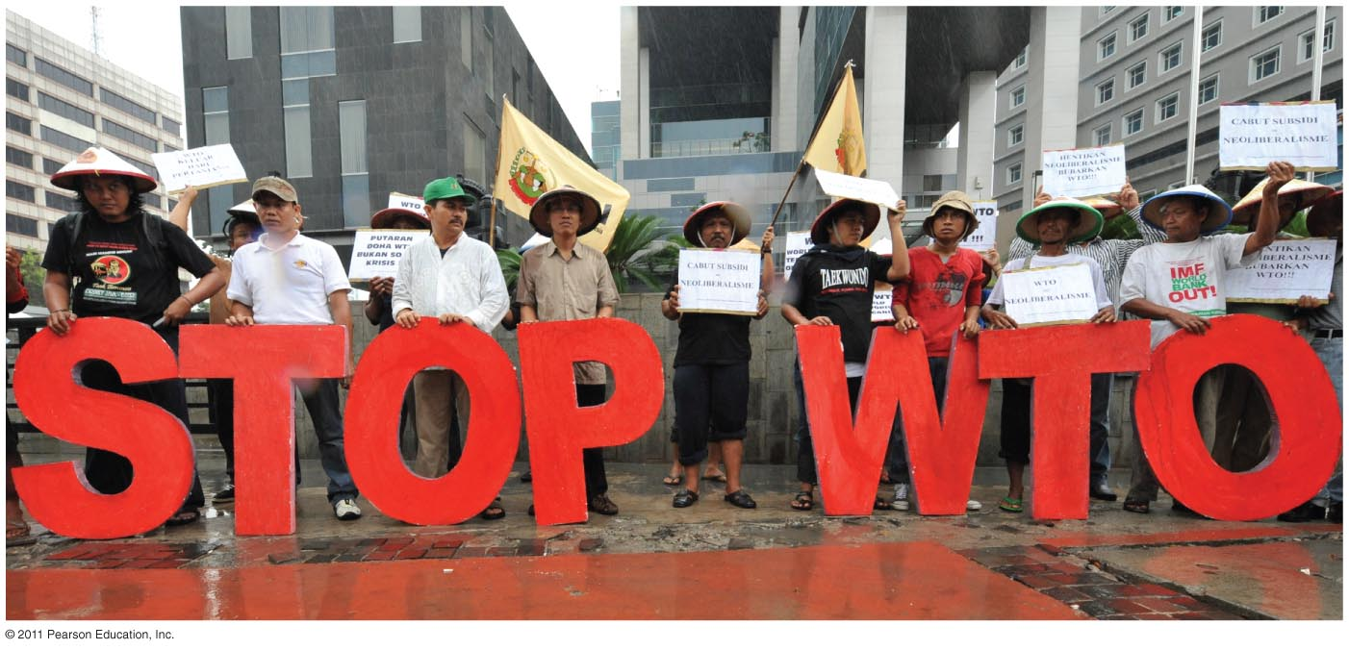
Notes:
FIGURE 9-29

Slide 13
Barriers to Development
Structure/geography of global economy
Wallerstein’s World Systems Theory
Dependency theory, countries are stuck in their role in the world economy because of its structure. Pessimistic
Example: Congo exploited by Western corps for cobalt, don’t get their fair share, can’t do anything about it (they are dependent!)
Social conditions
Lack of female empowerment (wastes productive assets)
Demographic trap (govt spending focused on dependency)
Lack of education (overall and gendered, no skills)
Disease
weakens labor force, creates orphans (malaria, HIV/AIDs)
Political Corruption and Instability
dictatorship, coups, corruption discourage foreign direct investment, why?
increased cost of capital (high risk → higher interest)

Slide 14
Biggest problem = Financing development
LDCs require money to fund development
FDI = foreign direct investment
Major source = transnational corps

Slide 15
Foreign Direct Investment

Slide 16
Financing development
LDCs require money to fund development
FDI = foreign direct investment
Major source = transnational corps
Int’l organizations as lenders (remember goal is to protect int’l trade and “global” economy):
The World Bank
Loans to make reforms, strengthen financial institutions, fund infrastructure projects
IMF (International Monetary Fund)
Provides loans to countries with debt payment issues
demand “structural adjustment programs” = austerity
realign spending, cut non-productive spending (pensions)
eliminate govt. bureaucracy, cut/privatize govt. jobs (often middle class jobs…CPS Aramark example)
reduce taxes will incr. econ. growth (“trickle down” theory)
Criticism is that middle/working class & poor end up paying for the bad decisions/corruption of the elite.

Slide 17
Non-governmental orgs. (NGOs)
Non-profits (Greenpeace, Doctors without Borders, Gates Foundation, Carter Center)
Usually have a specific focus (development, environment, peace, disease eradication (guinea worm example - Carter)
Criticism: some funds can be misappropriated → admin. salaries, expensive travel, you should check before donating, etc.
Example successful NGO development focused policy = microcredit program
Grameen Bank (Dr. Mohammad Yunus)
Loans to small entrepreneurs in LDCs (largely women) which are guaranteed by others in the village
98% repayment rate, incr. prosperity among women
Why is targeting women for development a good strategy?
Demographic impact (brings down CBR)
Socioeconomic impact (women use funds to feed children = decreases malnutrition, but also shows how culturally women are relegated to domestic sphere)

