Slide 1
Political Geography

Slide 2
Centripetal and Centrifugal Forces

Slide 3
Centrifugal force
Centripetal forces vs.
Attitude or force that unifies and enhances support for state
Attitude or force that divides and weakens support for a state
a single native language or
Any close nation-state
an “official” language (could be the colonizers)
English in India, Nigeria
revived Hebrew in Israel
Other homogeneous cultural factors
Catholicism in Poland
Catholicism in Republic of Ireland
patriotism, national symbols (anthems, flags, sports teams)
1980 Miracle on Ice
many native languages – “multilingual”
India (700+, 3 lang. families)
Canada (French and English)
Nigeria (Yoruba, Igbo, Hausa)
or almost all African countries
Other heterogeneous cultural factors
Muslims vs. Christians in Nigeria
Hindu vs. Muslims in India
Catholic vs. Protestant in Northern Ireland (UK)
desire for self-determination in multinational states (Yugoslavia)
language
religion
nationalism

Slide 4
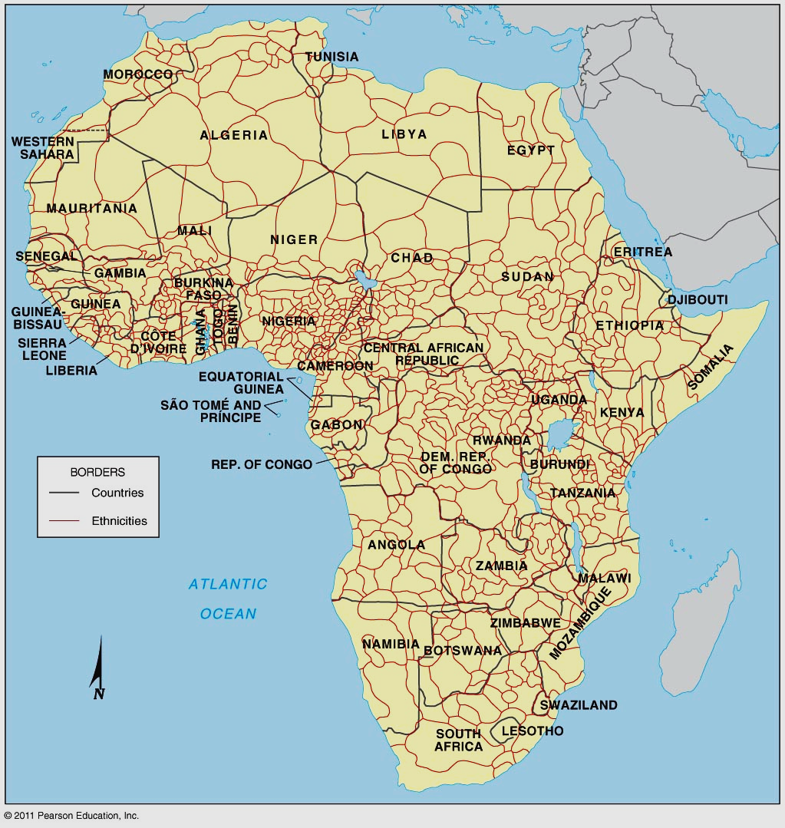
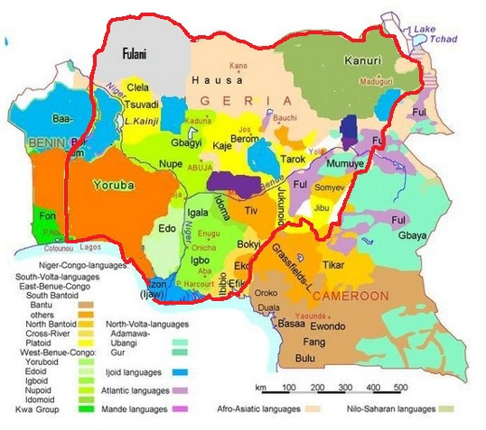
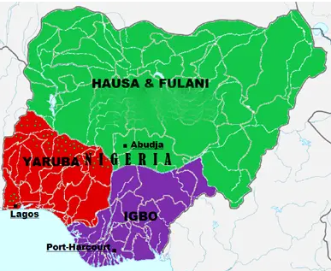
Ethnicities compete to dominate states in Africa
African borders do NOT correspond to ethnic groups
Legacy of imperialism
Scramble for Africa
SUPERIMPOSED!
Notes:
FIGURE 7-34

Slide 5
Ethnicities compete to dominate states in Africa

Slide 6
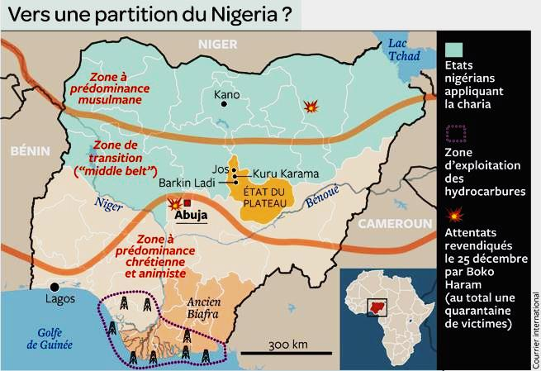
Ethnicities compete to dominate states in Africa
multilingual state
interfaith conflict
Shatterbelt/interfaith conflict, multilingualism, political corruption (often tied to ethnicity), competition for resources (oil in SE, grasslands in center), terrorism (Boko Haram), unequal wealth, Igbo separatism (Biafra Civil War)
Nigeria

Slide 7
Genocide vs. Ethnic Cleansing?
Genocide
intentional action to destroy a people (usually defined as an ethnic, national, racial, or religious group) in whole or in part.
6 million Jews killed by Nazis

Slide 8
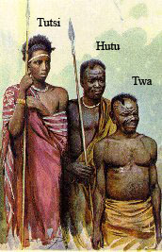
Ethnic Conflict in Africa
Rwanda
Hutu vs.Tutsi
ethnic divisions more “created” than real
hierarchy created by colonial Belgians
social construct
Tutsi made “privileged”
Hutus resent → take revenge in 1994
800,000 Tutsi and allies butchered over 100 days

Slide 9
Ethnic cleansing and genocide in Rwanda (1994)

Slide 10
Genocide vs. Ethnic Cleansing?
Ethnic cleansing
process in which a more powerful ethnic group forcibly removes a less powerful group from their territory
purpose is not to subjugate, but to remove
Post-WWII Europe
Yugoslavian Civil War
currently taking place in Myanmar as the Rohingya Muslims are being ethnically cleansed by Buddhists
article posted on website

Slide 11
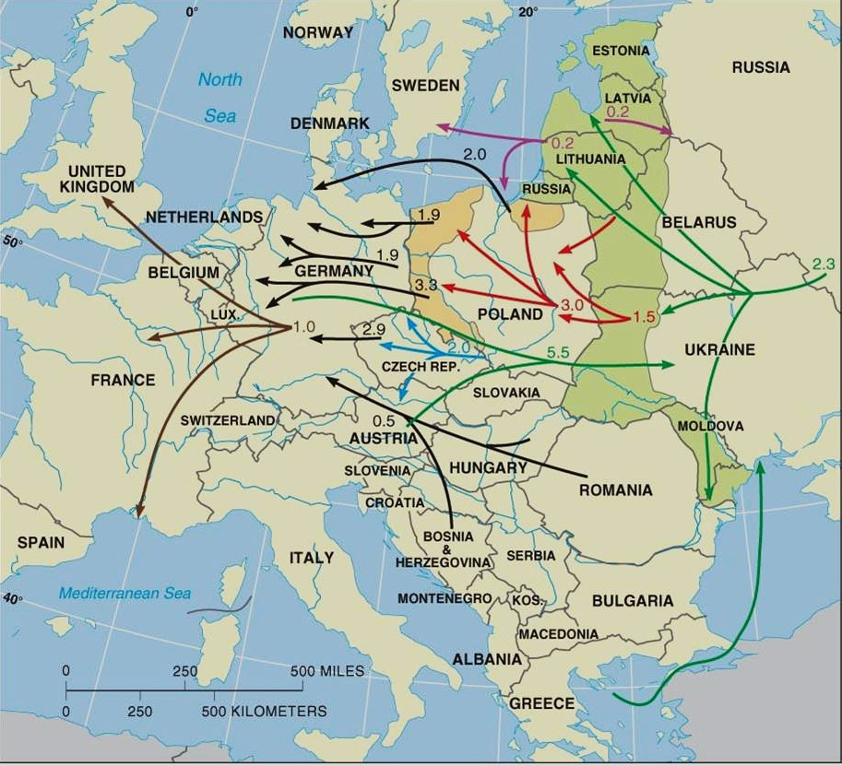
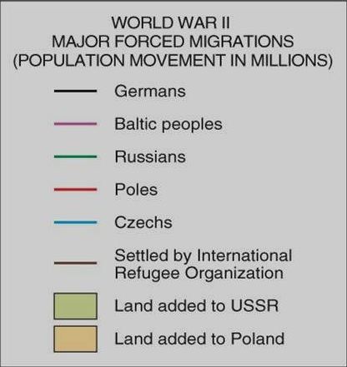
Ethnic cleansing in Europe
Post - WWII
Germans,
Poles
forced to “relocate”
Goals:
Construct a buffer zone for the USSR
New nations created along nation-state ideal
Subsequent/consequent borders (see next ppt)

Slide 12
Poland’s shifting borders

Slide 13
Centrifugal forces
Centripetal forces vs.
irredentism
superpower meddling (Africa, Latin America, Asia)
funding rebels, etc.
Dictatorship can be brutal and encourage dissent
Assad in Syria
poor governance, corruption, inequality
Incompetence can lead to “failed states”
Covid response
No regulation of ticket sales
Swifties?????
a common enemy may help to unite a people
For the USA
USSR during Cold War
Osama bin Laden after 9/11
Dictatorships can stifle dissent and other centrifugal forces therefore can be a centripetal force
Tito in Yugoslavia
Outside influences
Leadership or government (be wary of moral thinking here)
(see later ppts. for internal govt. structure as centrifugal, centripetal forces)

Slide 14
Centrifugal forces
Centripetal forces vs.
Physical Features
(topography)
Mountain ranges, oceans, deserts etc. can limit outside influences and bind a country together
Britain is an island
The oceans for the U.S.
Egypt along the Nile
Compact shape
Forward capitals spread development and link distant parts of country, central location can unify.

Slide 15
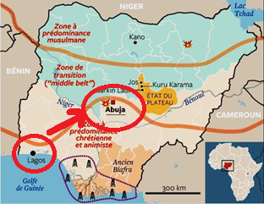
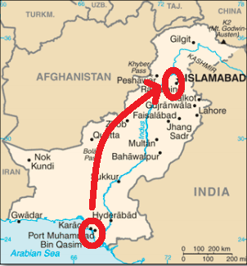
Forward Capital (construction/movement of the capital to achieve a goal…encourage development, political compromise, or to unify a country. Example of centripetal force)
Abuja, Nigeria
(also Brasilia, Brazil and Islamabad, Pakistan and Washington D.C.)

Slide 16
Topography as Centrifugal forces

Slide 17
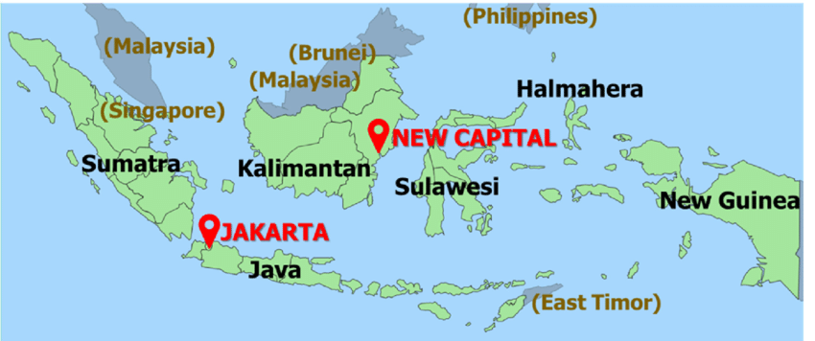
Indonesia tries to create a centripetal force to offset centrifugal topography
By building a forward capital (Nusantara) more centrally located within the archipelago

Slide 18
Centrifugal forces
Centripetal forces vs.
Physical Features
(topography)
Shape of state (see ppt.) and internal physical features can isolate populations and lead to separatism
Russia’ vastness has been a centrifugal force throughout its history
Indonesia’s islands create separate communities
Enclaves and exclaves can destabilize
Mountain ranges, oceans, deserts etc. can limit outside influences and bind a country together
Britain is an island
Egypt along the Nile
Compact shape
Forward capitals spread development and link distant parts of country, central location can unify.

Slide 19
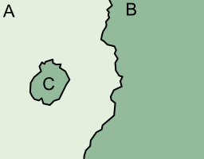
Exclaves/Enclaves
Exclaves — Pieces of national territory separated from the main body of a country by the territory of another
Hard to defend
Conflict with intervening state who may make claims (to them the territory/ethnicity is an enclave)
Enclave: A territory/ethnicity completely surrounded by another state/ethnicity
Isolated population may develop separatist feelings

Slide 20
Exclaves/fragmentation can be centrifugal
East and West Pakistan
Once one country but fragmentation (see “shapes” led to civil war and Bangladesh declared independence in 1971

Slide 21
Exclaves (Kaliningrad is an exclave of Russia, but not an enclave!

Slide 22
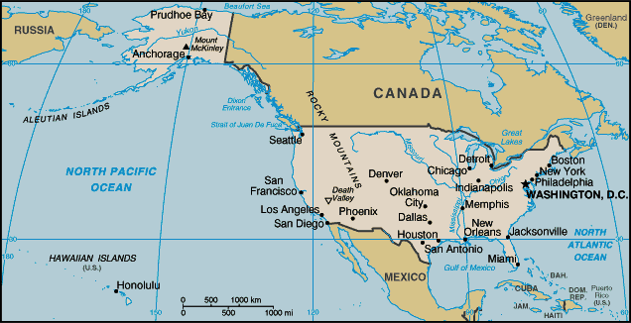
Alaska is an “exclave” of the US, Hawaii is not. Do you understand why?

Slide 23
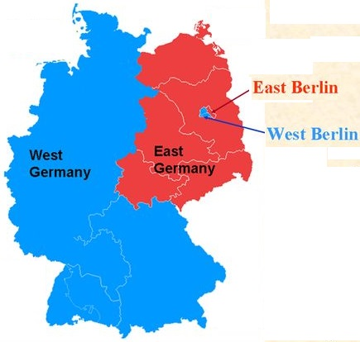
West Berlin was an exclave of West Germany. It was an “enclave” and centrifugal force within East Germany. Can you tell me why?
West Berlin serves as an escape route for East Germans
Brain drain
Prosperity and consumerism in West Berlin makes East Germans doubt communism
Western propaganda broadcast out of West Berlin

Slide 24
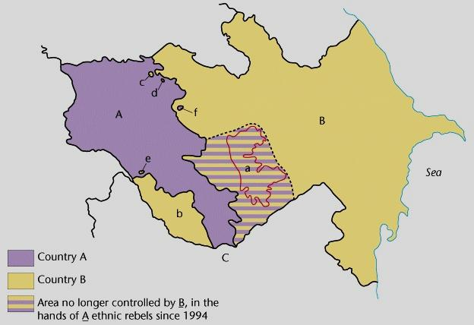
Enclaves/Exclaves

Slide 25
Centrifugal forces
Centripetal forces vs.
Physical Features
(topography)
Infrastructure
Shape of state (see ppt.) and internal physical features can isolate populations and lead to separatism
Russia’ vastness has been a centrifugal force throughout its history
Indonesia’s islands create separate communities
Enclaves and exclaves can destabilize
Less developed countries lack infrastructure. This may isolate areas and become a centrifugal force.
Physical barriers along borders (mountain ranges, oceans, deserts etc. can limit outside influences and bind a country together
Britain is an island
Egypt along the Nile
Compact shape
Forward capitals spread development and link distant parts of country
More advanced countries have things like airports, railroads, highways and the internet which allow people to remain in contact, people to move within the country, etc.

Slide 26
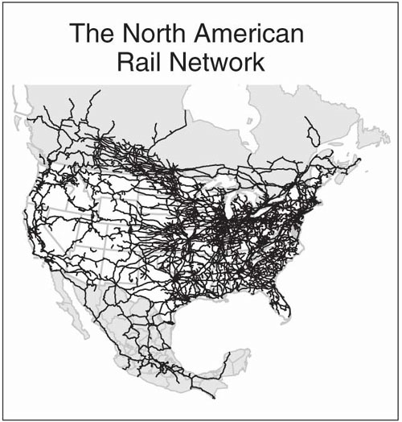
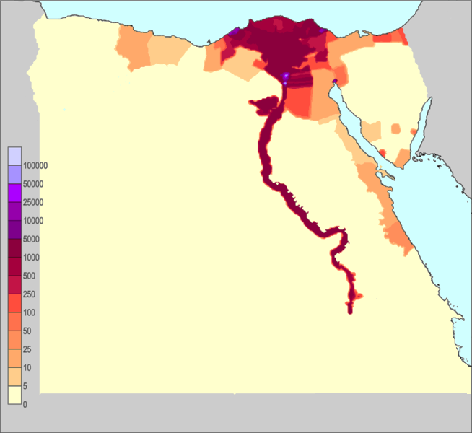
Topography and Infrastructure as Centripetal forces
Egypt’s topography isolated it from outside influences during ancient times leading to stable dynasties that lasted centuries. Its concentration along the Nile kept people united.
Developed transportation and communication systems can bind a country together and strengthen support for the state

