Slide 1
The Geography of Identities

Slide 2
Day Two Ethno-racial Clustering and Segregation

Slide 3
U.S. population (2019)

Slide 4
U.S. population trends through 2060

Slide 5
Distribution of minority groups w/in the U.S.

Slide 6
Distribution of ethnicities w/in the U.S.
Geographic distribution of ethnicities
European Americans also have distinctive clustering due to earlier waves of chain migration (but this has lessened due to assimilation, suburbanization and a lack of segregation)
Minority (Hispanic Americans, Black Americans, Asian Americans and Native Americans are clustered across three scales:
regionally
Minorities are clustered in different regions of the US (Southwest, Southeast, etc.)
in urban vs. rural areas
(more likely to find a person of minority descent in a city/suburb than in small town/farm)
within urban areas (neighborhoods)
Minority groups are often segregated in different neighborhoods within cities

Slide 7
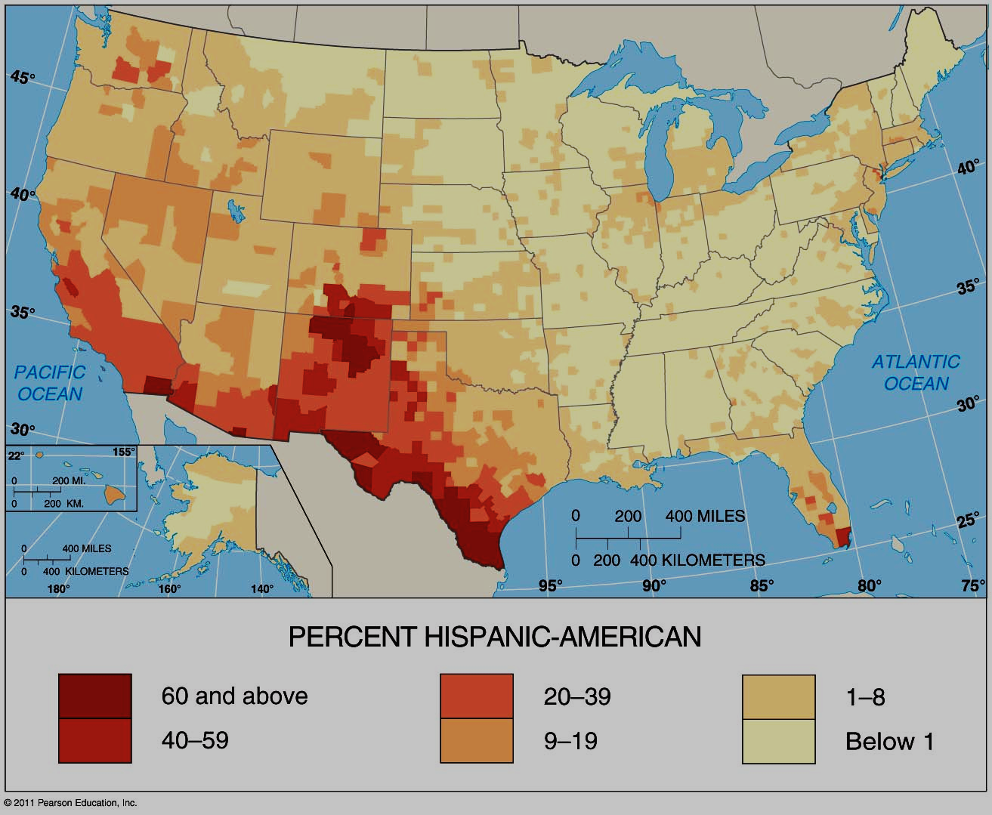
Clustering of Hispanics in the U.S.
Mostly in CA, TX, (NY and FL)
Gravity model
Areas farther from source tend to be larger (Chicago, NY etc.)
in SW
more evenly dispersed between rural and urban areas
In Northern states
concentrated in cities
NYC = ¼, but NY = 1/16
2/3rds of Hispanics are Mexican, but
NY ↔ strong Caribbean influence (PR/Dominican)
FL ↔ Cuban

Slide 8
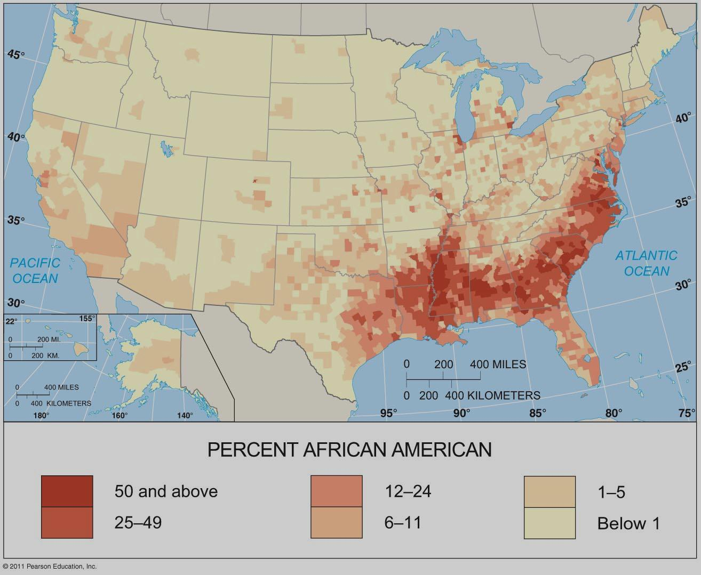
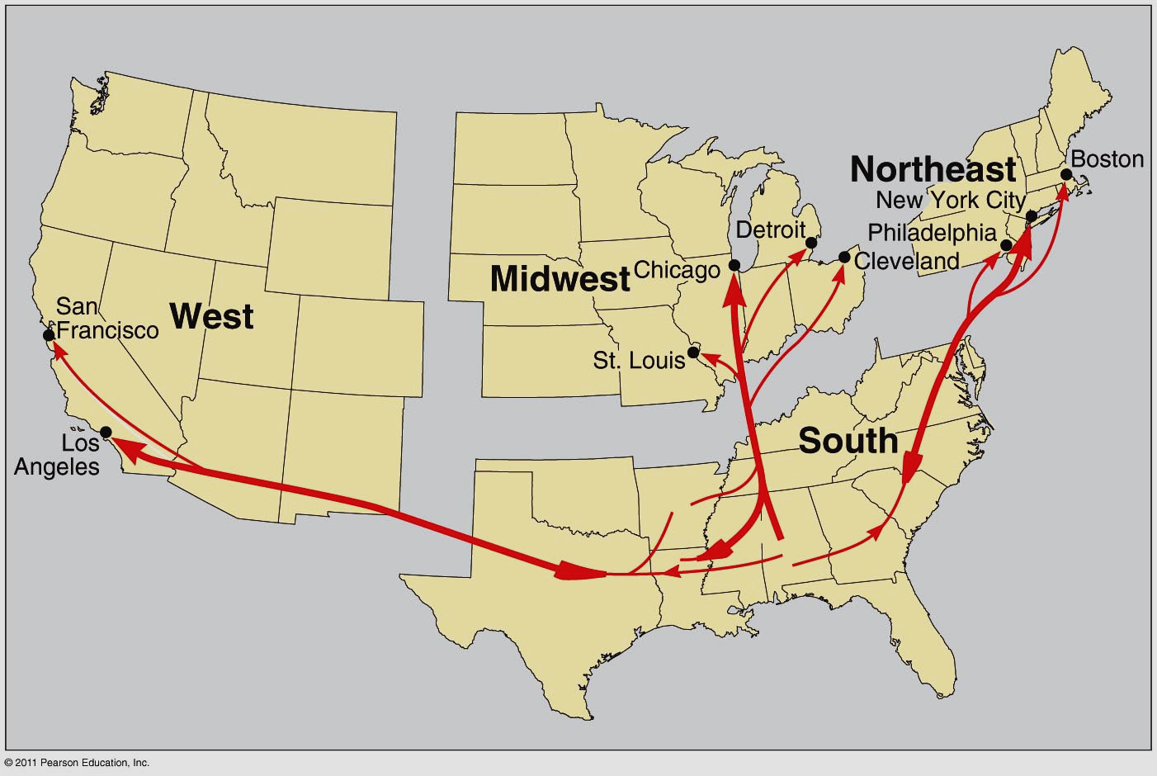
Clustering of African Americans in the U.S.
Clustered in SE
legacy of slavery
Northern cities
“Great Migration”
Segregation leads to spatial distribution
In South
“separate but equal”
Plessy v. Ferguson (1896)
“de jure” = by law, Jim Crow laws
ghettoization in North
de jure = restrictive covenants
“de facto” = by custom
economics

Slide 9
Differences in clustering outside of “hearth”
Mississippi
Illinois

Slide 10
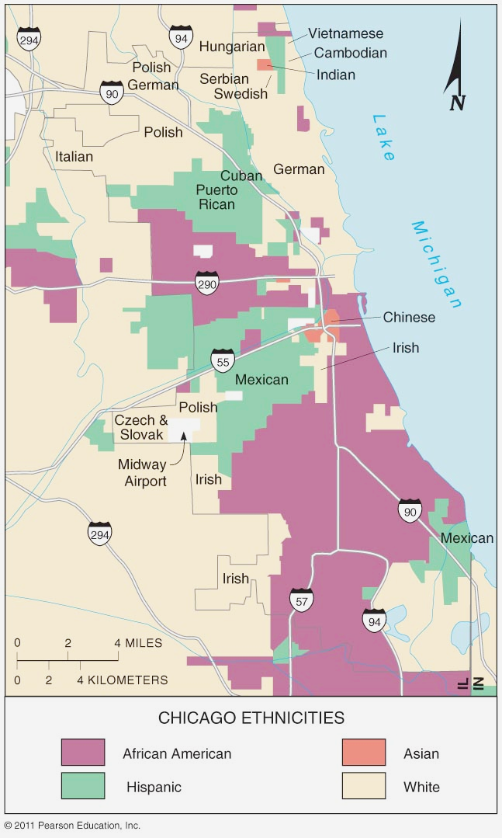
Concentration of minority groups in cities and in certain neighborhoods (residential segregation)
90% of minorities live in cities
Result is spatial effect of racism
ghettoization/“barrioization”
∆ to largely Hispanic pop.
redlining
loans not made in certain areas
leads to disinvestment, disrepair
restrictive covenants
limited what a future owner could do (“who they could sell to” No Blacks, Jews, Catholics, etc.)
A Raisin in the Sun (Lorraine Hansberry)
Spatial expansion of minorities
Civil Rights movement (1950s/60s)
restrictive covenants struck down (1948)
blockbusting
Real estate agents play on fears to make $
Leads to “white flight”
Large scale emigration of white middle class to the suburbs
furthers segregation
inner city = black, suburbs = white
Segregation is declining slowly but still a problem

Slide 11
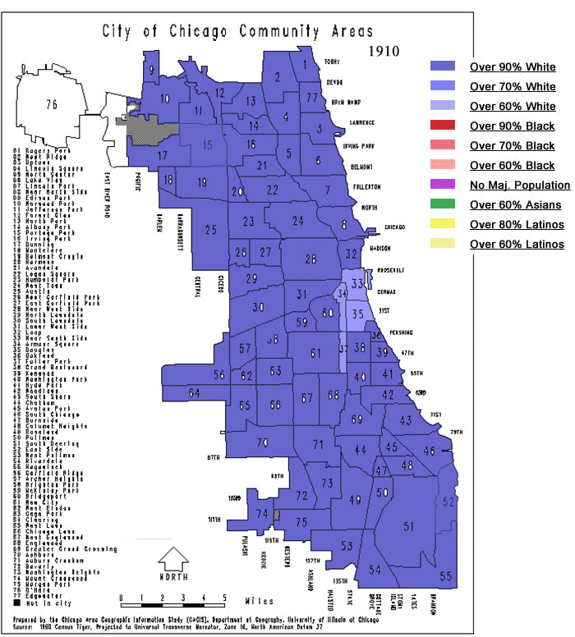
1910
Chicago predominantly white ethnic
Tomorrow we will discuss “Ethnic neighborhoods”
Many outlying neighborhoods still farmland

Slide 12
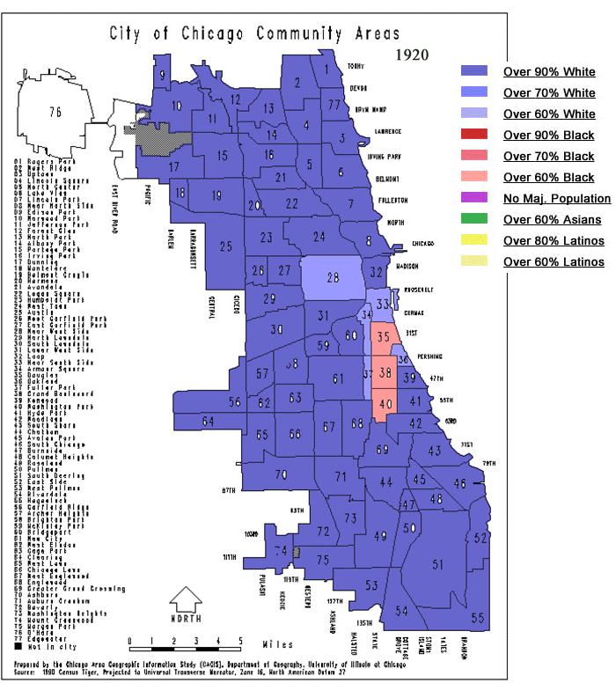
As the Great Migration begins
Blacks are clustered in the “Black Belt”
High poverty
Overcrowded substandard housing owned by absentee landlords
Buildings in disrepair
Rents are high
African Americans have little political sway to combat these abuses

Slide 13
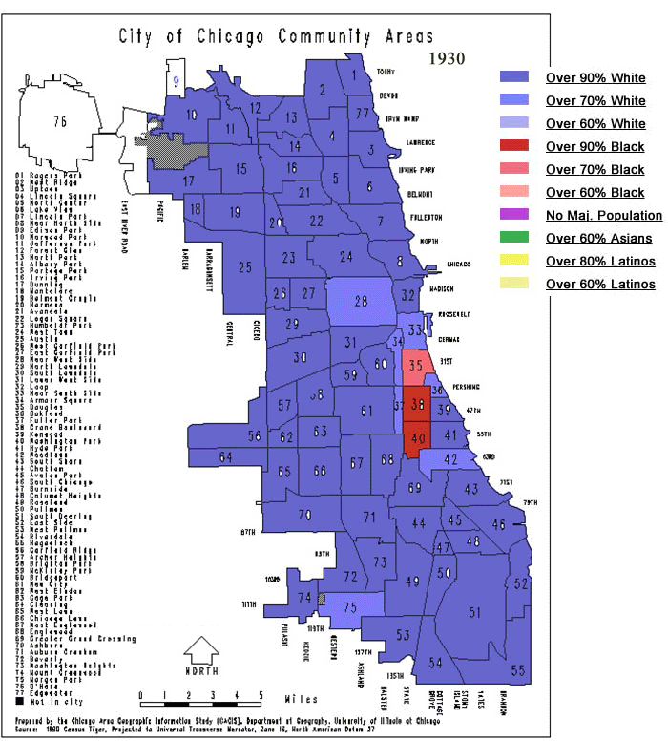
Note the density of Black residents in the “black belt”
reflects ghettoization
Redlining (later) and other housing discrimination policies are keeping African American residents in a high poverty, socially isolated areas.
Yet despite this…
The Stroll and Bronzeville develop as a black cultural hub like Harlem in NYC.

Slide 14
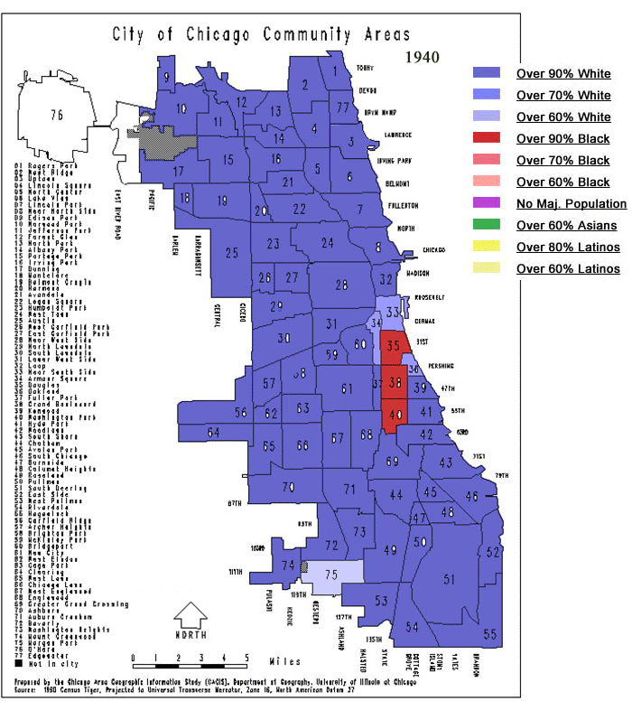

Slide 15
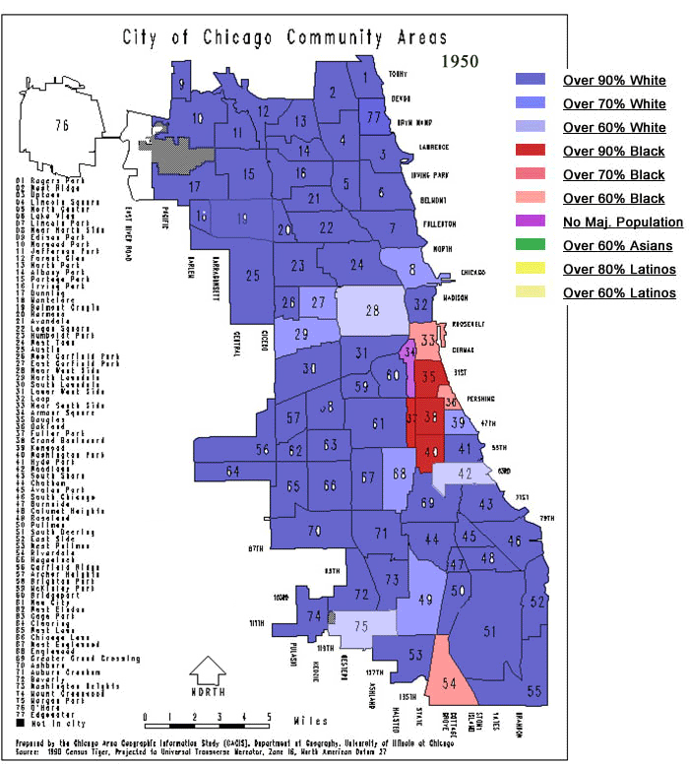
By 1950
Early Civil Rights wins!
Restrictive covenants are struck down
African-Americans begin to expand out of the black belt
Face hostility in areas where they move
Highways constructed
Growth of suburbs begins
White flight begins

Slide 16
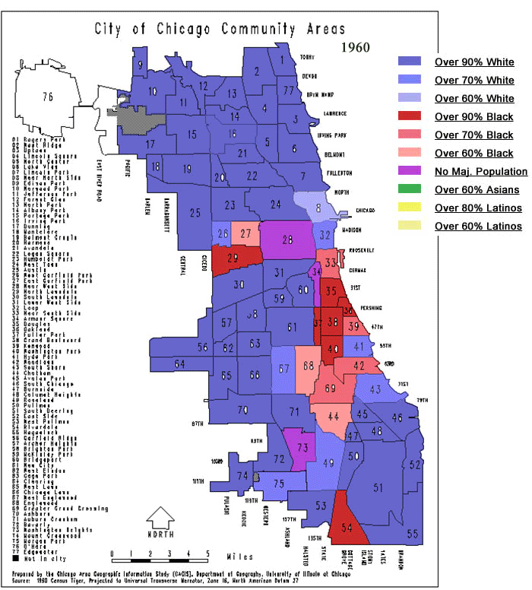

Slide 17
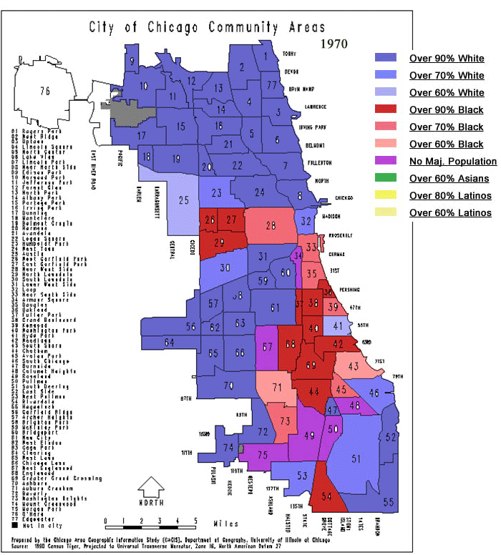
Blockbusting
Real estate agents play on white racist fears of property value decline to encourage rapid neighborhood change
accelerates white flight and suburbanization

Slide 18
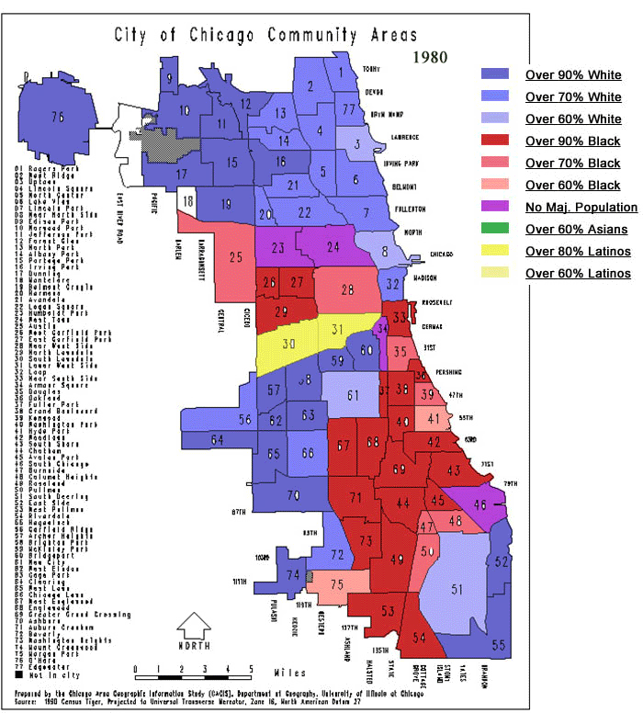
Note addition of majority Hispanic neighborhoods
Reflects changes made in the Immigration and Naturalization Act of 1965 which allowed non-European migration into the US
Reflects 15 years of immigration from Mexico

Slide 19
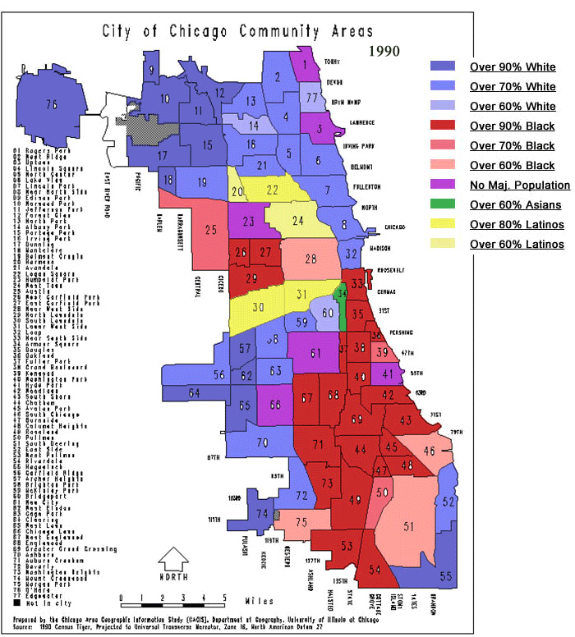
Note expansion of newer immigrant minority groups
Hispanics on the NW and SW sides
Asian in #34 (Chinatown)

Slide 20
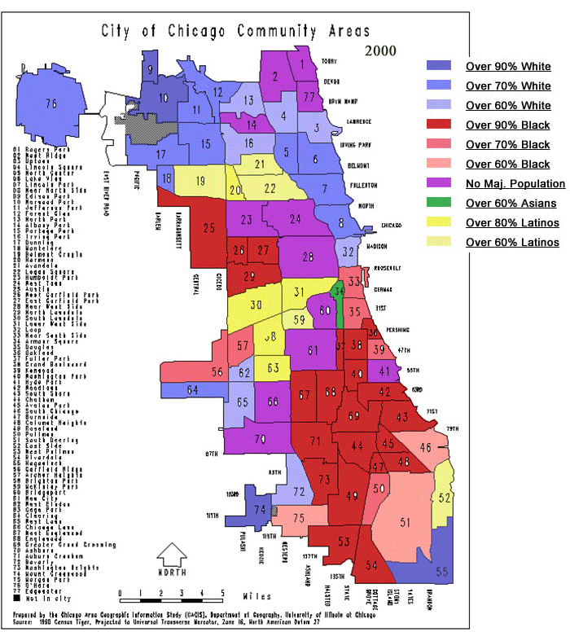
New dynamic
Minority areas expand but they are also being “pushed” outward from the city center
shift from minority majority in areas #25 (Near West Side) and #24 (West Town) from Black/Hispanic majority to “no majority”
change from “no majority” to white majority in #5 (Uptown)
Black % declines in #33 (Near South Side) and #35 (Douglas)
This is due to gentrification
We will discuss this phenomenon in our urban unit

Slide 21
Know why this happened?
1910
2000

Slide 22
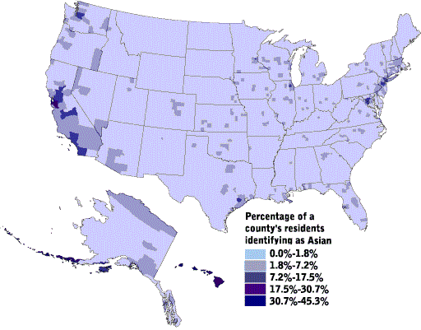
Asian Americans are concentrated on the West Coast and in some select cities. How would laws/models explain this?

Slide 23
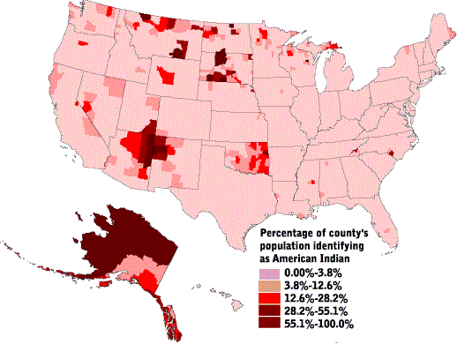
Native Americans are concentrated in the SW, Upper Great Plains and Alaska. This distribution represents a legacy of Indian Removal policies in the East, the Reservation System and Inuit folk culture (threatened).

Slide 24
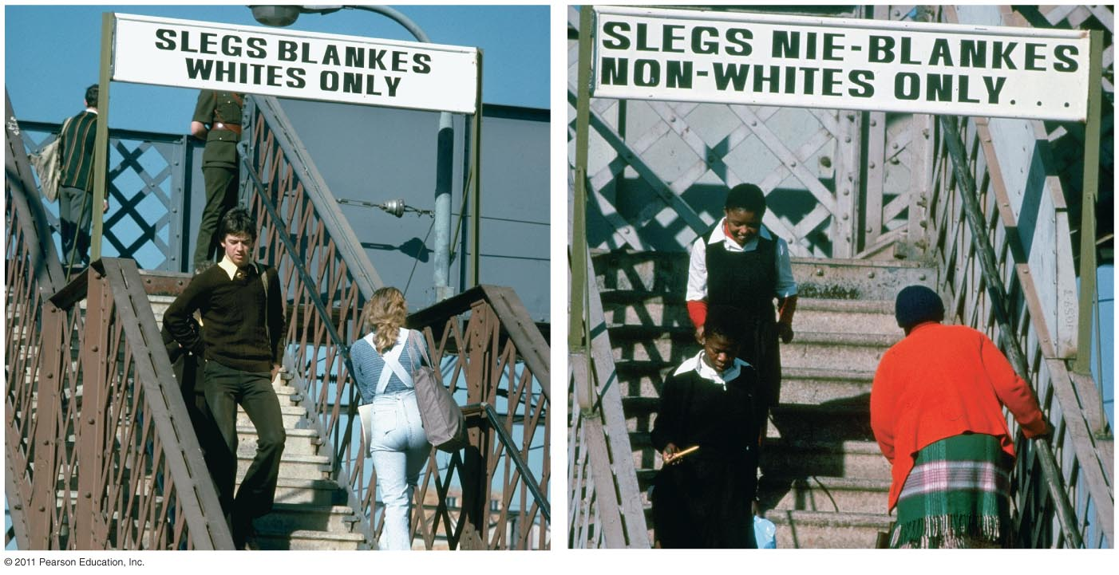
Legalized Segregation in Other Countries
Apartheid (Jim Crow on steroids)
Policy of racial separation by white South African govt.
Pass laws, Bantustans, racial classification
Black (70%) White (18%) Coloured/Mixed (9%), Indian (3%)

Slide 25
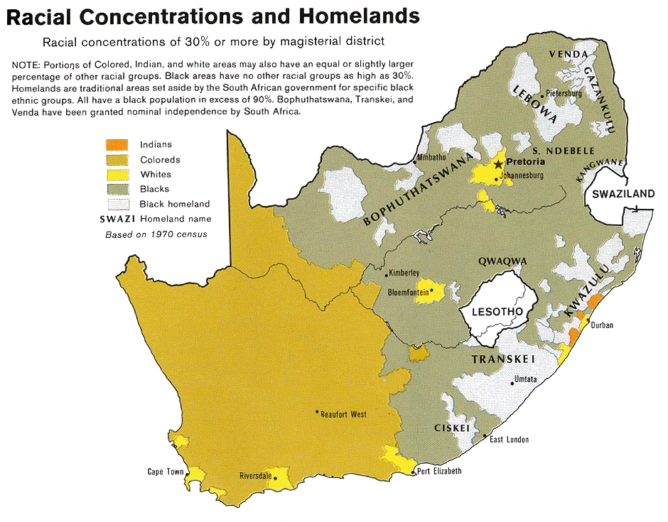

Slide 26
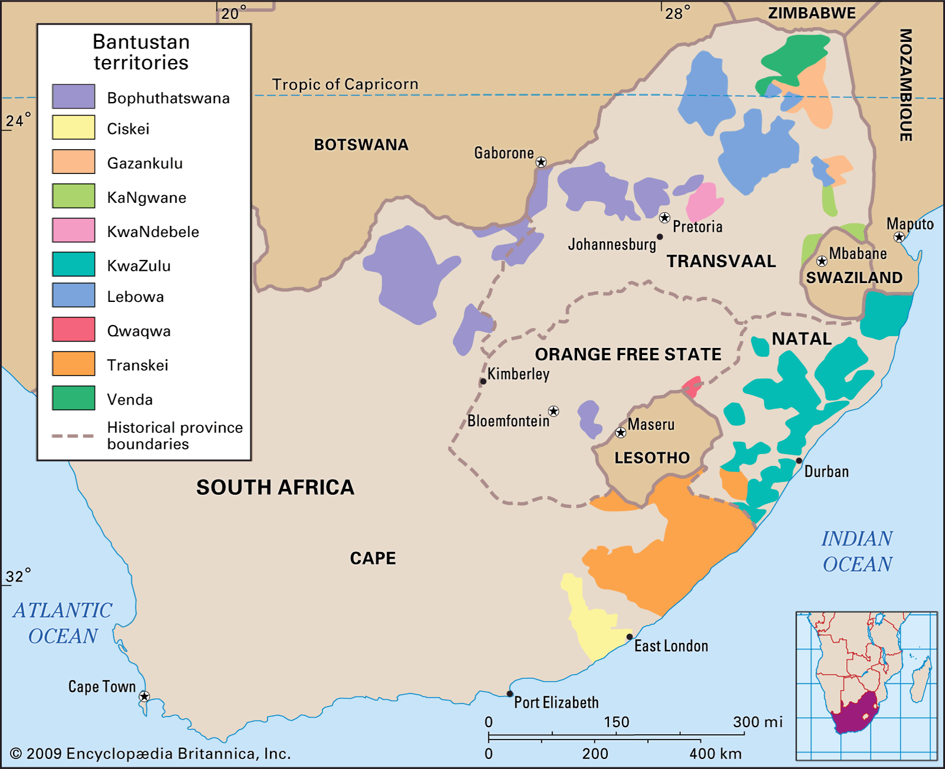

Slide 27
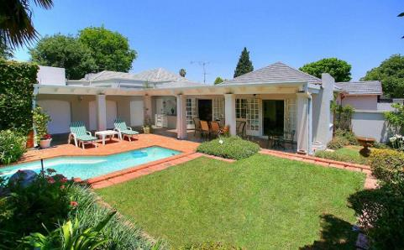

Slide 28
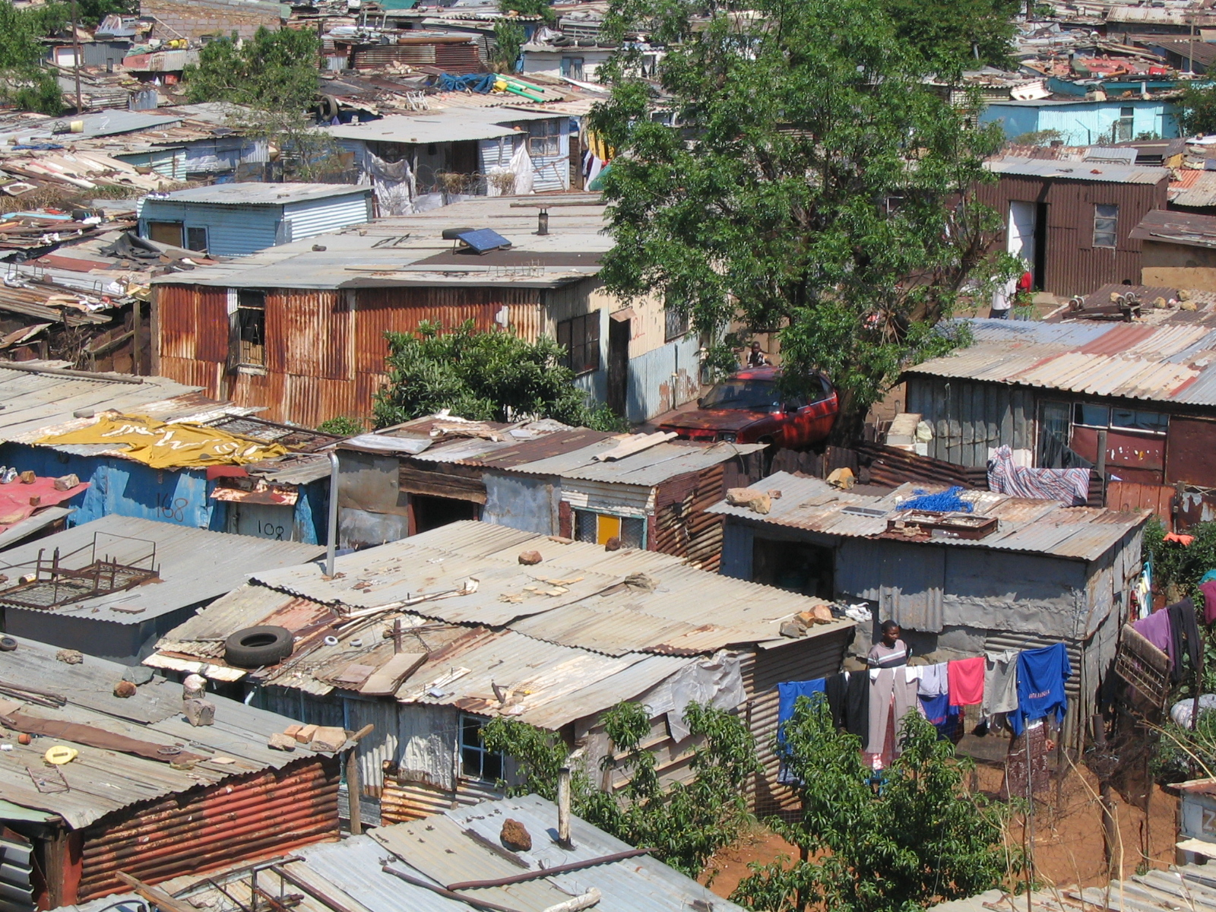

Slide 29
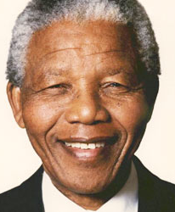
Apartheid in South Africa
End of Apartheid (begins in 1980s)
sanctions & disinvestment
Economic penalties, withdrawal of funds from South Africa convince white South African government to end apartheid
Nelson Mandela
Wins first all racial elections
1st black president (1994)
agrees not to seek revenge in exchange for whites and their investment remaining in South Africa
leads to political BUT NOT economic equality

