Slide 1
Demographic Transition Model (Unit 2)
Objective:
interpret and apply theories of population growth and decline,
understand how the DTM is used to explain population change over time + space.
identify stages of the DTM through the movement of CBR, CDR, and NIR/total pop.
understand demographic statistics and their relationship with each other and development
understand the economic and societal factors that affect demographic statistics

Slide 2
The Demographic Transition Model
Theory of how population changes (5 stages) as a country develops (from high birth/death rates → low birth/death rates).
Displays changes in CBR, CDR, NIR as country develops.
Also provides insight into migration, fertility, economic dev., industry/urbanization, labor, politics, + female empowerment.
As APHG students, you should begin talking about countries based on where they are on the DTM.
By placing a country on the DTM, you are defining the population dynamics + economic context of the country.

Slide 3
Demographic Transition Model
Assign CDR, CBR, Total Population colors. Label them on your paper (see above).
WRITE SMALL.
We will start with Stage 1:
What is CDR + CBR? How is each measured?
CBR = # of live births / 1,000 ppl per yr
CDR = # of deaths / 1,000 ppl per year
Notes:
It should say Crude Birth + Death Rates (left) + Total Population (right). LABEL with 3 separate colors.
“What is CBR + CDR? How are they measured?”
“What does having a high CBR/CDR tell you about a country?”
“What does a low CBR/CDR tell you about a country?”

Slide 4
Stage One

Slide 5
Stage 1: “High Stationary”
Other names: Hunting/gathering; Early Agricultural
No country in world is @ Stage 1, but *most of human history was Stage 1 (hundreds of thousands of years).
Examples:
Most of human history, today only a few remote groups (Amazon rainforest tribe), only countries that are in temporary crisis
Birth Rate (CBR) + Death Rate (CBD)?
CBR: High (>25)
CDR: High (>25)
Notes:
“Does anyone know the country that 1st entered Stage 2? (UK in 1790s, Germany mid-1800s, U.S. --- today’s MDCs)
If no country in world is Stage 1, what could we write as examples for Stage 1?
What are birth + death rates going to be at Stage 1? (high or low) Why?
If both rates are high, what’s your Natural Increase (NIR) going to be?
How do we determine NIR?
Not growing fast; we have gone up in last 200 years. Added 6 billion people in 200 years.
Until early 1800s, we only added 1 billion.

Slide 6
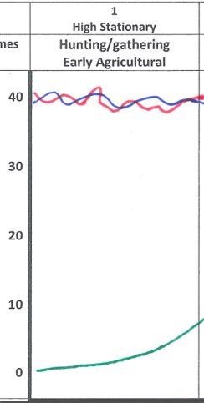
Stage 1:
Reasons for CBR + CDR?
Reasons for birth rate:
Children = $ economic assets (source of labor; more children = more crops.)
High IMR
High CBR, parents compensate for expected deaths among children by having more children
Religious or social traditions; lack of *female empowerment
Reasons for death rate:
“Age of pestilence and famine”
“Lives short, brutal, hungry”
Disease (pandemics, plague, famine/hunger, drought, constant war, childbirth dangerous – MMR/IMR high)
No modern medicine.
If both rates are high, what your Natural Increase (NIR)?
Stationary (-0.1 – 1.9%)
High CBR + CDR = low overall population; not growing fast (less than 1 billion global pop. until early 1800s)
CBR > 25
CDR > 25
(-0.1 – 1.9% NIR)
Notes:
Births are in the high range. Deaths are also super high.
What are reasons for high CBR + CDR in stage 1?
What is the #1 reason people had lots of children?
Economic assets
What kind of economic assets? What are children doing?
hands on the field/ farm labor – starts at age 5
Most people are subsistence farmers
Matter of survival; Children = more crops ; No food = starve
What is the 2nd reason besides farm laborers? Something else is going on at that time that they need to have a lot of kids
High infant mortality rate (IMR)
What other institutions are keeping women pregnant? What ideas are going on that’ll encourage women to have more kids?
The Church – religion + tradition
What is the tradition for women? (subservient to men – no female empowerment)
***FEMALE EMPOWERMENT is a HUGE part of the DTM – MOVES LINES
Why did people die young in Stage 1?
Disease (pandemics, plague, infection, wounds)
Drought, War, Famine,
What else could kill off a large portion of ½ the population? → childbirth
Childbirth: Pre C-sections / pre- prenatal care; Even the Queen of England died from childbirth. If she can die from it, peasants def. will.
MMR high

Slide 7
Stage Two

Slide 8
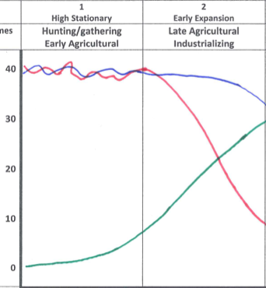
Stage 2: “Early Expansion”
Predict:
What will be the big change in Stage 2?
What causes this change in human history?
What happens to CDR? CBR? Total population?
CDR suddenly drops dramatically (8-25)
CBR stays high (25-40)
Total population increases very rapidly; steep J curve (NIR = 1.5-3.5%)
CBR (25-40)
CDR (8-25) – 1st break!
NIR rapid increase (1.5-3.5%)
Notes:
What will be the big change in Stage 2?
What causes the change in human history?
How does the Industrial Revolution (for today’s MDCs – UK, Germany, etc) bring down the death rate? (medicine)
What is the relationship between urbanization + birth rates? (stabilize food source)
What happens to CDR? CBR? Total population?
CDR suddenly drops dramatically
CBR stays high
Total population very rapidly increases
What country will be the 1st historically to enter Stage 2? (UK late 1790s, Western Europe mid-1800s, USA late 1800s)

Slide 9
Stage 2: “Early Expansion”
Other names: Late Agricultural/ Industrializing
Birth Rate (CBR)? Death Rate (CBD)? NIR?
CBR stays high (25-40); CDR declines rapidly = 1st break (8-25)
Total population/NIR: very rapid increase; steep J curve (1.5-3.5% -- enormous)
Reasons for continued high birth rate?
*Traditions persist (religion, lack of female empowerment) → maintain high birth rate
Limited access to birth control/ family planning.
Even with urbanization people are slow to realize children are not economic assets but burdens (takes a generation)
Reasons for declining death rate?
Industrial Revolution → Stabilizing food source (canned food), improved medical care (vaccines, access to health care in cities, urbanization happens with industrialization), lower IMR + MMR
Notes:
What happens to the birth rate at Stage 2 + why?
stays high
What do people begin to slowly realize at this point? What is no longer true from Stage 1?
- Children are not economic assets; they are economic burdens
Clothing, housing in tenaments is expensive.
Child labor won’t make up for fact that children = LOWER standard of living
How does the Industrial Revolution bring down the death rate?

Slide 10
Examples:
After the UK in 1790s, what countries enter Stage 2 next?
Western Europe (Belgium, Germany, etc): mid- 1800s
USA: late 1800s
Southern + Eastern Europe, Japan: early 1900s
What do all these countries have in common?
Industrialization, economic development. This will allow them to eventually leave stage 2.
All modern MDCs will leave Stage 2, move further along DTM.
When did LDCs enter Stage 2?
Post-WW2. Primary reason NOT economic development
Western medicine, vaccines diffused to LDCs, help w/ sanitation, etc.
(+) Brought CDR down; (-) same economies as before; CBRs will not follow → population exploding, BUT no economic development
“Demographic trap”…these countries will have difficulty bringing the CBR down because there is no economic development accompanying the drop in death rates. To be discussed later.
Notes:
After the UK in 1790s, what countries enter Stage 2 next?
Western Europe (Belgium, Germany, etc): mid- 1800s
USA: late 1800s
Southern + Eastern Europe: early 1900s
What do all these countries have in common?
Emigration (leaving one’s country) during Stage 2.
All modern MDCs. Will leave Stage 2, move further along DTM.
When did LDCs enter Stage 2?
Post-WW2. Primary reason NOT economic development
western MDCs gave poorest countries vaccines, help w/ sanitation, etc. Positives? Negatives?
(+) Brought CDR down; (-) same economies as before; CBRs will not follow → population exploding, but no economic development (demographic trap)
***Important to keep in mind: Stage 2 happens in two ways: (1) Industrial Revolution; (2) Diffusion of medical tech w/ no economic development

Slide 11
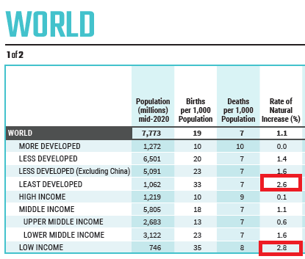
Countries/Regions in Stage 2 now?
sub-Saharan Africa: for example Nigeria (will overtake U.S. pop.),
Pakistan, Afghanistan, Palestine, Iraq
HOWEVER, this situation is evolving as we speak.
CBR is dropping in areas where it has been (until recently) stubbornly high.
This includes India, Bangladesh, Central America, SE Asia

Slide 12
**Important to Keep in Mind:
Key characteristic: a dramatic drop in the CDR
Stage 2 happens in TWO ways:
MDCs = Industrial Revolution w/ economic development (early 1800s to early 1900s as industry diffuses)
LDCs = Diffusion of medical tech after WWII w/ no economic development

Slide 13
Stage Three

Slide 14
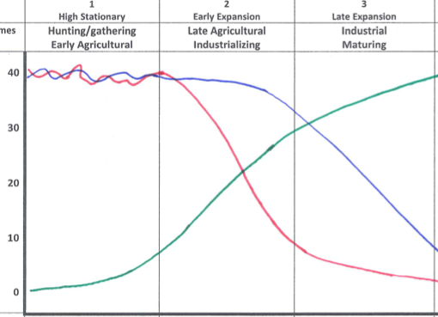
Stage 3: “Late Expansion”
NIR much slower (1.0-2.0%) = “demographic momentum”
Predict: What happens to the lines in Stage 3? (CDR, CBR, NIR/Total Population)
CBR falls (12-25) – 2nd break!
CDR declining slowly (5-12)
Notes:
Predict: What happens to the lines in Stage 3?

Slide 15
Stage 3: “Late Expansion”
Other name: Industrial/Maturing
Birth Rate (CBR)? Death Rate (CBD)? NIR?
CBR falling – 2nd break (12-25); CDR declines slowly (5-12); Total population/NIR: increasing but much slower (1.0-2.0%) = “demographic momentum”
Reasons for lower birth rate?
Fewer children needed in urban environment (people realize children = economic burdens)
Tradition is waning (secular influences, city living, beg. of birth control, *female empowerment late Stage 3).
Other forces: Government anti-natalist policies (China)
Reasons for lower death rate?
Medical advances, immunizations, govt. action - better sanitation (prevents cholera), lifestyle/diet
Notes:
What is the 1st reason ppl have less kids? (children = economic burdens; beginning of family planning, later marriages)
What social force has more influence on the countryside than cities? (religion)
Religion → more kids; traditions wane or decrease → secular influences you would not get in countryside
Women become more empowered – later marriages, school, jobs, 1-2 kids, mother + other things
Outside forces?
Gov gets involved – anti-natalist politices (China’s 1 child policy – forces China along DTM, even before economic dev)
What’s still killing people at Stage 2? (cholera – poor sanitation, ppl living close together, too many ppl clustered)
In Stage 3 – CDR goes down bc the gov takes action setting policy, building sewers
Ppl wanna live longer (better lifestyle, diet)

Slide 16
Examples
The world as a whole is in stage three
Population is growing but much slower than during the late 20th century
The curve has been bent
Most LDCs are now in stage three
Mexico, Brazil? (very late stage 3, maybe even four) & other parts of Central + South America, SE Asia (Indonesia, Thailand, Vietnam), India, Bangladesh (stage 3)

Slide 20
**Important to Keep in Mind:
Key characteristic: a dramatic drop in the CBR
But, Demographic momentum:
Population will continue to grow until TWO generations have children at or below replacement rate.
Replacement rate is a TFR (total fertility rate) of and average of 2.1 children per women over their lifetime
Demographic momentum happens when a society approaches replacement rate but its population is still growing

Slide 21
Stage Four

Slide 22
Stage 4: “Low Stationary”
What does “Low Stationary” mean for CBR + CBD rates + total population/NIR?
Hint: Stage 1 = “High Stationary”
How will lines be similar to/diff from Stage 1?
Birth Rate (CBR)? Death Rate (CBD)? Total Population (NIR)?
CBR: Low (8-16)
CDR: Low (5-12)
*Low rates = stable or slow increase (NIR: 0-1.0%)
*CBR = CDR = Zero Population Growth (ZPG)
Notes:
What does “Low Stationary” mean for CBR + CBD rates + total population/ NIR?
Hint: Stage 1 = “High Stationary”
How will lines be similar to/diff from Stage 1?
Birth Rate (CBR)? Death Rate (CBD)? Total Population (NIR)?
What happens when both rates are low?

Slide 23
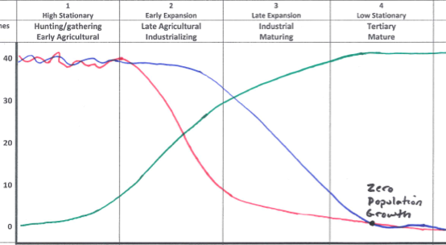
Stage 4: “Low Stationary”
What does “Low
Stable/low NIR (0-1.0%)
CBR = CBD
Notes:
What does “Low Stationary” mean for CBR + CBD rates + total population/ NIR?
Hint: Stage 1 = “High Stationary”
How will lines be similar to/diff from Stage 1?
Birth Rate (CBR)? Death Rate (CBD)? Total Population (NIR)?
What happens when both rates are low?

Slide 24
Stage 4: “Low Stationary”
Other name: Tertiary/Mature/Post-Industrial
Birth Rate (CBR)? Death Rate (CBD)? NIR?
CBR low(8-16), CDR low (5-12)
CBR = CDR = Zero Population Growth (ZPG)**
Dying grandparents are replaced by children, demographic momentum has run its course, second generation to be at replacement rate fertility
Total population/NIR: stable/low (0-1.0%)
Reasons for low birth rate?
*Gender empowerment, family planning, later marriages, less traditional values (secular, urban influences), govt. encourages population control (anti-natalist policies)
Reasons for low death rate?
Lifestyle changes (diet, exercise), good healthcare - improved treatment for chronic diseases extends life expectancy (Lipitor for high cholesterol lowers risk of strokes)

Slide 25
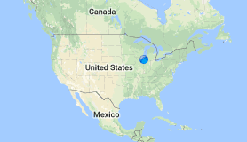
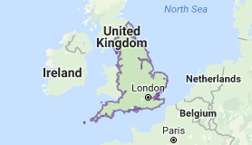
Examples:
USA, UK, France, Canada, Scandinavia, other N/W Europe
Immigrant birth rates keeps US, UK, France in stage 4,
Migration itself doesn’t count but….
immigrants bring higher CBR with them from native countries.
Former colonial countries have a more consistent immigrant stream so UK, France, the Dutch are in four while Germany without former colonies struggles in five.

Slide 26
Stage Five

Slide 27
Stage 5: Declining/Theoretical?
All countries in Stage 5 trying to fight it.
Why might Stage 5 be a bad place to be?
What is so bad about having a declining population?
*Can mean economic decline. Less customers, workers, lower GNI!
Birth rates? Death rates? Total Pop/NIR?
CBR = VERY low
CDR = Low, possibly going up/ increasing.
NIR = declining/ negative NIR (< 0%)
Notes:
Stage 5 is theoretical. What does theoretical mean?
(demographers not sure it’s a pattern every country goes through)
What is the key characteristic of a Stage 5 population? (pop. decline)
What’s happening to CBR? CDR?
Why is CDR possibly going up? (older population makes up bigger composition of total pop; more old ppl are dying and less young people being born)

Slide 28
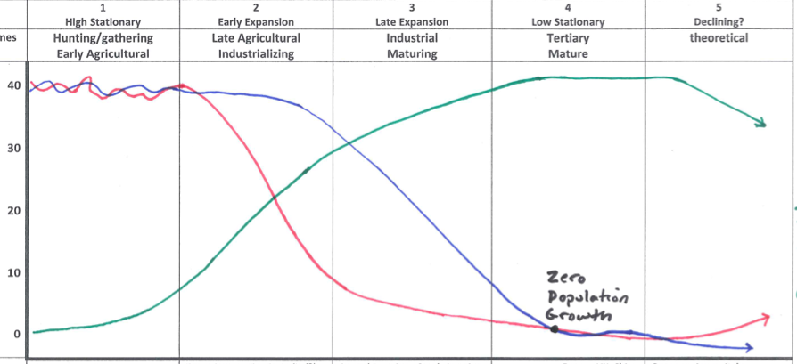
Stage 5: Declining/Theoretical?
negative
NIR (<0%)
CDR low, could increase (10-15)
CBR very
low (<10)
Notes:
Stage 5 is theoretical. What does theoretical mean?
(demographers not sure it’s a pattern every country goes through)
What is the key characteristic of a Stage 5 population? (pop. decline)
What’s happening to CBR? CDR?
Why is CDR possibly going up? (older population makes up bigger composition of total pop; more old ppl are dying and less young people being born)

Slide 29
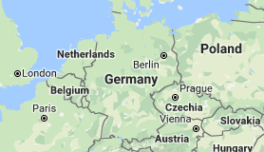
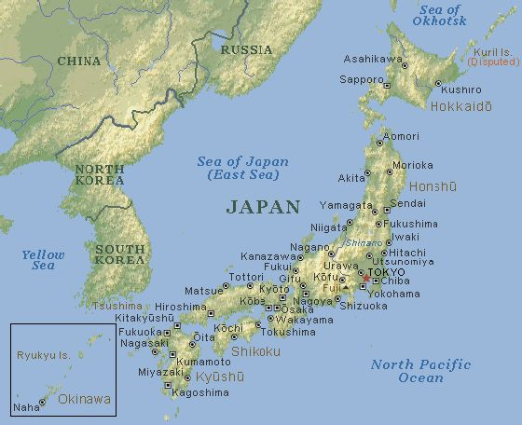
Stage 5: Examples?
Germany, Japan, Italy, Eastern Europe – Russia (?)

Slide 30
Stage 5: “Declining”
Reasons for very low birth rates (CBR)?
Continuation of stage 4 trends
Female empowerment, economic cost of children
*Pessimism over bleak future (Russia, Eastern Europe – see similar pattern in “Rustbelt” states of US). No kids b/c why would you bring kids into declining future?
Reasons for death rates (CDR)?
Large elderly population increases death rate

Slide 31
Ways to face stage 5?
Allow immigrants to come (Germany).
Immigration itself is not included on the DTM? But….
Immigration can offset declining birthrates
Immigrants often bring birthrate from their country of origin
keeps US, UK, France in stage 4;
Pro-natalist policies – encouraging childbirth as a positive thing
“Do it for Denmark”
Russia has increased its birth rates in the last decade.
Automation, vending machines (Japan)
Japan has liberalized immigration laws but
Immigration remains unpopular with people
Japanese believe in homogeneity; sameness of population.
Naturalization (citizenship) and other laws are more strict.

Slide 32
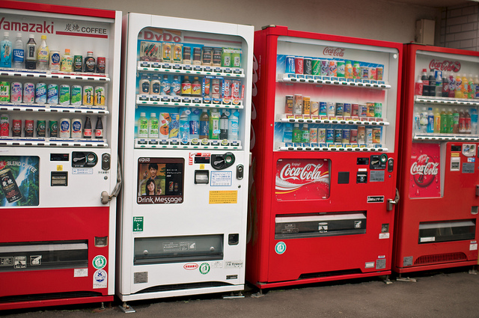
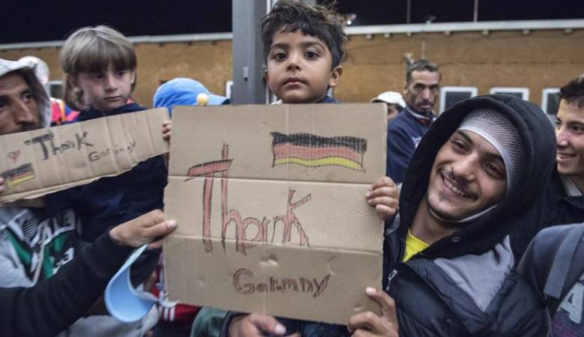
Solutions?

