Slide 1
Political Geography

Slide 2
Nations and States
“Nation” ≈ ethnicity
culturally defined group of people w/ a shared past and a common future who relate to a territory and have political goal of self-determination/autonomy.
“State” = country
A politically org. territory administered by a sovereign govt. recognized by most of the int’l community.

Slide 3
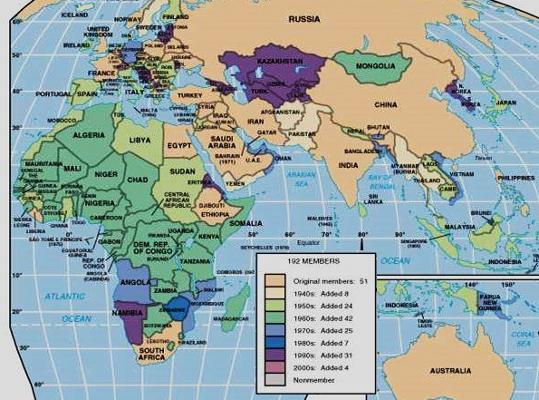
United Nations Membership (States)
Post-WWII creation of states
51 original members (1940s)
surge in 1960s (decolonization in newly free Africa)
surge in early 1990s (fall of communism new states formed out of the USSR, Yugoslavia, Czecholslovakia)
Now around 200 (193)!

Slide 4
What makes a “state”?
Sovereignty
Having the last say over a territory — legally
Established government of a defined territory and a permanent population
Territoriality/Territorial integrity
The right of a government to keep the borders and territory of a state intact and free from attack
Self-determination
The right of an ethnicity to control its own fate
this goal is how an ethnicity becomes a nation/nationality

Slide 5
Transformation of Ethnicities into Nationalities
Nationality = identification with a group of people who share a common political allegiance to a particular country/hearth
Nationalism (two meanings)
1. loyalty and devotion to a nation, patriotism
BUT, nationalism can be dangerous!
We’re the best! You stink!
Can lead to hyper-competition, cause of WWI
And remember the Nazis were uber-nationalistic!
2. desire to achieve self-determination for an ethnicity
Nation-state = ethnicity and territory correspond
No perfect example exists
close = Denmark, Iceland, Japan (note two are islands)
perceived as “natural”/“always existing” but a relatively recent thing
But, since the 1800s, it has been considered an ideal
map of Europe transformed by nationalistic goals.

Slide 6
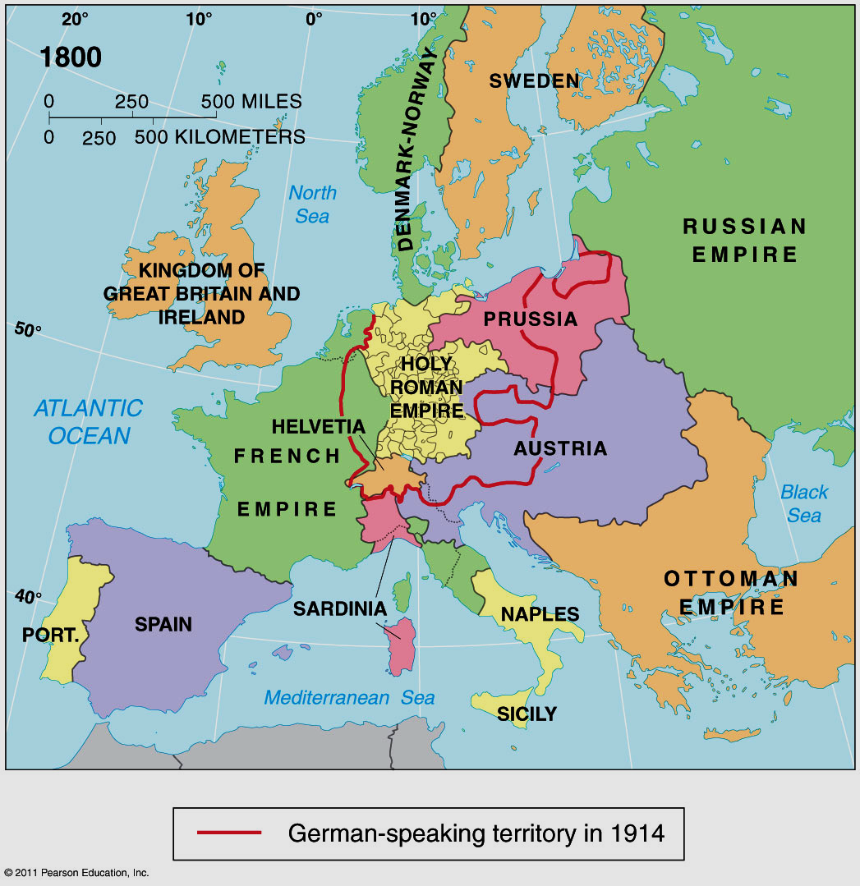
Notes:
FIGURE 7-15a

Slide 7
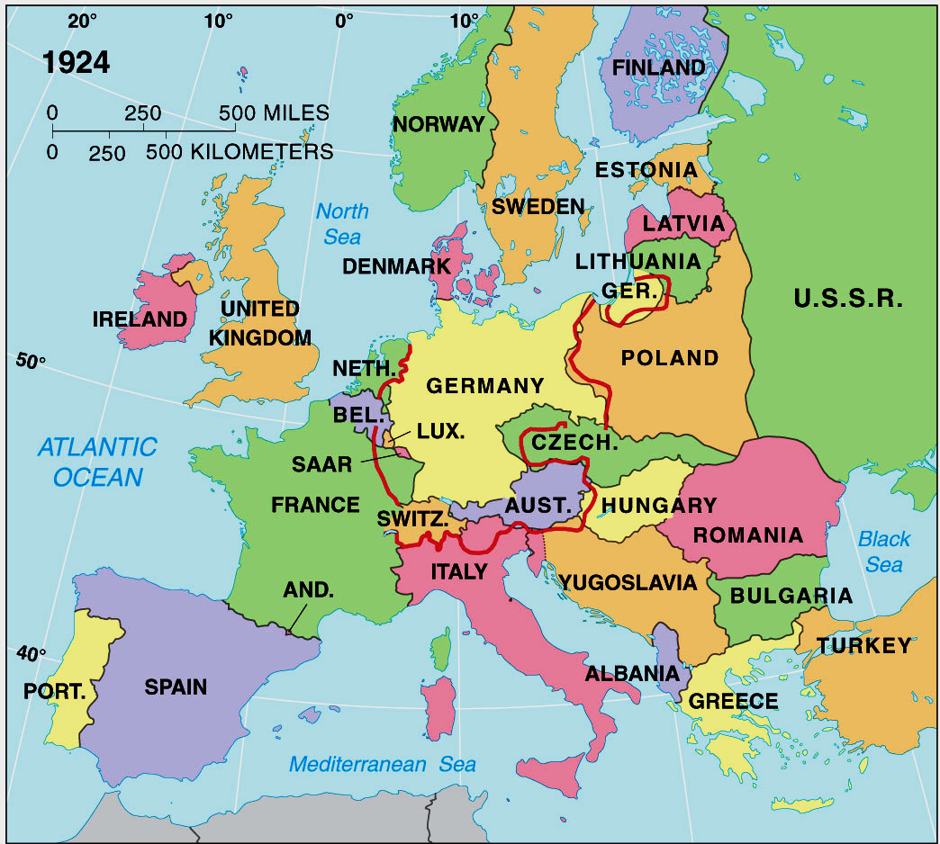
Notes:
FIGURE 7-15b

Slide 8
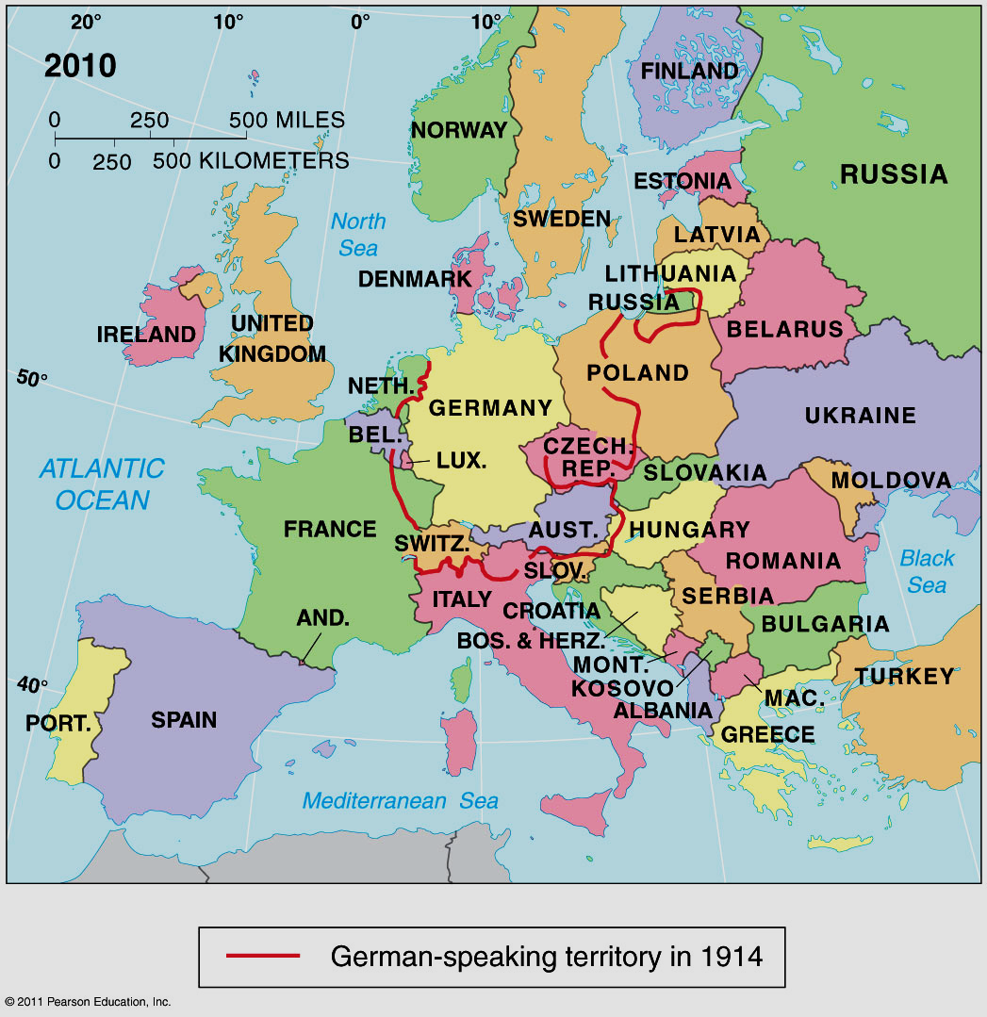
Notes:
FIGURE 7-15d

Slide 9
The Triumph of Nationalism
The growth of nation-states in most closely linked to language

Slide 10
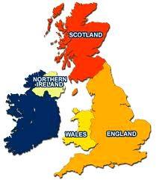
If not nation-states, what are most countries?
Multiethnic state
A state with multiple ethnic groups, all of whom contribute to a larger national identity without desire for ethnic self-determination
Example: the United States
“e pluribus unum” = “Out of many, one”
Multinational state
A state with multiple ethnic groups who retain their own distinctive national identity (thru political desire to have autonomy/self-determination)
Example: the United Kingdom →
Example: the former Yugoslavia

Slide 11
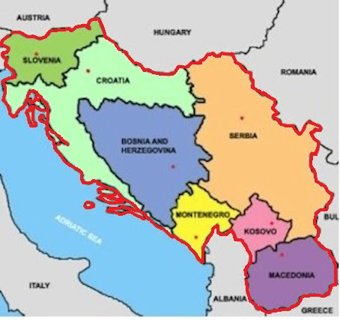
Multinational State
A state with more than one nation
The former Yugoslavia

Slide 12
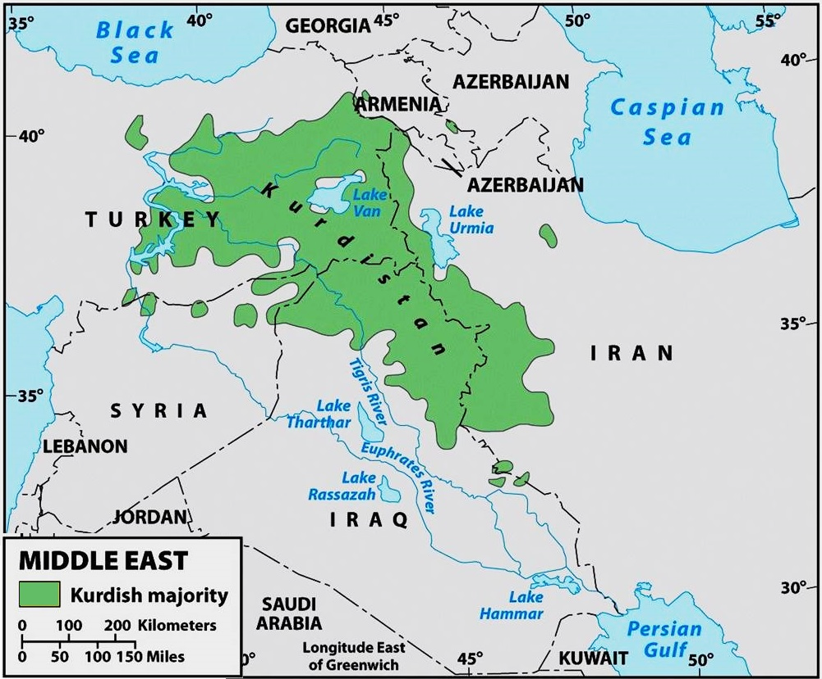
Stateless Nation
A group of people who are not in control of the govt. in any state, but being a “nation” they want one.
Kurds, Palestinians are examples

Slide 13
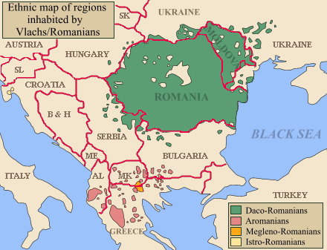
What is the difference between a stateless nation and a “multi-state” nation?
Multi-state nation is a nation that spans borders but controls at least two, if not more, states
Koreans
North AND South Korea
Romanians
Romania & Moldova

Slide 14
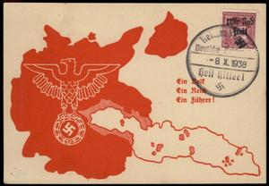
Irredentism
Assertion by a govt that part of its ethnicity living outside its borders (and consequently that territory) belongs to it
Germany over Sudetenland
Just before WWII
Munich Appeasement
Giving into an aggressor’s demands to maintain peace
Serbia over Bosnian Serbs (1990s)
Russia over Crimea and parts of Eastern Ukraine
NOW!
Estonia/Latvia next?

Slide 15
Russia and Ukraine
long co-history
Kievan “Rus”, similar languages, Orthodox religion
but, Ukraine periodically controlled by others, autonomous
sees itself as distinct
What does this dialect chain tell you?

Slide 16
Slavic Languages

Slide 17
Russia and Ukraine
long co-history
Kievan “Rus”, similar languages, Orthodox religion
but, Ukraine periodically controlled by others, autonomous
sees itself as distinct
What does this dialect chain tell you?
Ukraine is part of USSR (1921 - 1991)
Ukrainians resist collectivization of farming
Stalin’s holodomor, millions Ukrainians die of starvation
Independent upon collapse of communism but still in Russian sphere of influence
Euromaidan movement (2014) brings a more pro-Western, EU-mentality
Putin counters with aggressive irredentism
annexes Crimea (2014)
supports separatist movements in East = Donbass (2014 - today)
invades Ukraine February 2022!

Slide 18
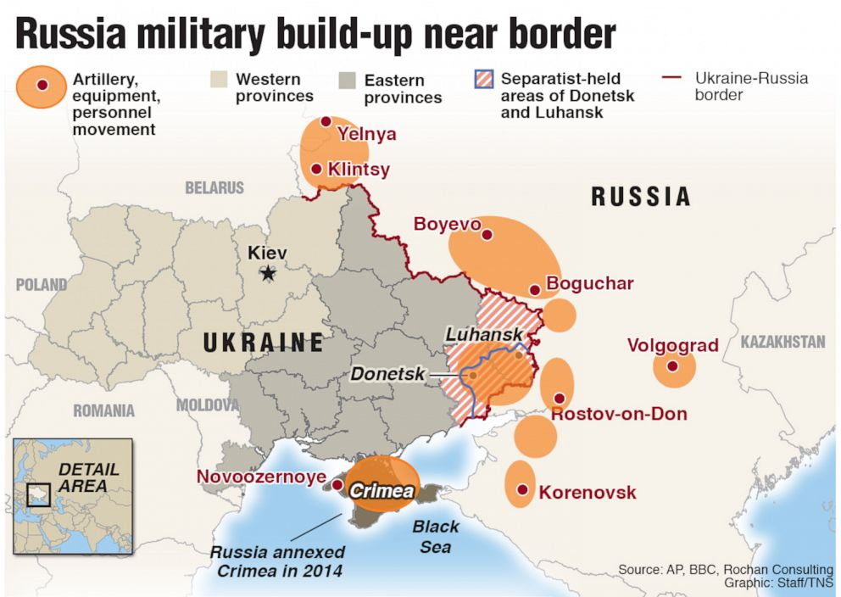
Russia and Ukraine

Slide 19
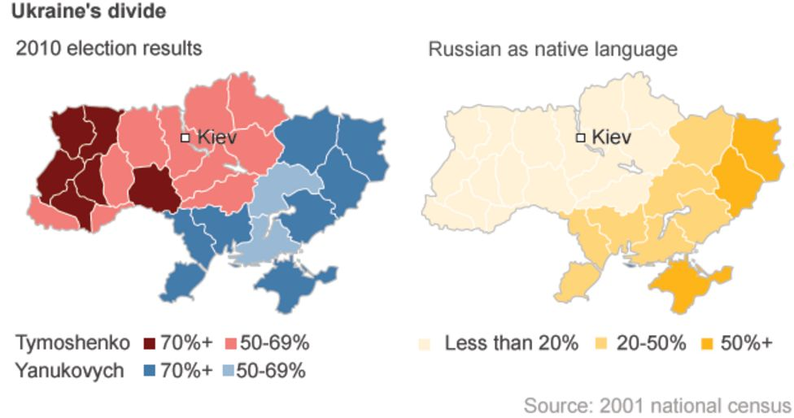
Ukrainian Divide

Slide 20
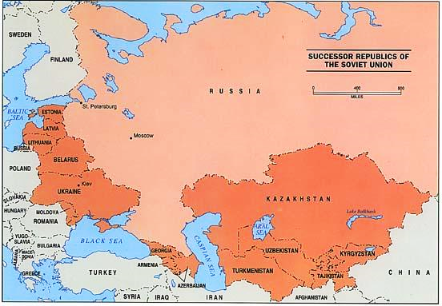
Ethnic identity in the former USSR
Central Europe
Moldova
Ukraine (17% Russian)
Belarus (8%)
Central Asia
Turkmenistan
Uzbekistan
Tajikistan
Kyrgyzstan
Kazakhstan (24%)
Baltic States
Lithuania
Latvia (27%)
Estonia (25%)
Caucasus
Azerbaijan, Armenia and Georgia

Slide 21
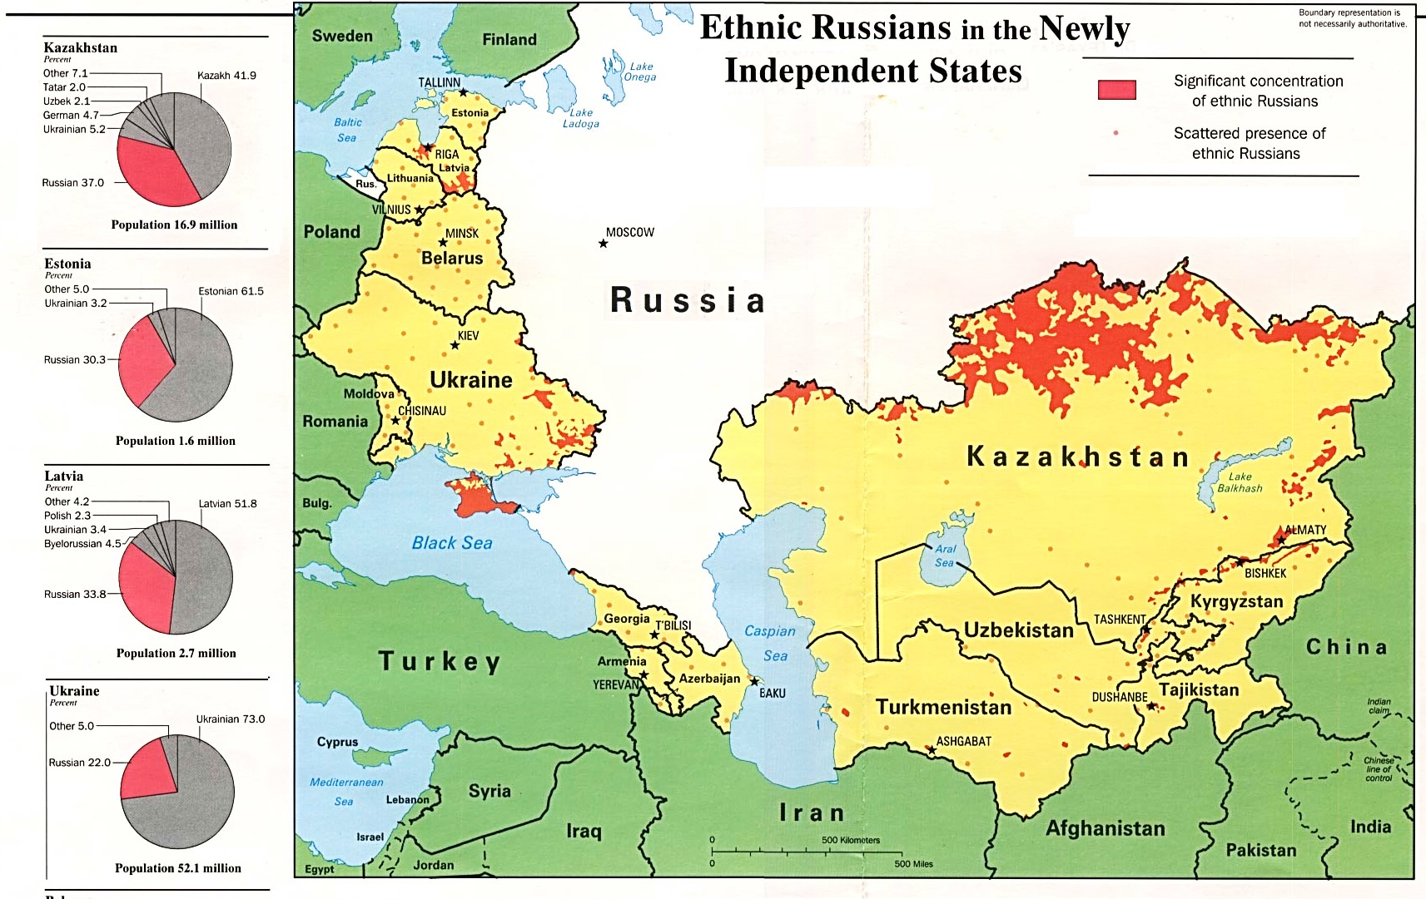
Could future Russian irredentism lead to a larger conflict with US/NATO? The Baltic states are now in NATO (more on this under geopolitics and supranationalism)

Slide 22
Exceptions to “sovereign” states
Satellite state -- state that falls under domination of another and loses much of its sovereignty (aka: puppet state)
Eastern European countries under Soviet domination during Cold War

Slide 23
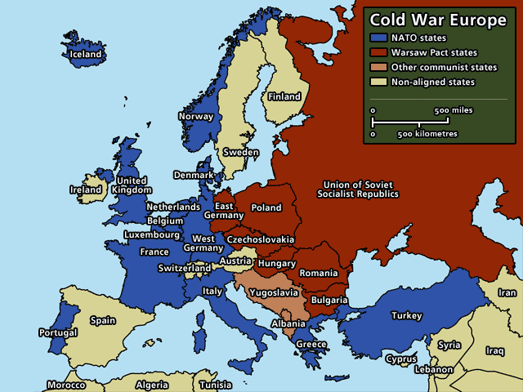

Slide 24
Exceptions to “sovereign” states
Satellite state -- state that falls under domination of another and loses much of its sovereignty (aka: puppet state)
Eastern European countries under Soviet domination during Cold War
Autonomous/semi-autonomous regions – areas of a state that are given a degree of self-determination.
Usually distant from main country or an ethnic minority
Native American reservations (US), Hong Kong (China), Iraq (Kurdistan), Israel (Palestinian Territory, West Bank)
Methods/Motivations? We will cover later
And then there is China/Taiwan
Both claim to be the sovereign government of a combined China. In reality each is “sovereign” over its own territory, Taiwan is not recognized internationally as a sovereign state. Watch this: https://www.youtube.com/watch?v=MZqVv2wj6C4

Slide 26
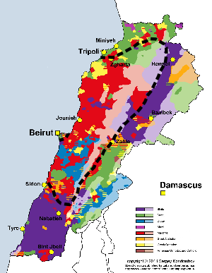
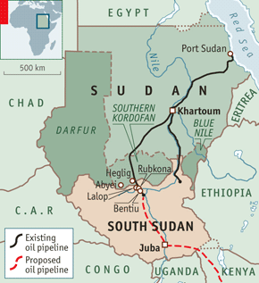
Breakdown or collapse of states
failed state?
a state whose political or economic system has become so weak that the government is no longer in control.
Lebanon
Yemen
Somalia…Evidence? = pirates
“balkanized” (adj.)
area that can’t stabilize into sovereign states due to ethnic conflict
“balkanization” (n.)
breakdown of state due to ethnic conflict (this could be the end result of devolution)
Yugoslavia
USSR
Czechoslovakia
Sudan (Arab North, Christian/Animist South)

Slide 27
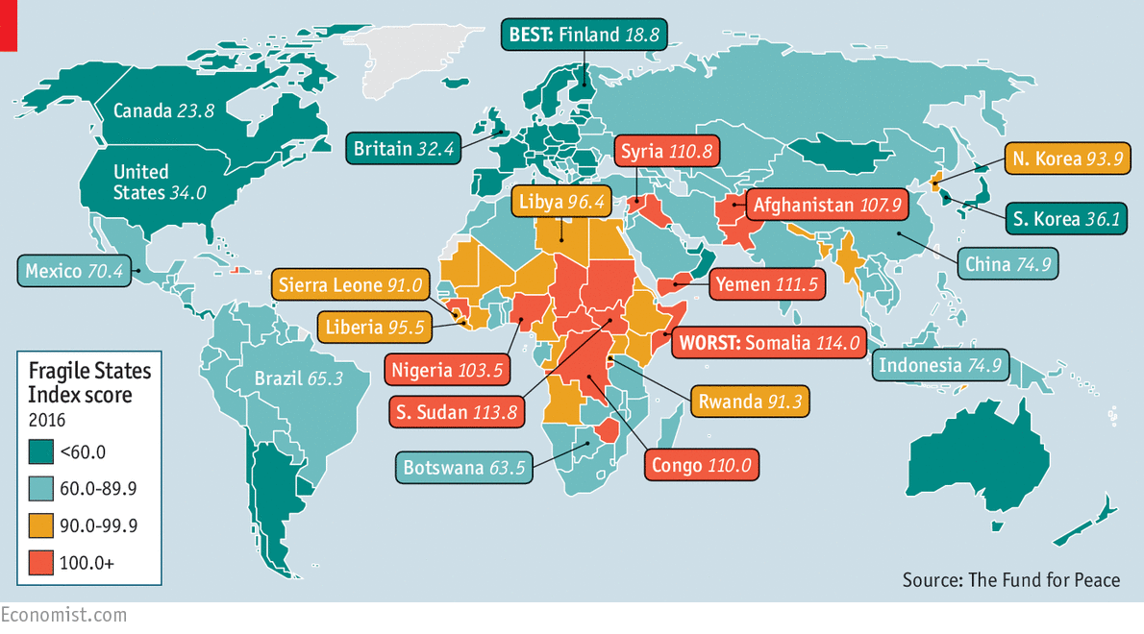
Failed States
In our next lecture, we will discuss factors that make states stronger, more united and sovereign vs. those which might weaken them and lead to their failure. These are referred to as centripetal and centrifugal forces.

