Slide 1
The Geography of Identities

Slide 2
Day One Introduction Race vs. Ethnicity

Slide 3
“Ethnicity” vs. “Race”
Ethnicity
share cultural identity of same homeland/hearth
distinctive cultural traits (language, religion etc.)
can have ancestral links
Race
share genetic traits
Biological features within one “race” are highly variable
Biological classification into distinct “races” is unscientific = “social construct”

Slide 4
Complexity of Ethnicity and Race

Slide 5
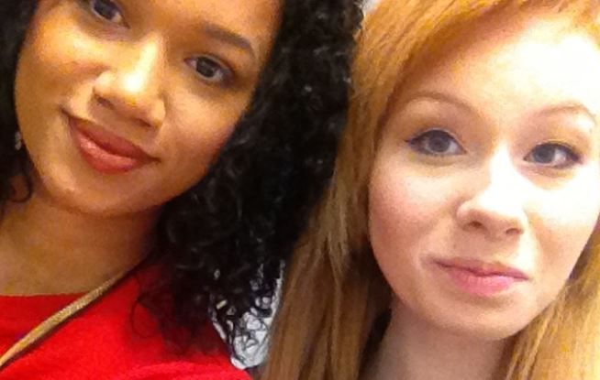
Complexity of Ethnicity and Race
These twins show how “race” is a social construct not biological science. These women were conceived in the same womb from the same parents. Yet would be considered two different races by society.

Slide 6
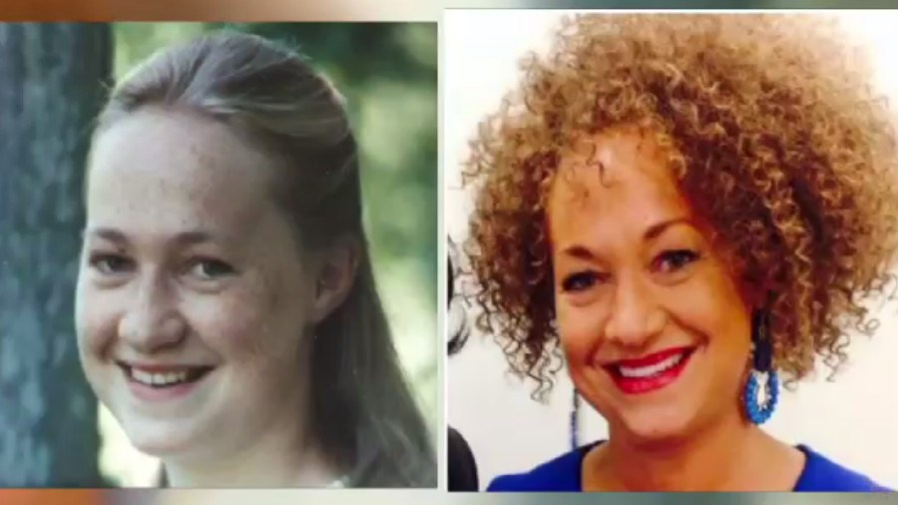
Complexity of Ethnicity and Race

Slide 7
Ethnicity and Race
Ethnicity
share cultural identity of same homeland/hearth
distinctive cultural traits (language, religion etc.)
can have ancestral links
Race
share genetic traits
Biological features within one “race” are highly variable
Biological classification into distinct “races” is meaningless = “social construct”
Yes race exists, but we made it up!
Not scientific
Often defines the “other” (what we are not!)
racism – the belief that one race is superior or that a person’s race affects their abilities
implicit bias test
Both race and ethnicity along with gender and sexuality help to form one’s “identity”.

Slide 9
Role of ethnic/identity groups (copy into notes)
keepers of traditions (language, religion, recipes, etc.)
provides social interaction and group identity thru shared exp.
friendships and marriage partners
recreational outlets, social services and political power
business success and niche employment
But, “us vs. them” can give rise to suspicion, friction, distrust, clannishness, and even violence towards others
Ethnic minorities can be changed by the more dominant culture and can contribute to the overall culture
acculturation – interplay between minority and dominant culture (minority groups adopt elements of dominant culture like language but also contribute to the ethnic mosaic)
assimilation – minority groups take culture of dominant group (at times this has been forced!)
ethnicity has (at times) been transformed from a folk culture concept → popular culture concept (food, music, etc.)

Slide 10
Modern ethnic stereotypes: niche employment
some groups “gravitate” to particular jobs
Irish police and firemen, Chinese launderers, Italian barbers, or Greek restaurant owners
do we see this today? Why?
reasons for:
(1) immigrants’ previous experiences/education,
(2) the absence of other attractive job options,
Low wage, hazardous, risk-taking/entrepreneurial
(3) government policy (visa preferences, etc.)
(4) co-ethnic sponsorship (favoritism, loans, know-how).
Korean grocers
Filipino nurses
Vietnamese nail salons
Indian tech engineers
What do all these groups have in common?
Exposure to English language

